Slide 1
Lesson 1
Video, example, workshop

Slide 2
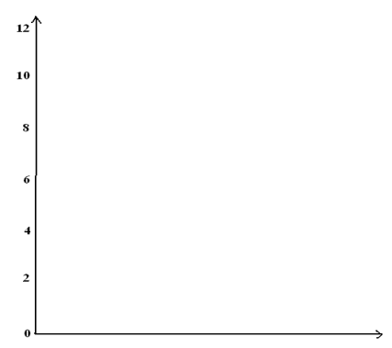
Opening
Describe, in words, the motion of the man in the video.
http://www.mrmeyer.com/graphingstories1/graphingstories2.mov
How high do you think he was at the top of the stairs?
Were there intervals of time when his elevation wasn’t changing?
Did his elevation ever increase?
Can we represent this on a graph?
How should we label the axes?
What units should we use?
Where does starting at the top show up on the graph?
Show with hands what the general shape should look like.

Slide 3
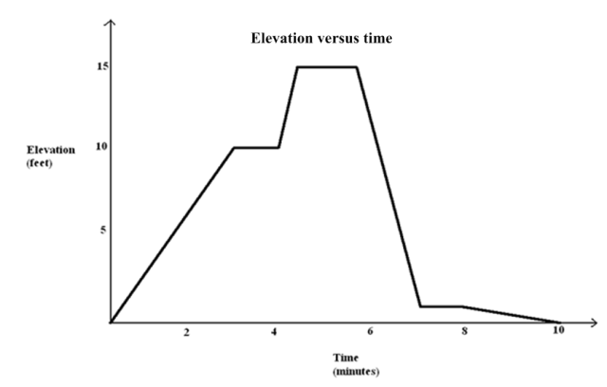
Example
Here is an elevation-v-time graph of a person’s motion. Describe what the person might be doing.
What is happening when the graph is increasing/decreasing/constant?
What does it mean when one part is steeper than another?
Is it possible it’s a person on a ladder? Hill?
What’s the average rate of change from 0 to 4 minutes?

Slide 4
Notes
Piecewise-Defined Linear Function:
When given non-overlapping intervals, a (real) piecewise linear function is the union of the intervals where each is defined by (possibly different) linear functions.
Side Note: the non-overlapping intervals might be unclear if it’s not obvious which contains the end points.
[0,2) [2,5) [5, 10) versus [0,2] (2,5] (5, 10]

Slide 5
Workshop
Must Do
May Do
Classwork exercises a-f
http://www.mrmeyer.com/graphingstories1/graphingstories3.mov
Fluency practice
24
Flashcards
Integer war
Scavenger hunt

Slide 6
Lesson 2
Examples, workshop, notes

Slide 7
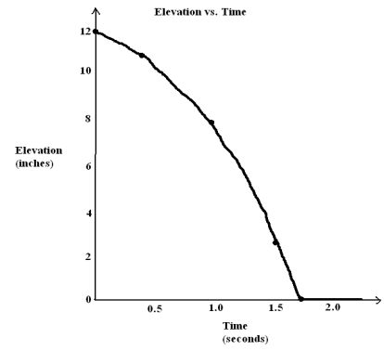
Example 1
Describe, in words, the motion shown in the video.
https://www.youtube.com/watch?v=MNouL91FVaI
Focus on the elevation of the ball and give details linking elevation and time.
Focus on general shape
Notice the tail at the end
Should it be a constant rate?

Slide 8
Workshop
Must Do
May Do
Classwork exercises 1-3
https://www.youtube.com/watch?v=ZCFBC8aXz-g
http://www.mrmeyer.com/graphingstories1/graphingstories4.mov
Complete cw #1
Fluency practice
24
Flashcards
Integer war
I have.. Who has…
Scavenger hunt

Slide 9
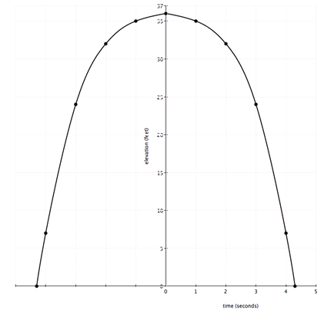
Summary
After reflecting these graphs over the y-axis (vertical line), you get graphs like this.
Classwork #1
Classwork #2
NOTE: in context, negative portions of these graphs don’t always make sense.

Slide 10
Notes
When you reflect a curve over a vertical line, you get a parabola, or U-shaped graph, that represents a quadratic function, which has x raised to the second power

Slide 11
Lesson 3
Example, workshop, notes

Slide 12
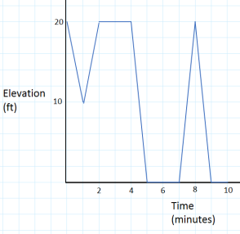
Example
Darryl lives on the third floor of his apartment building. His bike is locked up outside on the ground floor. At 3:00 p.m., he leaves to go run errands, but as he is walking down the stairs, he realizes he forgot his wallet. He goes back up the stairs to get it and then leaves again. As he tries to unlock his bike, he realizes that he forgot his keys. One last time, he goes back up the stairs to get his keys. He then unlocks his bike, and he is on his way at 3:10 p.m.
Sketch a graph that shows his change in elevation over time.

Slide 13
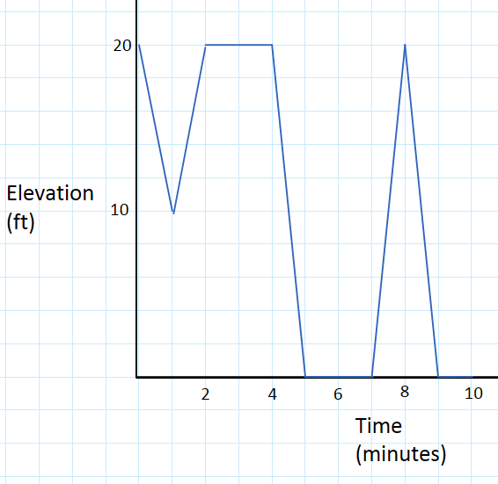
Darryl lives on the third floor of his apartment building. His bike is locked up outside on the ground floor. At 3:00 p.m., he leaves to go run errands, but as he is walking down the stairs, he realizes he forgot his wallet. He goes back up the stairs to get it and then leaves again. As he tries to unlock his bike, he realizes that he forgot his keys. One last time, he goes back up the stairs to get his keys. He then unlocks his bike, and he is on his way at 3:10 p.m.

Slide 14
Workshop
Must Do
May Do
Classwork exercise 1
https://www.youtube.com/watch?v=gEwzDydciWc
Complete cw #1-2
Fluency practice
24
Flashcards
Integer war
I have… who has…
Scavenger hunt

Slide 15
Notes
When you have a multiplication pattern, you get a curve that represents an exponential function.
So far we have looked at 3 types of graphs: linear, quadratic, and exponential and we will spend the next several days (and much of the year) studying how to recognize and use them in real-life situations.

Slide 16
Lesson 4
Example, workshop

Slide 17
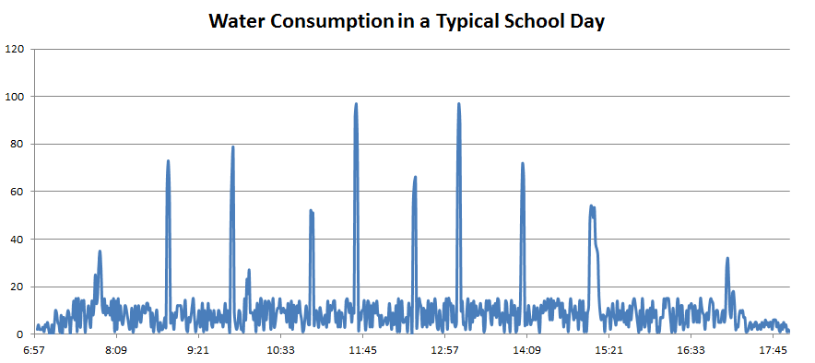
Example
How is water mainly used at a school?
What are the axes for?
What causes large spikes? Small spikes?
Typical water usage (ignoring large spikes)?
Regular school day: 8:00am – 3:04pm
After School: 3:15 – 5:15
Around 10am there is a 13 minute advisory period
Units on the vertical axis?
Typical amount of water used, not including the spikes.

Slide 18
Workshop
Must Do
May Do
Classwork exercises 1-3
Fluency practice
Integer war
I have… who has…
24
Flashcards
Complete classworks 1-3

Slide 19
Lesson 5
Example, notes, workshop

Slide 20
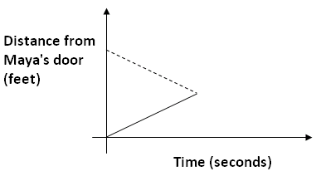
Example
Consider this story and sketch ONE graph of the situation:
Maya and Earl live at opposite ends of the hallway in their apartment building. Their doors are $50 ft.$ apart. Each starts at his or her own door and walks at a steady pace toward each other and stops when they meet.

Slide 21
Notes
The intersection point of the graphs of two equations is an ordered pair that is a solution to both equations.
In the context of a distance (or elevation) story, this point represents the fact that both distances (or elevations) are equal at the given time.

Slide 22
Workshop
Must Do
May Do
Exit ticket #3-4
Classwork exercises 1-8
http://youtu.be/X956EvmCevI
Fluency practice
24
Flashcards
Integer war
Scavenger hunt
Create a poster of problems 1-4

Slide 23
Lesson 6
Opening, examples, notes, workshop

Slide 24
Opening – the 4-number game
Use the digits 1, 2, 3, and 4 one or fewer times and addition and multiplication (as well as grouping symbols) to create as many different positive integers as you can.
Value | Expression
1
2
3
4
5
6
7
8
9
10
11
12
13
Value | Expression
14
15
16
17
18
19
20
21
22
23
24
25

Slide 25
Opening Discussion
We know that 1+2+3=6 AND 1x2x3=6. Is this true for all a, b, c? Is a+b+c always equal to abc?

Slide 26
Example
Now, what if the symbols were 3, x, y, and a (instead of 1, 2, 3, 4).
What expressions can you make from these symbols using addition only?
What expressions can you make when repetition is allowed?
What if, in the 4-number game, we allowed repeated use of symbols. Knowing that 1+2+3+4=10, we can make 110 because
10x10+10 = 110, so (1+2+3+4)(1+2+3+4)+(1+2+3+4) = 110
Did anyone, or can anyone, make 4x + 5y + 3a from this?

Slide 27
Notes
Distributive property: if a, b, and c are real numbers, then a(b + c)=ab + bc
(a+b)² = a² + 2ab + b²
(a+b+1)(b+1) = ab + b² + a + 2b + 1
(a+b)(c+d)(e+f+g) = ace + acf + acg + ade + adf + adg + bce + bcf + bcg + bde + bdf + bdg
Collecting, or combining, like terms is an extension of the distributive property.
x + x = 2x because: x + x = 1x + 1x = (1+1)x = 2x
Terms – single numbers, variables, or combinations connected by multiplication (separated by add/subtraction)
Like terms – terms that have the same variables raised to the same exponents.

Slide 28
Workshop
Must Do
May Do
Classwork exercises 1-5
Independent work

Slide 29
Lesson 7
Opening, notes, example, workshop

Slide 30
Opening
Shyanne draws the following picture to represent 3 + 4:
Ben looks at the picture from the opposite side of the table and says “You drew 4 + 3.” Why does Ben interpret it this way?

Slide 31
Opening
Shyanne adds more to her picture and says: “Now the picture represents (3 + 4) + 2.”
How might Ben see the picture?

Slide 32
Opening
Shyanne then draws another picture of squares to represent 3 x 4. Ben moves to the end of the table and says “From my new seat it looks like 4 x 3.” What picture did Shyanne draw and where did Ben sit for his view?
Challenge: Draw a picture for (3 x 4) x 5 that could also be (4 x 5) x 3 from a different view point.

Slide 33
Notes: The Properties & Definitions
commutative property: For real numbers, a+b=b+a &a×b=b×a.
associative property: For real numbers, (a+b)+c=a+(b+c) & (ab)c=a(bc).
Numerical symbol: represents a specific number.
Variable symbol: a placeholder for a number.
Algebraic expression: A numerical symbol, a variable symbol, or a combination using the five main operations
Numerical expression: An algebraic expression that contains only numerical symbols
**Two expressions are equivalent if we can convert one expression into the other by applying properties**

Slide 34
Example
Viewing the diagram below from two different perspectives illustrates that (3+4)+2 equals 2+(4+3).
Is it true for all real numbers x, y, and z that (x+y)+z should equal z+(y+x)?

Slide 35
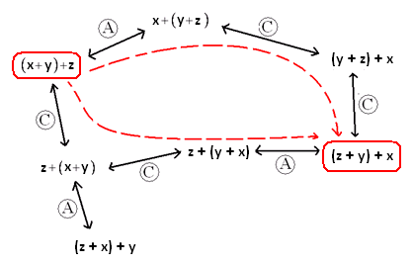
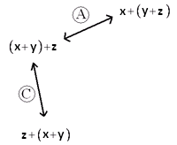
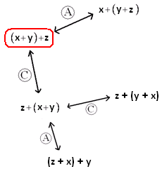
Example, continued
Is it true for all real numbers x, y, and z that (x+y)+z should equal z+(y+x)?

Slide 36
Workshop
Must Do
May Do
Exit ticket #5-6
Classwork exercises 1-5
Complete cw #1-6
Fluency practice
24
Flashcards
Integer war
Scavenger hunt

Slide 37
Lesson 8
Warm Up, notes, workshop

Slide 38
Warm Up
How many quarters, nickels, and pennies are needed to make $1.13?
Fill in the blanks:
8,943= _______ ×1000 +_______×100 + _______×10 + _______×1
= _______×10³ + _______×10² + _______×10 +_______×1
8,943= _______×20³ +_______×20² +_______×20 +_______×1
113= _______×5² + _______× 5 + _______×1

Slide 39
Notes: The Properties & Definitions
Monomial: a polynomial expression generated using only multiplication. It does not contain addition/subtraction.
Binomial: the sum or difference of two monomials
Trinomial: the sum or difference of 3 monomials
Polynomial: the sum or difference of any number of monomials
(numbers in base x)
The degree of a polynomial is the degree of the term with the highest exponent.
Polynomial expression:
A numerical expression or a variable symbol, or
The result of connecting two previously generated polynomial expressions using addition or multiplication

Slide 40
Workshop
Must Do
May Do
Classwork exercises 1-5
Complete cw #1-7
Fluency practice
24
Flashcards
Integer war
Scavenger hunt

Slide 41
Lesson 9
Warm up, example, workshop

Slide 42
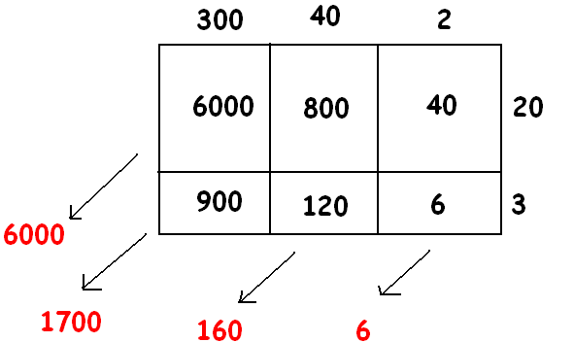
Warm Up
Gisella computed 342×23 as follows:
Can you explain what she is doing? What is her final answer?
Try the same method for:
(3x² + 4x + 2)(2x + 3)
(2x² + 10x + 1)(x² + x + 1)
(x - 1)(x³ + 6x² - 5)

Slide 43
Examples
(3x² + 4x + 2)(2x + 3) (2x² + 10x + 1)(x² + x + 1) (x - 1)(x³ + 6x² - 5)

Slide 44
Workshop
Must Do
May Do
Classwork exercises 1-4
Complete cw #1-8
Fluency practice
24
Flashcards
Integer war
Scavenger hunt
Create notes sheet
Organize folder

Slide 45
May Do – Test Review
Complete classwork and homework #1-8
Create notes sheet
Organize folder
Fluency practice
Fluency retests
Scavenger hunt

