Slide 1
Lesson 10
Warm up, recall/notes, example, workshop

Slide 2
Warm Up
Consider the statement: “The president of the US is a US citizen.”
Is the statement a grammatically correct sentence?
What are the subject and verb of the sentence?
Is the sentence true?
Consider the statement: “The president of France is a US citizen.”
Is the statement a grammatically correct sentence?
What are the subject and verb of the sentence?
Is the sentence true?
Consider the statement: “2+3=1+4.”
This is a sentence. What are the verb and subject of the sentence?
Is the sentence true?
Consider the statement: “2+3=9+4."
Is this statement a sentence? And if so, is the sentence true or false?

Slide 3
Notes
Recall: A number sentence is a statement of equality between two numerical expressions. It is true if both expressions are equivalent.
An algebraic equation is a statement of equality between two expressions. They can be number sentences but often contain unknowns.

Slide 4
Example - don’t copy
Consider the following scenario.
Julie is 300 feet away from her friend’s front porch and observes, “Someone is sitting on the porch.”
Given that she did not specify otherwise, we would assume that the “someone” Julie thinks she sees is a human. We cannot guarantee that Julie’s observational statement is true. It could be that Julie’s friend has something on the porch that merely looks like a human from far away. Julie assumes she is correct and moves closer to see if she can figure out who it is. As she nears the porch, she declares, “Ah, it is our friend, John Berry.”

Slide 5
Notes
Recall: A number sentence is a statement of equality between two numerical expressions. It is true if both expressions are equivalent.
An algebraic equation is a statement of equality between two expressions. They can be number sentences but often contain unknowns.
Domain - what type of number a variable represents

Slide 6
Workshop
Must Do
May Do
Classwork exercises 1-3
Classwork exercises 4-5
Fluency practice
24
Integer war
Flashcards
Integer coloring puzzles
I have… who has…
What’s my number?

Slide 7
Lesson 11
Opening, Notes, Examples, workshop

Slide 8
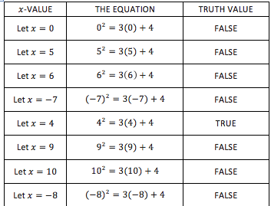
Opening
Consider the equation, x² = 3x + 4, where x represents a real number. Are the expressions x² and 3x+4 algebraically equivalent?
Can you find the other solution?

Slide 9
Notes
The solution set of an equation written with one variable is the set of all values one can assign to that variable to make the equation true.
To solve an equation means to find the solution set for that equation.

Slide 10
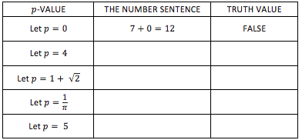
Example 1
Consider the equation 7+p =12.

Slide 11
Notes
The solution set of an equation written with one variable is the set of all values one can assign to that variable to make the equation true.
To solve an equation means to find the solution set for that equation.
A solution set can be described in words, in set notation, or graphically on a number line.
In a graphical representation, a solid dot includes the number the dot is on and an open dot means that number is not included.

Slide 12
Set Notation Notes
Curly brackets { } indicate a set
Items in the set are called elements
Elements are listed in increasing order
A set with no elements is an empty set and is denoted { } or {∅}
An ellipsis is used to suggest a continued pattern like {1, 2, 3, …, 10}
Notation can also be:
{variable symbol number type | a description} for example {x real | x>0} means real numbers greater than 0

Slide 13
Example 2
Solve for a: a² = 25.
IN WORDS: a² = 25 has solutions 5 and -5.
IN SET NOTATION: {-5, 5 }
IN A GRAPHICAL REPRESENTATION ON NUMBER LINE:

Slide 14
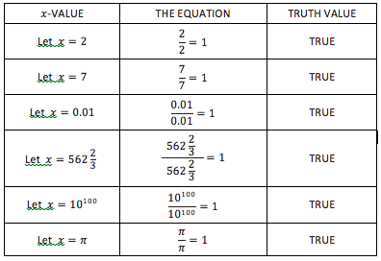
Example 3
Solve = 1 for x over the set of positive real numbers.
WORDS: The solution set is the set of all positive real numbers.
SET NOTATION: {x real | x>0}
GRAPHICAL REPRESENTATION:

Slide 15
Example 4
Solve for x: x(3+x) = 3x + x².
Since these expressions are equivalent by the distributive property, all real numbers, x, will work.
Words: The solution set is all real numbers.
Set notation: Difficult to do so we just say: {R}
Graphical:

Slide 16
Example 5
Solve for w: w+2 > 4.
WORDS: w must be greater than 2.
SET NOTATION: {w real | w>2 }
GRAPHICALLY:

Slide 17
Workshop
Must Do
May Do
Classwork exercises 1-7
KhanAcademy
Fluency Practice
Complete classwork 10
Classwork/homework odd

Slide 18
Lesson 12
Warm Up, notes, example, workshop

Slide 19
Opening Warm Up
Why should the equations (x-1)(x+3) = 17+x and
(x-1)(x+3) = x+17 have the same solution set?
Why should the equations (x-1)(x+3) = 17+x and
(x+3)(x - 1) = 17+x have the same solution set?
Do you think the equations (x-1)(x+3)=17+x and
(x-1)(x+3)+500 = 517 + x should have the same solution set? Why?
Do you think the equations (x-1)(x+3)=17+x and
3(x-1)(x+3)=51+3x should have the same solution set? Why?

Slide 20
Notes - Solving Equations
When solving equations, the goal is to find the solution or solution set for the variable.
To do this, use properties of operations (commutative, associative, and distributive properties as well as combining like terms) as well as the properties of equality to rewrite equations until the solution sets become obvious.
Properties of equality: adding (or subtracting) and/or multiplying (or dividing) by the same value on both sides of an equation keeps the solution (or lack of solution) the same.

Slide 21
Example
Consider the equation 3x + 4 = 8x - 16. Solve using the given starting point.

Slide 22
Workshop
Must Do
May Do
Classwork exercise 1-4
KhanAcademy
Homework even numbers
Fluency games/practice

Slide 23
Lesson 13
Warm up, Example, workshop

Slide 24
Opening Warm Up
In each of the steps above, we applied a property of real numbers and/or equations to create a new equation.
Why are we sure that the initial equation x(1 - x) + 2x - 4 = 8x - 24 - x² and the final equation 20 = 5x have the same solution set?
What is the common solution set to all these equations?

Slide 25
Notes - Solving Equations
Assuming there is a solution to an equation, applying the commutative, associative, and distributive properties as well as the properties of equality will not change the solution set of the equation.
Anything else you try to do to both sides of an equation only produces possible solutions but may not maintain the solution set.
(examples: squaring both sides, removing denominators, or other unjustified moves)

Slide 26
Example
What if we remove the denominator from both sides?
Square both sides?

Slide 27
Workshop
Must Do
May Do
Classwork exercises 1-5
KhanAcademy
Homework even numbers
Fluency games/practice
Complete classwork 12

Slide 28
Lesson 14
Warm up, example, notes, examples, classwork

Slide 29
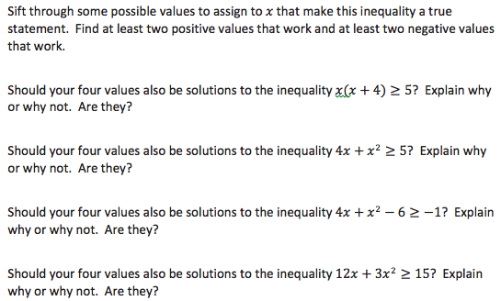
Opening Warm Up
Consider the inequality:

Slide 30
Example 1
What is the solution set to the inequality 5q+10>20? Express the solution set in words, in set notation, and graphically on the number line.

Slide 31
Notes - Solutions to Inequalities
We are now talking about sentences using >, <, ≥, and ≤
Just like equations, rewriting an inequality using the commutative, associative, and distributive properties and the addition (and subtraction) property of inequality does not change the solution set of an inequality.
Multiplying (and dividing) by a positive value maintains the solution set.
**Multiplying or dividing by a negative value, the inequality sign flips (and solution set changes).

Slide 32
Example 2
Solve -q ≥ -7, for q.

Slide 33
Example 3 - Don’t need to copy
Jojo was asked to solve 6x+12<3x+6, for x. She answered:
6x+12<3x+6
6(x+2)<3(x+2) Apply the distributive property.
6<3 Divide both sides by
She wrongly deduced no solution since the final statement is false.
What is the solution to the inequality?
What was JoJo’s error?

Slide 34
Workshop
Must Do
May Do
Exit ticket 12-13
Classwork exercises 1-8
KhanAcademy
Fluency work
Classwork 12-13
HW 12 evens

Slide 35
Lesson 15
Warm Up, notes, examples, classwork

Slide 36
Warm Up
Determine whether each claim given below is true or false.
Right now, I am in math class and English class.
Right now, I am in math class or English class.
3+5=8 and 5<7-1
10+2≠12 and 8-3>0
3<5+4 or 6+4=9
16-20>1 or 5.5+4.5=11
These are all examples of declarative, compound sentences (statements with 2 clauses).
How were sentences connected by “and” determined true?
How were sentences connected by “or” determined true?

Slide 37
Notes
If two clauses are connected by “and” then both must be true for the entire statement to be deemed true.
If two clauses are connected by “or” then one or both must be true for the entire statement to be deemed true.

Slide 38
Example 1
Solve each system of equations and inequalities.
a) x+8=3 or x-6=2 b) 4x-9=0 or 3x+5=2
c) x-6=1 and x+2=9 d) 2w-8=10 and w>9

Slide 39
Example 2
Using a colored pencil, graph the inequality x<3 on a number line.
Using a different colored pencil, graph the inequality x>-1 on the same number line.
Using a third colored pencil, darken the section of the number line where x<3 and x >-1.
Notation for AND statements: -1 < x < 3

Slide 40
Example 3
Using a colored pencil, graph the inequality x<-4 on a number line.
Using a different colored pencil, graph the inequality x>0 on the same number line.
Using a third colored pencil, darken the section of the number line where x<-4 or x>0.
Does 0 < x < -4 work?

Slide 41
Workshop
Must Do
May Do
Classwork exercises 1-7
KhanAcademy
Fluency work
Classwork 12-13
HW 12 evens
Complete classwork 14

Slide 42
Lesson 16
Classwork, notes

Slide 43
Workshop
Must Do
May Do
Classwork exercises 1-7
Challenge Thoughts:
Poindexter says that ${\left(a+b\right)}^{2}$ equals $a^{2}+2ab+b^{2}$. Is he correct?
Solve $x^{2}+14x+49<121,$ for $x$. Present the solution graphically on a number line.
KhanAcademy
Study cw #15-16
Prepare to discuss #6 & 7
Fluency work
Integer practice on computers, with cards, etc.

Slide 44
Summary
When statements are connected by “and” BOTH parts must be true, so the overall solution is where the graphs overlap.
When statements are connected by “or” ONE or BOTH has to be true, so the overall solution is the combination of BOTH graphs.

Slide 45
Lesson 17
Warm Up, notes, examples, classwork

Slide 46
Warm Up
Solve each equation for x.
x - 10 = 0 + 20 = 0
Demanding Dwight insists that you give him two solutions to the following equation:
Can you provide him with two solutions?
Demanding Dwight now wants FIVE solutions to the following equation:
Can you provide him with five solutions?
Do you think there might be a sixth solution?

Slide 47
Notes: Zero-Product Property
Recall: Any number multiplied by 0 equals 0.
This means that if you are multiplying numbers and you know the product is 0, any of at the factors can be 0 to make the equation true.
Meaning, if ab = 0, then either a or b (or both) must be 0
If abc = 0, then either a, b, or c (or more than one) must be 0.

Slide 48
Warm Up, revisited and continued
Consider the equation (x-4)(x+3)=0.
Rewrite the equation as a compound statement.
Find the two solutions to the equation.

Slide 49
Example 1
Solve , for x.

Slide 50
Example 2
Solve , for x.

Slide 51
Example 3
Consider the equation (x-2)(2x-3)=(x-2)(x+5).

Slide 52
Workshop
Must Do
May Do
Classwork exercises 1-10
KhanAcademy
Fluency practice
Integers practice!
War, trash, Heads Up
Online games

Slide 53
Lesson 18
Warm up, examples, classwork

Slide 54
Factoring: Distributive property
The distributive property, in its simplest form says:
a(b + c) = ab + bc or reversed ab + bc = a(b + c)
So, if we have 5a + 5b, we factor out the 5 to get 5(a + b)
If we take out the symbols, we get:
+
=
(
+
)
(x - 2)
(2x - 3)
+
(x - 2)
(x + 5)
=
(x - 2)
(
(2x - 3)
+
(x + 5)
)

Slide 55
Warm Up
You can check answers to a division problem by performing multiplication. For example, 20÷4=5 is correct because 5×4 is 20, and is correct because .
Using this reasoning, explain why there is no real number that is the answer to the division problem 5÷0.
Some claim that . What do you think?
Does the expression have meaningful value for whatever value one chooses to assign to x?
Does the expression always have the value 3 for whichever value one assigns to x?

Slide 56
Notes: Variables in Denominators
When there is a variable in a denominator in an equation, you need to eliminate an possible x values that would make the denominator 0 (make a compound statement).
Then, to solve, remove variable expressions in the denominator by using the fact that cross multiples are equal.

Slide 57
Example 1
Consider the equation:
Rewrite as a system of equations
Solve for x (find the solution set)

Slide 58
Example 2
Consider the equation:
Rewrite as a system of equations
Solve for x (find the solution set)

Slide 59
Workshop
Must Do
May Do
Classwork exercises 1-10
KhanAcademy
Classwork exercise 11
Complete classwork 17
Fluency practice

Slide 60
Lesson 19
Warm up, examples, classwork

Slide 61
Warm Up
Solve each equation for x. For part (c), remember a variable symbol, like a, b, and c, represents a number.
a) 2x - 6 = 10 b) -3x - 3 = -12 c) ax - b = c
Compare your work to the 3 problems above. Did you do anything differently?
Solve the 3rd equation for a instead. Anything different?

Slide 62
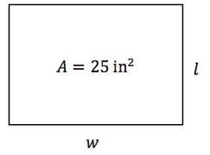
Example 1
The area A of a rectangle is 25 in².
The formula for area is A=lw.
If the width w is 10 inches, what is the length l?
If the width w is 15 inches, what is the length l?
Rearrange the area formula to solve for l.
Verify that the area formula, solved for l, will give the same results for l as having solved for l in the original area formula.

Slide 63
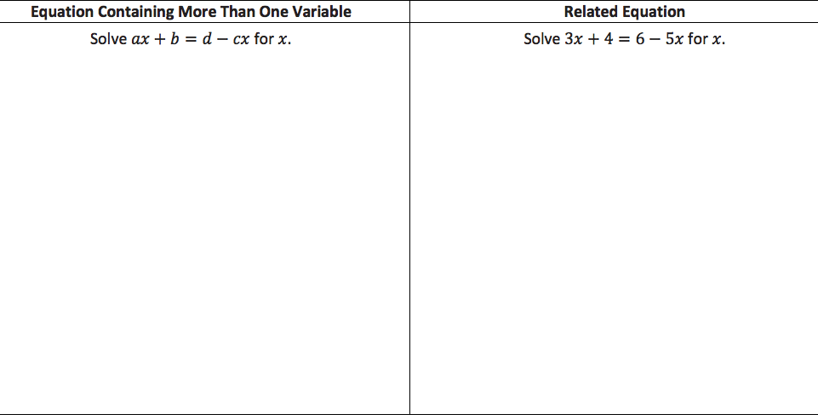
Example 2a

Slide 64
Example 2b

Slide 65
Workshop
Must Do
May Do
Exit ticket 17&18
Classwork exercises 1-10
KhanAcademy
Complete cw 17&18
HW 19 (evens)
Fluency practice

Slide 66
Lesson 20
Warm up, review/notes, classwork

Slide 67
Warm Up
Circle all the ordered pairs (x, y) that are solutions to the equation 4x - y = 10.
(3, 2) (2, 3) (-1, -14) (0, 0) (1, -6)
(5, 10) (0, -10) (3, 4) (6, 0) (4, -1)
How did you decide whether or not an ordered pair was a solution to the equation?

Slide 68
Notes: Solutions to two-variable equations
An ordered pair is a solution to a two-variable equation when each number substituted into its corresponding variable makes the equation a true number sentence. All of the solutions to a two-variable equation are called the solution set.
Each ordered pair of numbers in the solution set of the equation corresponds to a point on the coordinate plane. The set of all such points in the coordinate plane is called the graph of the equation.
Equations in the form ax + by = c and/or y = mx + b will result in graphs that are linear (a straight line)

Slide 69
Workshop
Must Do
May Do
Classwork exercises 1-7
KhanAcademy
Complete cw 19
HW 19 (evens)
Fluency practice

Slide 70
Summary
When values can by any number, connect the plotted points.
When context makes it so that only certain numbers make sense, do not connect the line.
A calculator or other device does not care about context - that is where the human mind has to apply the filters to domain.

Slide 71
Lesson 21
Warm up, review, classwork, notes, example, classwork

Slide 72
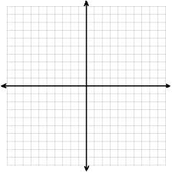
Warm Up
Circle all the ordered pairs (x, y) that are solutions to the equation 4x - y ≤ 10.
(3, 2) (2, 3) (-1, -14) (0, 0) (1, -6)
(5, 10) (0, -10) (3, 4) (6, 0) (4, -1)
Plot solutions on a
coordinate plane.

Slide 73
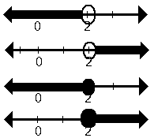
Recall
When working with inequalities in one variable, you learned to graph the solution set on a number line.
When working with inequalities with two variables, the solutions are also represented visually but in two-dimensions in the coordinate plane.

Slide 74
Workshop
Must Do
May Do
Classwork exercise 1
Classwork exercises 2

Slide 75
Notes: Two-variable inequalities
Any ordered pair in the solution set to a two-variable inequality will be a (x, y) point located on or above/below the line because that is the portion of the graph where y is greater/less than the other expression.
A half-plane is the graph of a solution set of an inequality on a coordinate grid

Slide 76
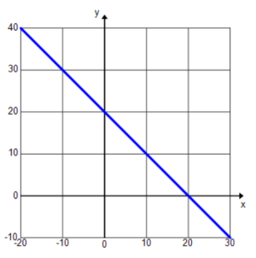
Example
The solution to x + y = 20 is shown on the graph below.
Graph the solution to $x+y≤20$.
Graph the solution to $x+y≥20$.
Graph the solution to $x+y<20$.
Graph the solution to $x+y>20$.

Slide 77
Notes: Two-variable inequalities
Any ordered pair in the solution set to a two-variable inequality will be a (x, y) point located on or above/below the line because that is the portion of the graph where y is greater/less than the other expression.
A half-plane is the graph of a solution set of an inequality on a coordinate grid.
Dotted line for strictly less/greater
Solid line for “or equal to”

Slide 78
Workshop
Must Do
May Do
Classwork exercise 2-4
KhanAcademy
Fluency practice

Slide 79
Lesson 22
Warm up, examples, classwork, summary

Slide 80
Warm Up
Consider the following compound sentence:
$x+y>10$ and $y=2x+1$.
Circle all the ordered pairs $(x,y)$ that are solutions to $x+y>10$.
Underline all the ordered pairs $(x,y)$ that are solutions to $y=2x+1$.
$\left(3,7\right)$ $\left(7, 3\right)$ $\left(−1,14\right) \left(0,1\right) \left(12,25\right)$
$\left(5,11\right)$ $\left(0, 12\right)$ $\left(1,8\right)$ $\left(12,0\right) \left(−1,−1\right)$
Which ordered pair(s) $(x,y)$ are solutions to the compound sentence $x+y>10$ and $y=2x+1 ?$

Slide 81
Warm Up, cont’d
Sketch the solution set to the inequality $x+y>10$ and the solution set to $y=2x+1$ on the same set of coordinate axes. Highlight the points that lie in BOTH solution sets.
Describe the solution set to $x+y>10$ and $y=2x+1$.

Slide 82
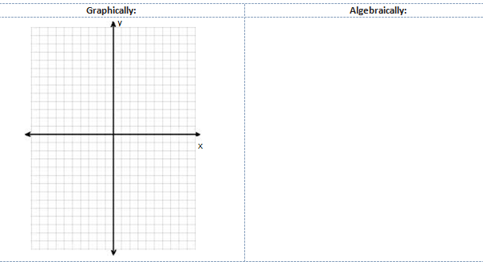
Example 1
Solve the following system of equations.
$$\left\{\begin{aligned}y=2x+1 \\ x−y=7\end{aligned}\right.$$

Slide 83
Workshop
Must Do
May Do
Classwork exercise 1
Classwork exercises 2

Slide 84
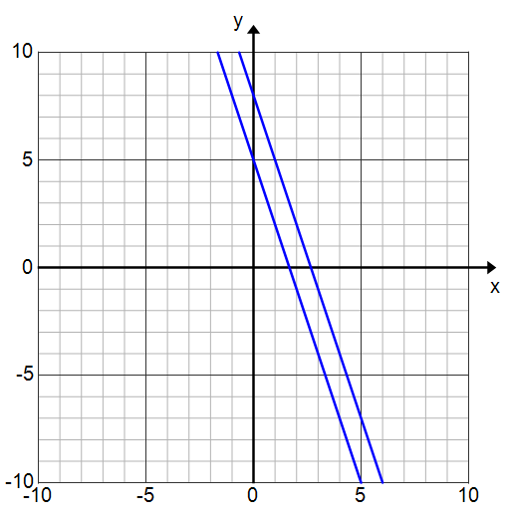
Example 2
Now suppose the system of equations from Exercise 1(c) was instead a system of inequalities:
$$\left\{\begin{aligned}3x+y≥5 \\ 3x+y≤8\end{aligned}\right.$$
Graph the solution set.

Slide 85
Example 3
Graph the solution set to the system of inequalities.
$2x−y<3$ and $4x+3y≥0$

Slide 86
Summary/Notes
There are 3 ways to solve a system of equations:
Graphically,
Algebraically (elimination or substitution), or
Numerically (with a table)
Graphs often lead to estimating solutions, but they are often the best method for systems of inequalities due to the difficulty in describing solution sets.

Slide 87
Workshop
Must Do
May Do
Classwork exercise 2-3
KhanAcademy
Fluency

Slide 88
Lesson 23
Warm up, example, classwork

Slide 89
Warm Up
Here is a system of two linear equations. Verify that the solution to this system is $(3,4)$.
Equation A1: $y=x+1$
Equation A2: $y=−2x+10$

Slide 90
Example – Elimination Method
Solve this system of linear equations algebraically.
{
$$2x+y=6$$
$$x−3y=−11$$

Slide 91
Key Point
The elimination method works because multiplying both sides of an equation by the same constant maintains the solution set.

Slide 92
Workshop
Must Do
May Do
Classwork23 exercise 1-3
KhanAcademy
Fluency
Complete cw21 & cw22

Slide 93
Lesson 24
Warm up, examples, classwork, summary

Slide 94
Warm Up
In Lewis Carroll’s Through the Looking Glass, Tweedledum says, “The sum of your weight and twice mine is $361$ pounds.” Tweedledee replies, “The sum of your weight and twice mine is $362$ pounds.” Find both of their weights.

Slide 95
Example
Lulu tells her little brother, Jack, that she is holding $20$ coins, all of which are either dimes or quarters. They have a value of $\$4.10$. She says she will give him the coins if he can tell her how many of each she is holding. Solve this problem for Jack.

Slide 96
Key Points
When there are two unknowns, we need at least two equations in order to solve the system.
When writing systems of equations/inequalities:
Define your variables (do not write x= or y= )
Create the equations/inequalities
Solve using the best method
Graphing
Substitution
Elimination
Interpret the meaning of the solution in context.
This might mean using a discrete line rather than continuous if not all points make sense.

Slide 97
Workshop
Must Do
May Do
Classwork24 exploratory challenge
KhanAcademy
Fluency
Complete cw21 & cw22 & cw23

Slide 98
Lesson 25-28
Overview, workshop

Slide 99
Modeling

Slide 100
Example
In a school choir, $\frac{1}{2}$ of the members were girls. At the end of the year, $3$ boys left the choir, and the ratio of boys to girls became $3:4$. How many boys remained in the choir?

Slide 101
Example
The “double and add 5” game is played by using a given starting number, doubling it and adding 5 to get to round 2, and then double and add 5 again. The goal is to find the smallest starting whole number that produces a result of 100 or more in 3 rounds or fewer.

Slide 102
Workshop
Must Do
May Do
Complete all classwork and homework 1-24
Complete cw25-28, either:
#1-3,
#4-5, or
#6
KhanAcademy
Fluency
Note sheet
Folder organize
cw 25-28 another set

