Slide 1
Lesson 9
Intro, classwork, notes

Slide 2
Recall
Recall from your work in Grade 6 and Grade 8 that categorical data are data that are not numbers. Bivariate categorical data results from collecting data on two categorical variables. In this lesson, you will see examples involving categorical data collected from two survey questions.
A statistical question is one that can be answered by data and it is anticipated that the data will vary.

Slide 3
Intro
Superheroes have been popular characters in movies, television, books, and comics for many generations. Superman was one of the most popular series in the 1950s, while Batman was a top-rated series in the 1960s. Each of these characters was also popular in movies released from 1990 to 2013. Other notable characters portrayed in movies over the last several decades include Captain America, She-Ra, and the Fantastic Four. What is special about a superhero? Is there a special superhero power that makes these characters particularly popular?
High school students in the United States were invited to complete an online survey in 2010. Part of the survey included questions about superhero powers. More than 1,000 students responded to this survey that included a question about a favorite superhero power. Researchers randomly selected 450 of the completed surveys. A rather confusing breakdown of the data by gender was compiled from the 450 surveys:
  100 students indicated their favorite power was to fly. 49 of those students were females.
  131 students selected the power to freeze time as their favorite power. 71 of those students were males.
  75 students selected invisibility as their favorite power. 48 of those students were females.
  26 students indicated super strength as their favorite power. 25 of those students were males.
  And finally, 118 students indicated telepathy as their favorite power. 70 of those students were females.

Slide 4
Workshop
Must Do
May Do
Classwork9 #1-12
Khan Academy
Crossing the River
Inky Puzzles
Exponents practice/review

Slide 5
Notes
Categorical data: data that are not numbers
Bivariate categorical data: results from collecting data on two categorical variables.
Two-way frequency table: used to summarize bivariate data
Joint frequencies: numbers within a two-way table
Marginal frequencies: the totals for each categorical variable (row and column totals)

Slide 6
Lesson 10
Intro/Example, Notes, Classwork

Slide 7
Intro
Determining the number of students in each cell presents the first step in organizing bivariate categorical data. Another way of analyzing the data in the table is to calculate the relative frequency for each cell. Relative frequencies relate each frequency count to the total number of observations. For each cell in this table, the relative frequency of a cell is found by dividing the frequency of that cell by the total number of responses.

Slide 8

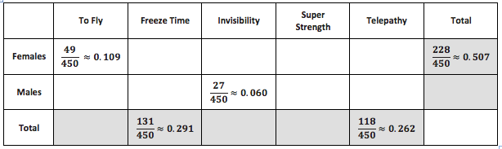
Example (on your classwork)
How would the frequencies look if males and females had the same opinions about their favorite superpower?

Slide 9
Notes
Two-way frequency table: used to summarize bivariate data
Joint frequencies: numbers within a two-way table
Marginal frequencies: the totals for each categorical variable (row and column totals)
Relative frequency: compares a frequency count to the total observations. There can be joint relative frequencies and marginal relative frequencies.
Found by dividing the frequency in a cell by the total observations.
Expressed as a decimal or fraction.

Slide 10
Workshop
Must Do
May Do
Classwork10 #1-10
Complete cw #1
Khan Academy
Crossing the River
Inky Puzzles
Exponents practice/review

Slide 11
Lesson 11
Opening, notes, classwork, summary

Slide 12
Intro
After further discussion, the students involved in designing the superhero comic strip decided that before any decision is made, a more careful look at the data on the special powers a superhero character could possess was needed. There is an association between gender and superpower response if the superpower responses of males are not the same as the superpower responses of females. Examining each row of the table can help determine whether or not there is an association.
How is a relative frequency calculated?
How could we calculate a relative frequency for only the female students? Or only the male students?

Slide 13
Notes
Two-way frequency table: used to summarize bivariate data
Joint frequencies: numbers within a two-way table
Marginal frequencies: the totals for each categorical variable (row and column totals)
Relative frequency: compares a frequency count to the total observations. There can be joint relative frequencies and marginal relative frequencies.
Found by dividing the frequency in a cell by the total observations.
Expressed as a decimal or fraction.
Conditional relative frequencies compare a frequency count to a marginal total (row or column total).
Calculated by dividing
Expressed as a decimal or percent
Two categorical variables are associated if there conditional relative frequencies are “quite or noticeably different.”
An association does NOT mean causation.

Slide 14
Example
Calculate the conditional relative frequency of:
a female student who chose invisibility as her superpower
a male student who chose invisibility as his superpower
a female student who chose to fly as their superpower.

Slide 15
Workshop
Must Do
May Do
Classwork 11 #1-16
Complete cw #1-2
KhanAcademy
Crossing the River
Inky Puzzles
Exponents practice/review

Slide 16
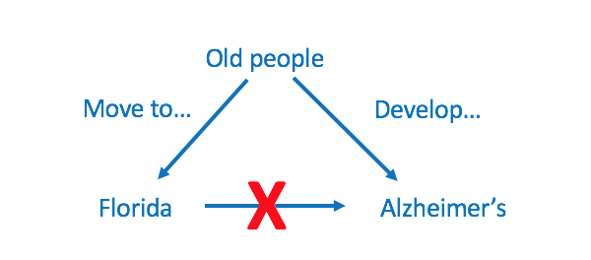
Correlation ≠ causation examples

Slide 17
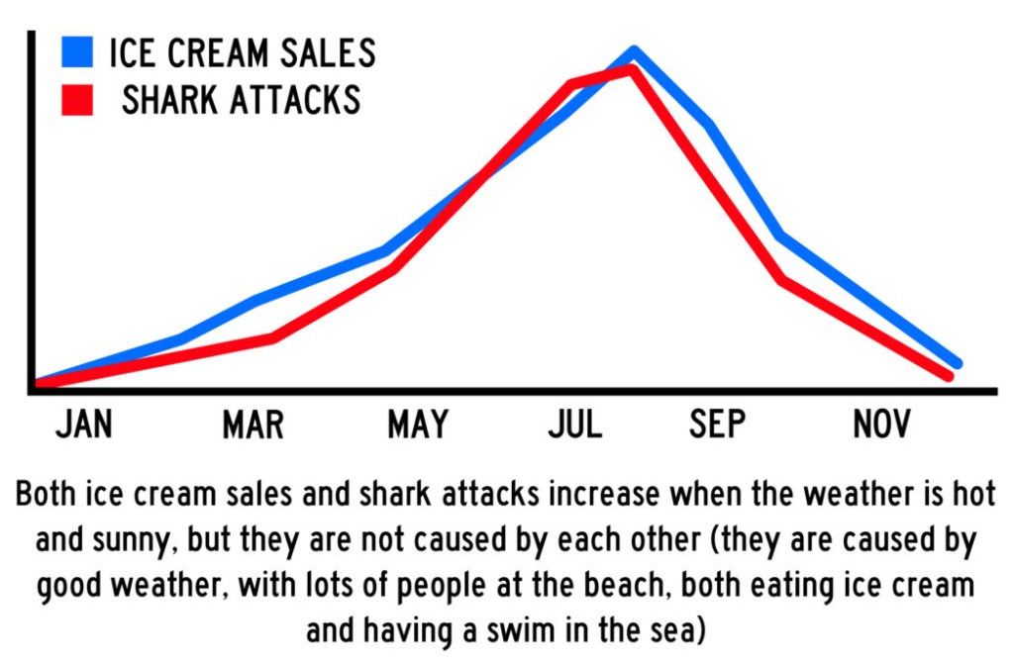
Correlation ≠ causation examples

Slide 18
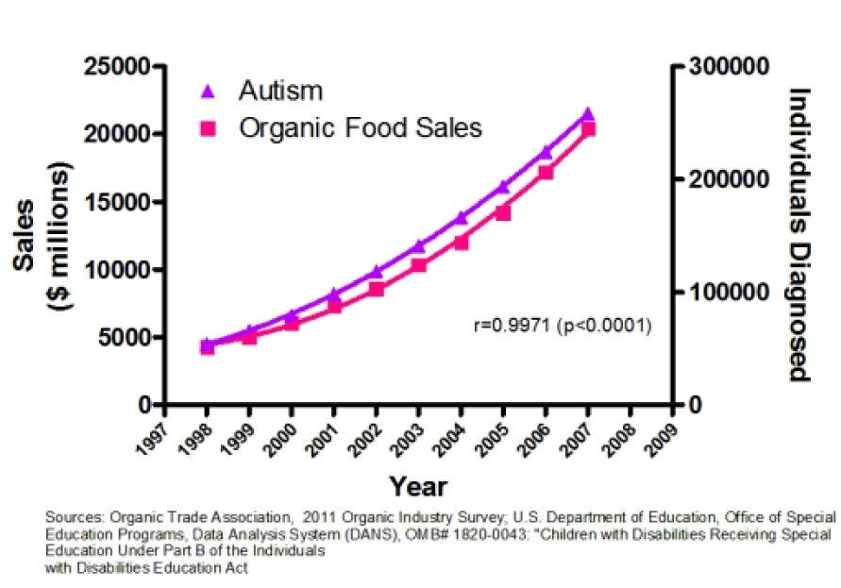
Correlation ≠ causation examples

Slide 19
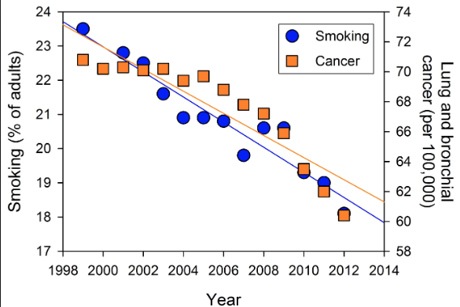
Correlation ≠ causation examples

Slide 20
Lesson 12
Intro, Notes/Example, classwork

Slide 21
Intro
A scatter plot is an informative way to display numerical data with two variables. In your previous work in Grade 8, you saw how to construct and interpret scatter plots. Recall that if the two numerical variables are denoted by x and y, the scatter plot of the data is a plot of the (x, y) data pairs.

Slide 22
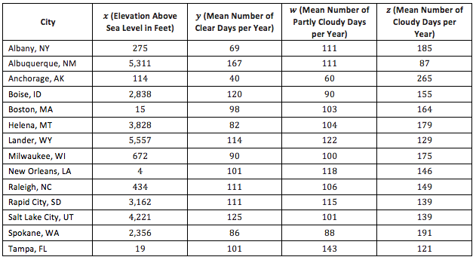
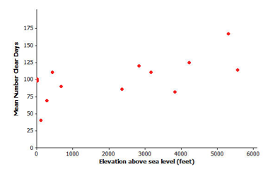
Example
Do you see a pattern or does it look totally scattered?
How would you describe the relationship?
Would a straight line be a good way to describe the relationship?

Slide 23
Notes
A scatter plot is an informative way to display numerical data with two variables.
Data in a scatterplot are said to be related if they show a general pattern, although real-life data will not every fall perfectly in a precise pattern.
Linearly related variables are data that fall in a linear patter but do not make a perfect line.
Nonlinearly related variables are data that have a pattern but not a linear one.

Slide 24
Workshop
Must Do
May Do
Exit ticket 11
Classwork12 #1-12
Complete classwork 9-11
Khan Academy
Exponents review
Crossing the River/Carnival Bears
Inky Puzzles

Slide 25
Lesson 13
Intro, Notes/Example, classwork, discussion

Slide 26
Intro
Not all relationships between two numerical variables are linear. There are many situations where the pattern in the scatter plot would best be described by a curve. Two types of functions often used in modeling nonlinear relationships are quadratic and exponential functions.
Sometimes the pattern in a scatter plot looks like the graph of a quadratic function (with the points falling roughly in the shape of a U that opens up or down), as in the graph below.
In other situations, the pattern in the scatter plot might look like the graphs of exponential functions that either are upward or downward sloping.

Slide 27
Notes
A scatter plot can be used to investigate whether or not there is a relationship between two numerical variables.
Linear, quadratic, and exponential functions are common models that can be used to describe the relationship between variables.
Models (equations) can be used to answer questions about how two variables are related.
Graphs and equations can be used to make predictions about the data because although the data doesn’t fall directly on the graph, it is close enough to provide a reasonable using the equation or the graph.
Quadratic
Exponential

Slide 28
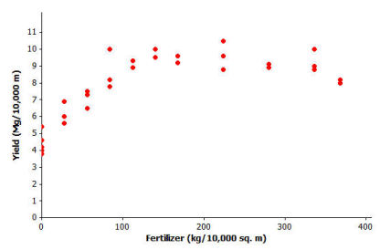
Example1
Farmers sometimes use fertilizers to increase crop yield but often wonder just how much fertilizer they should use. The data shown in the scatter plot below are from a study of the effect of fertilizer on the yield of corn.
What type of relationship does this seem to be?
Is fertilizer good for plants?
Can plants be over-fertilized?
How can we find the amount of fertilizer that produces the most corn?

Slide 29
Example2
How do you tell how old a lobster is? This question is important to biologists and to those who regulate lobster trapping. To answer this question, researchers recorded data on the shell length of 27 lobsters that were raised in a laboratory and whose ages were known.
What type of relationship does this seem to be?
What is meant by regulating lobster trapping?
Why would biologists care about the age of a lobster?

Slide 30
Workshop
Must Do
May Do
Classwork exercises 1-12
Complete classwork 12
KhanAcademy
Crossing the River/Carnival Bears
Exponents practice
Inky Puzzles

Slide 31
Lesson 14
Warm Up, example, classwork, example, classwork, notes, example, classwork

Slide 32
Warm Up
Read and complete #1 on your classwork

Slide 33
Example 1
When two variables x and y are linearly related, you can use a line to describe their relationship. You can also use the equation of the line to predict values.
The line y = 25.3 + 3.66x can be used to describe the relationship between shoe length and height, where x represents shoe length and y represents height. To predict the height of a man with a shoe length of 12 in…
While the equation provides a prediction, they do not guarantee you an exact value

Slide 34
Classwork
Complete #2-6 on your classwork

Slide 35
Example 2
One way to think about how useful a line is for describing a relationship between two variables is to use the line to predict the y-values for the points in the scatter plot. These predicted values could then be compared to the actual y-values.
The first data point in the table represents a man with a shoe length of 12.6 in. and height of 74 in.
If you use the line y=25.3+3.66x to predict this man’s height, you would get:

Slide 36
Example 2, continued
His predicted height is 71.42 in. Because his actual height was 74 in., you can calculate the prediction error by subtracting the predicted value from the actual value. This prediction error is called a residual. For the first data point, the residual is calculated as follows:
Residual = actual y-value minus predicted y-value
= 74 - 71.42
= 2.58
When you use a line to describe the relationship between two numerical variables, the best line is the line that makes the residuals as small as possible overall.

Slide 37
Classwork
Complete classwork #7-13

Slide 38
Notes
Linear equations can be used to make predictions about data that have an approximately linear relationship.
The goal is for the line to make the residuals as small as possible overall.
Residual: actual y-value minus predicted y-value
This is usually done using the least squares line (also called regression line or best-fit line). This should be done on your calculator!
The slope of the least squares line is the change in the predicted value of the y-variable associated with an increase of one in the value of the x-variable.
The y-intercept of a line is the predicted value of y when x equals zero. When using a line as a model for the relationship between two numerical variables, it often does not make sense to interpret the y-intercept because of context.

Slide 39
Example 3 - calculator
Fortunately, a graphing calculator can be used to find the equation of the least squares line.
Take out your calculator handbook and I’ll show you how to enter data and obtain the equation of the least squares line using your graphing calculator.

Slide 40
Workshop
Must Do
May Do
Finish classwork14 #1-17
KhanAcademy
Start homework 14
Crossing the River/Carnival Bears
Exponents
Inky puzzles

Slide 41
Lesson 15
Opening, notes, classwork

Slide 42
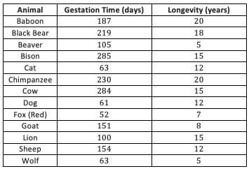
Review/Warm Up
Use your calculator to find the least squares regression line for the animal data shown
Confirm: Equation should be y = 6.642 + 0.03974x

Slide 43
Think…
Finding the equation of the least squares line relating longevity to gestation time for these types of animals provides the equation to predict longevity.
How good is the line? In other words, if you were given the gestation time for another type of animal not included in the original list, how accurate would the least squares line be at predicting the longevity of that type of animal?

Slide 44
Key Points: Residuals
After you calculate the residuals, what do they tell us?
What does a large positive residual mean?
What does a large negative residual mean?
What do residuals close to 0 mean?
Residuals: actual y-value minus predicted y-value
negative: prediction > actual
positive: prediction < actual
close to 0: prediction(s) accurate
They provide an idea of how close a prediction by a least squares regression is likely to be.

Slide 45
Workshop
Must Do
May Do
Exit ticket #14
Classwork15 #1-8
KhanAcademy
HW #1 (get equation so you don’t need a calculator)
Crossing the River/Carnival Bears
Exponents review/practice
Inky puzzles

Slide 46
Lesson 16
Warm Up, Intro, example, notes, classwork

Slide 47
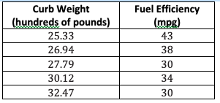
Warm Up
The curb weight of a car is the weight of the car without luggage or passengers. The table below shows the curb weights (in hundreds of pounds) and fuel efficiencies (in miles per gallon) of five compact cars. Use a calculator to find the least squares regression line.
Confirm: Equation should be y = 78.62 - 1.529x

Slide 48
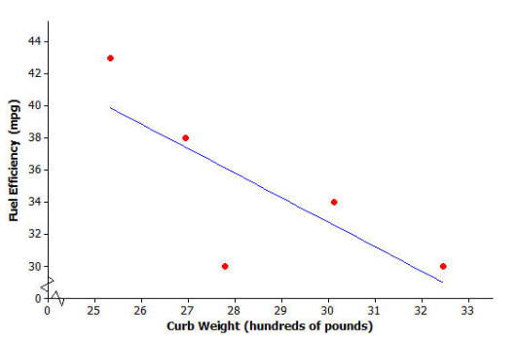
Intro
Will the residual for the car whose curb weight is 25.33 hundred pounds be positive or negative? Roughly what is the value of the residual for this point?
Will the residual for the car whose curb weight is 27.79 hundred pounds be positive or negative? Roughly what is the value of the residual for this point?
Positive, ~3 above the line
Negative, ~6 below the line

Slide 49
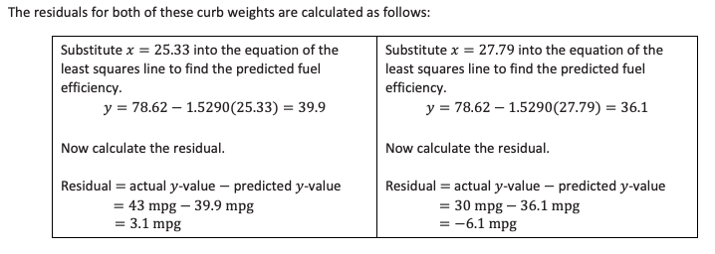
Example
Complete classwork #1-2

Slide 50
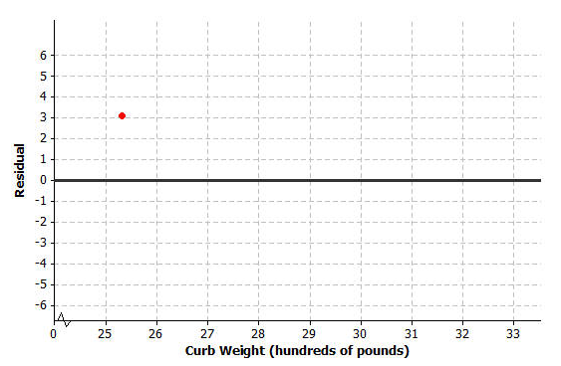
Example 2/Notes
It is often useful to make a graph of the residuals, called a residual plot.
In a residual plot, the x-values from the data set stay on the x-axis and y-axis becomes the corresponding residuals.
The weight of the first car is 25.33 hundred pounds and the residual is 3.1 mpg.

Slide 51
Workshop
Must Do
May Do
Classwork16 #1-4
Finish classwork 15
KhanAcademy
HW #1 (get equation so you don’t need a calculator)
Crossing the River/Carnival Bears
Exponents review/practice
Inky puzzles

Slide 52
Lesson 17
Warm Up, Intro, example, notes, classwork

Slide 53
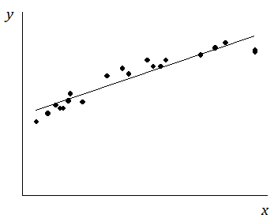
Warm Up
Suppose you are given a scatter plot and least squares line that looks like the one below. Describe what you think the residual plot would look like.

Slide 54
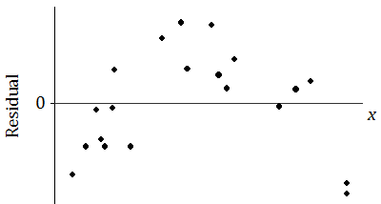
Introduction
The residual plot loots like this:
Why is looking at the pattern in the residual plot important?

Slide 55
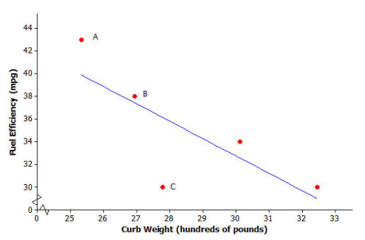
Example
In the previous lesson, you looked at a scatter plot showing how fuel efficiency was related to curb weight for five compact cars. The scatter plot and least squares line are shown below.
What kind of residual does Point A have?
What kind of residual does Point B have?
What kind of residual does Point C have?

Slide 56
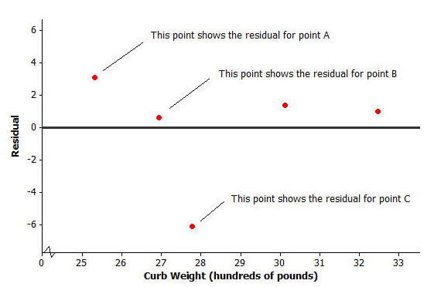
Example, continued
The residual plot for this data set looked like this:

Slide 57
Notes - Analyzing residuals
If a residual plot has a pattern to it, then a linear model was NOT the best fit.
If a residual plot is scattered, then a linear model was the best fit for the data.

Slide 58
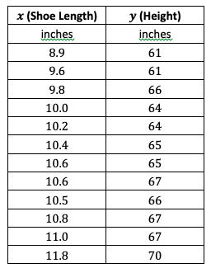
Tech Time
Take out your calculator handbooks to learn how to use the calculators to create residual plots!
This data set of shoe lengths and heights of 12 adult women is shown in the table below.

Slide 59
Workshop
Must Do
May Do
Classwork17 (sketch residual plot based on calculator)
Exit ticket #15-16
KhanAcademy
HW (so you don’t need a calculator)
Crossing the River/Carnival Bears
Exponents review/practice
Inky puzzles

Slide 60
Lesson 18
Recall, Intro, example, notes, classwork

Slide 61
Recall - Analyzing residuals
If the points in a residual plot are random, then a linear model is the best fit.
If the points in a residual plot have a pattern, then a linear model was NOT the best fit.

Slide 62
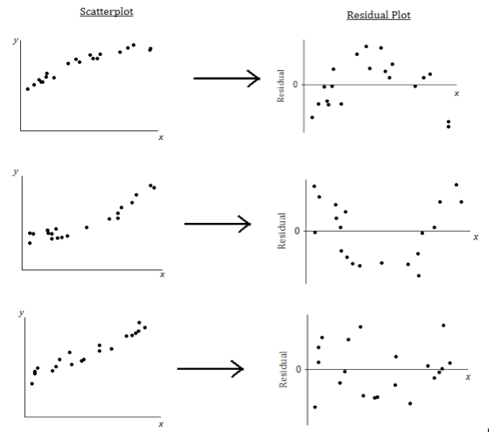

Slide 63

Follow Up
Why is the first residual plot arch shaped?
Why is the second plot U-shaped?
Why does the third seem to be scattered?
What does it mean when there is a curved pattern in the residual plot?
What does it mean when the points in the residual plot seem to be scattered?
If the pattern isn’t actually linear, what type of pattern could it be?
How can looking at the original
data set lead to the wrong
conclusion?

Slide 64
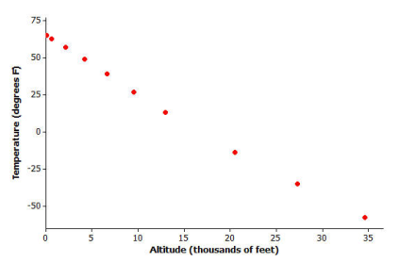
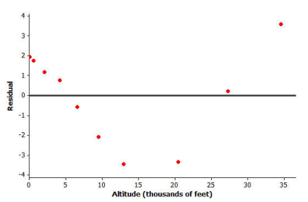
Example 2
How can looking at the original data set lead to the wrong conclusion?
The residuals are the vertical deviations from the least squares line in the original scatter plot. Because of the change of scale, tiny vertical deviations can be shown as much larger distances from the zero line in the residual plot. Therefore, a very subtle curvature in the original relationship can be seen more clearly in the residual plot. This is why you draw residual plots.

Slide 65
Workshop
Must Do
May Do
Classwork18 #1-3
Exit ticket #17-18
KhanAcademy
Crossing the River/Carnival Bears
Exponents review/practice
Inky puzzles

Slide 66
Lesson 19
Recall, example/notes, classwork

Slide 67
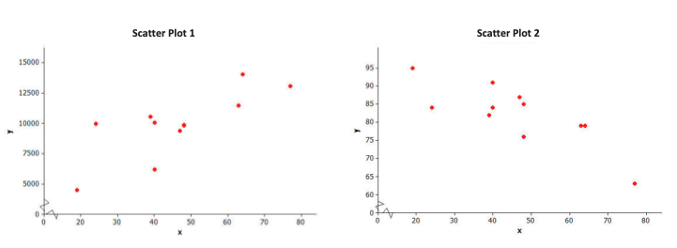
Warm Up/example
Linear relationships can be described as either positive or negative. Below are two scatter plots that display a linear relationship between two numerical variables x and y. Which is positive and which is negative? Why?

Slide 68
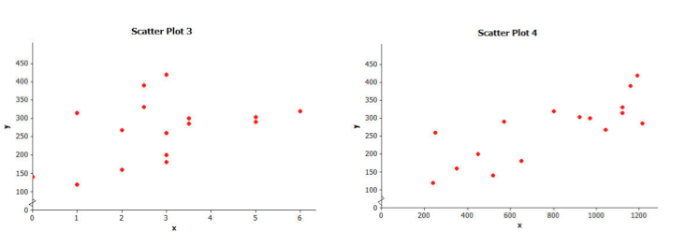
Warm Up/example, part 2
It is also common to describe the strength of a linear relationship. Both of these are positive relationships. Which would you say is stronger and why?
What would a scatterplot with the strongest possible positive linear relationship look like? The strongest negative linear relationship?

Slide 69
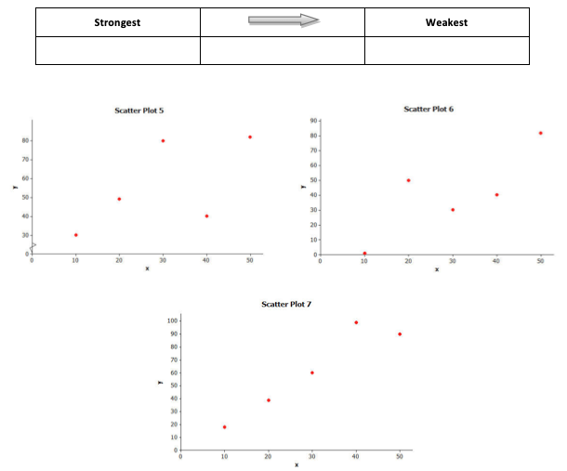
Warm Up/example, part 3
Consider the three scatter plots below. Place them in order from the one that shows the strongest linear relationship to the one that shows the weakest linear relationship.

Slide 70
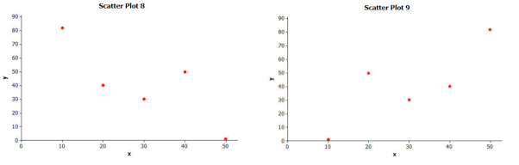
Warm Up/example, part 4
Which of the following two scatter plots shows the stronger linear relationship? (Think carefully about this one!)

Slide 71
Notes (LAST ONES FOR THE UNIT)
Linear relationships are often described in terms of strength and direction.
Positive relationship: x and y increase together
Negative relationships: as x increases, y decreased
The closer the points are to a line, the stronger the relationship.
The correlation coefficient (r) is a measure of the strength and direction of a linear relationship.
The closer the is to +1 or -1, the stronger the linear relationship.
Just because there is a strong correlation between the two variables does not mean there is a cause-and-effect relationship.

Slide 72
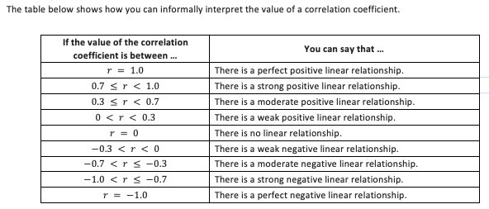

Slide 73
Activity
Sort/match the graphs and correlation coefficients.

Slide 74
Recall: Correlation ≠ Causation
Even an incredibly strong correlations DOES NOT mean that there is a causal relationships between the two variables. That comes from human analysis and thinking about other reasons the data could be connected!
There is a strong positive correlation between shoe size and reading ability in children. But it would be silly to think that having big feet causes children to read better. It just means that the two variables vary together in a predictable way. Can you think of a reason that might explain why children with larger feet also tend to score higher on reading tests?

Slide 75

Correlation Coefficient
There is an equation used to calculate the correlation coefficient (that you may use in AP statistics) but we will the graphing calculator to calculate this:

Slide 76
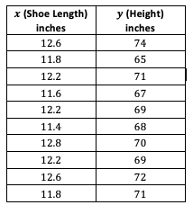
Example
Enter this data on shoe length in inches and height in inches for 10 men into your calculator
Calculate the correlation coefficient and interpret its value.

Slide 77
Workshop
Must Do
May Do
Classwork19 #1-6
KhanAcademy
HW 2a and 3b and 3d (so you don’t need a calculator)
Crossing the River/Carnival Bears
Exponents review/practice
Inky puzzles

Slide 78
Lesson 20
Poster making

Slide 79
Workshop
Must Do
May Do
Poster project
  Shoe length and height(14)
  Gestation and longevity(15)
  Time and cost surgery(15)
  Curb weight and efficiency(16)
  Athlete track times(16)
  Temperature and volume(18)
  Latitude and # of chicks(13)
  Elevation and clear days(12)
KhanAcademy
HW #19
Notesheet
Folder organize
All past cw/hw

Slide 80
Test
1 (Lesson 1-8)
1a – choose mean vs median
1b-d – calculate and analyze mean and median
2 (Lesson 9-11)
Analyze conditional relative frequencies
3 (Lesson 9-11)
Fill in missing data entries in table to make frequencies a certain way
4 (Lesson 18-19)
4a-b – estimate correlation coefficient
4c – predict based on graphs
5 (Lesson 12-19)
5a(lesson14) – Interpret the slope
5b(lesson 14-15) – meaning of residual
5c(lesson 12-3) – Explain what relationship means about variables
5d-e(lesson17-19) – how to check if model is good
6 (calculator skills)
Scatterplot, regression line, residual plot, correlation coefficient

