Slide 1
Lesson 1
Warm Up, example, notes, example, classwork

Slide 2
Warm Up
Mrs. Rosenblatt gave her students what she thought was a simple task: What is the next number in the sequence 2, 4, 6, 8, …?
Cody: I am thinking of a plus 2 pattern, so it continues 10, 12, 14, 16, ….
Ali: I am thinking of a repeating pattern, so it continues 2, 4, 6, 8, 2, 4, 6, 8, …
Suri: I am thinking of the units digits in the multiples of two, so it continues 2, 4, 6, 8, 0, 2, 4, 6, 8, ….
Are each of these valid responses?
What is the 100th number in the sequence for each person’s scenario?
What is an expression, in terms of n, for the n^{th} number in the sequence in Cody’s scenario?

Slide 3
Example 1
Jerry has thought of a pattern that shows powers of two. Here are the first six numbers of Jerry’s sequence:
1, 2, 4, 8, 16, 32, ….
Write an expression for the n^{th} number of Jerry’s sequence.
Key Point: Should you start with n=0 or n=1? In the big picture it doesn’t matter as long as you define your starting point, but for this module we will assume starting with n=1 to keep everyone consistent.

Slide 4
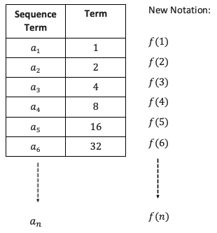
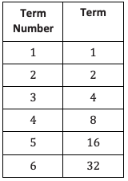
Example 1, continued
Key Point: Should you start with n=0 or n=1? In the big picture it doesn’t matter as long as you define your starting point, but for this module we will assume starting with n=1 to keep everyone consistent.

Slide 5
Notes
A sequence can be thought of as an ordered list of elements. Each element is called a term.
Terms are usually indexed using subscripts, and for this module we will start with 1: a₁, a₂, a₃, …
The ellipsis (…) indicates a regular pattern.
The terms are spoken as “a sub 1, a sub 2” etc.
When using a formula you can also use f(n) notation, which is spoken as “f of n, f of 1, f of 2” etc. meaning formula for the n^{th} term or formula for the 2nd term.
Graphs will be discrete points, not continuous.

Slide 6
Example 2
Consider the sequence: 4, 7, 10, 13, 16, ….
1) Write a formula for the sequence using both the a_{n} notation and the f(n) notation.
2) Does the formula f(n) = 3(n - 1) + 4 generate the same sequence? Why might some people prefer this formula?
3) Graph the terms of the sequence as ordered pairs n, f(n) on a coordinate plane. What do you notice about the graph?

Slide 7
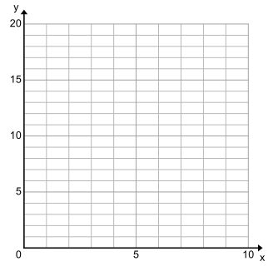
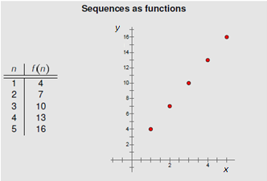
Example 2, continued
Consider the sequence: 4, 7, 10, 13, 16, ….
3) Graph the terms of the sequence as ordered pairs n, f(n) on a coordinate plane. What do you notice about the graph?

Slide 8
Workshop
Must Do
May Do
Classwork1 #1 - 3
Reflection questions
Khan Academy
Classwork1 #4
Carnival Bears/Crossing the River
Exponents review
Linear equation practice

Slide 9
Reflection Questions
Why is it important to have a formula to represent a sequence?
Can one sequence have two different formulas?
What does f(n) represent? How is it read aloud?
It is important to have a formula to represent a sequence to demonstrate the specific pattern and to help in finding any term of the sequence (20th term, 50th term, 1,000th term, and so on). This is very useful when we need to make predictions based on the formula chosen to model the existing data sequence.
Yes, depending on what value of n you chose to start with. Some students may point out that two different-looking formulas may be related by equivalent expressions: 5(n+2) is different from 5n+10.
It represents the n^{th} term of a sequence just like a_{n}. It is read “f of n.”

Slide 10
Lesson 2
Warm Up, Example, Notes

Slide 11
Warm Up/Recall
Recursive sequence: A recursive sequence is a sequence that is defined by (1) giving an initial term and (2) building off that term with a set rule. We saw these in Module 1 when you explore the double and add 5 game.
Find the first 5 terms of these recursive sequences:
a₁ = 3 and a_{i+1}=a_{i} + 3, for i ≥ 1,
a₁ = 3 and a_{i+1} = 3a_{i}, for i ≥ 1,

Slide 12
Example 1
Consider Akelia’s sequence 5, 8, 11, 14, 17, ….
If you believed the pattern, what might you say is the next number?
When asked to write a formula for her sequence, Akelia started by writing:
5 8 = 5 + 3 11 = 5 + 3 + 3 = 5 + 2×3 14 = 5 + 3 + 3 + 3 = 5 + 3×3
Use this reasoning to help write her formula, using the letter A to name it, for Akelia’s sequence.

Slide 13
Example 1, continued
Akelia’s sequence 5, 8, 11, 14, 17, ….
Formula: A(n) = 5 + 3(n - 1)
What does A(n) mean again?
Explain how each part of the formula relates to the sequence
What’s another, equivalent, way to write this formula?

Slide 14
Example 1, continued
Akelia’s sequence 5, 8, 11, 14, 17, ….
When Johnny saw the sequence he wrote the following:
A(n+1) = A(n) + 3 for n ≥ 1 and A(1) = 5
What does A(n+1) mean?
5 8 = 5+3 11 = 8+3 14 = 11+3 17 = 14+3
What do we call the 5th term?
How do you find the 5th term in terms of the 4th term?
How do you find the 6th term in terms of the 5th term?
How do find the (n+1)^{th} term in terms of the n^{th} term?

Slide 15
Notes
Recursive sequence: A recursive sequence is a sequence that is defined by (1) giving an initial term and (2) building off that term with a set rule.
Explicit Formula: specifies the n^{th} term of a sequence as an expression. Used to find any term without know preceding one.
Example: A(n) = 5 + 3(n - 1)
Recursive Formula: specifies the n^{th} term of a sequence based on the preceding term(s).
Example: A(n+1) = A(n) + 3
Note on notation:
Subscripts and parentheses serve the same purpose in indexing terms in a sequence. Both will be used throughout the unit.

Slide 16
Example 1, continued
Akelia’s formula was an explicit one. Johnny’s was recursive.
Why does Akelia’s formula has “times 3” when Johnny’s has “plus 3”?
If we wanted the 200th term in the sequence, whose formula would we most likely use?
If you wanted to know how the sequence changes from one term to the next, whose formula is more useful?
To find the 200th term using Johnny’s formula, what would we need to know?

Slide 17
Example 2
Consider a sequence given by the formula
a_{n} = a_{n-1} - 5, where a₁ = 12 and n ≥ 2.
List the first five terms of the sequence.
Write an explicit formula.
Find a₆ and a₁₀₀ of the sequence.

Slide 18
Workshop
Must Do
May Do
Classwork2 #1-6
Summary/Reflection
Complete cw #1
Khan Academy
Extension assignment
Crossing River/Carnival Bears
Linear Equation practice/review
Exponents

Slide 19
Lesson 3
Warm Up, notes, classwork

Slide 20
Warm Up/example 1
Yesterday, we talked about the sequences created by Akelia.
What sequence does $A\left(n+1\right)=A\left(n\right)−3$ and $A(1)=5$ for $n≥1$ yield?
What sequence does $A(n+1)=A(n)+3$ and $A(1)=5$ for $n≥1$ yield?

Slide 21
Warm Up/example1, continued
Johnny suggests that they plot the sequences to help them understand the patterns.
What is the slope of the line connecting the points?
Is there a relationship between the slope and sequences themselves?
Sequences that create linear graphs are called arithmetic.

Slide 22
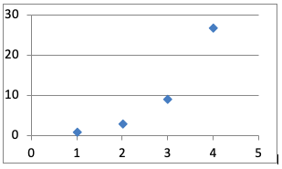
Example 2
Now look at the sequence $1$, $3$, $9$, $27$, …. What do you notice? How is the sequence different from the sequences before?
If we plot this sequence we get this graph. Is this arithmetic/linear?
Sequences that create exponential graphs are called geometric.

Slide 23
Notes
There are two primary types of sequences:
Arithmetic: sequences that show an addition or subtraction pattern and create linear graphs.
Explicit formula:
f(n)
SLOPE
CONSTANT RATE RATE OF CHANGE
Y-INTERCEPT
INITIAL VALUE
FIXED AMOUNT
(0, b)
x=0

Slide 24
Notes
There are two primary types of sequences:
Geometric: sequences that show a multiplication or division pattern and create exponential graphs.
Explicit formula:
f(n) = a(b)^{x}
INITIAL VALUE
GROWTH OR DECAY RATE
>1 growth
<1 decay

Slide 25
Workshop
Must Do
May Do
Exit ticket 1-3
Classwork 3 #1-2
Reflection/summary question
Classwork3 #4-5
KhanAcademy
Exponents review
Linear practice

Slide 26
Lesson 4
Examples, notes, classwork

Slide 27
Warm Up
Have you ever thought it odd that banks pay YOU interest for the honor of looking after your money for you?
Throughout history, people had to PAY BANKS to look after their money. In the Renaissance, with the rise of world exploration, banks realized that looking after people’s money was an incredibly good thing for them. They could make money off of the large amounts of money they were keeping for others. They wanted to encourage more people to give them their money to keep, so they started paying customers.

Slide 28
Banks originally computed simple interest, and that is the type of interest studied in this example. Simple interest is calculated at the end of each year on the original amount either borrowed or invested (the principal).
Kyra has been babysitting since sixth grade. She has saved $\$1,000$ and wants to open an account at the bank so that she earns interest on her savings. Simple Bank pays simple interest at a rate of $10\%$. How much money will Kyra have after $1$ year? After $2$ years, if she does not add money to her account? After $5$ years?

Slide 29
Come up with a formula to calculate simple interest.

Slide 30
Example 1
Raoul needs $\$200$ to start a snow cone stand for this hot summer. He borrows the money from a bank that charges $4\%$ simple interest per year.
How much will he owe if he waits $1$ year to pay back the loan? If he waits $2$ years? $3$years? $4$years? $5$ years?
Write a formula for how much he will owe after $t$ years.

Slide 31
In the 1600s, banks realized that there was another way to compute interest and make even more money. With compound interest, banks calculate the interest for the first period, add it to the total, and then calculate the interest on the total for the next period, and so on.

Slide 32
Try to write an explicit formula for this. Start with writing the recursive pattern.

Slide 33
Example 2
Jack has $\$500$ to invest. The bank offers an interest rate of $6\%$ compounded annually. How much money will Jack have after $1$ year? $2$ years? $5$ years? $10$ years?

Slide 34
Example 3
If you have $\$200$ to invest for $10$ years, would you rather invest your money in a bank that pays $7\%$ simple interest or in a bank that pays $5\%$ interest compounded annually? Is there anything you could change in the problem that would make you change your answer?

Slide 35
Notes - Interest
Simple interest: Interest is calculated once per year on the original amount borrowed or invested. The interest does not become part of the amount borrowed or owed (the principal). I = prt (calculates interest only)
Compound interest: Interest is calculated once per period on the current amount borrowed or invested. Each period, the interest becomes a part of the principal. FV = p(1+r)^{t} (calculates future total)
r is the interest rate written as a decimal, t is time, p is principal amount

Slide 36
Workshop
Must Do
May Do
Complete classworks 1-3
Classwork/homework

Slide 37
Lesson 5
Warm up/example, Classwork, discussion/summary

Slide 38
Warm Up/example
Two equipment rental companies have different penalty policies for returning a piece of equipment late.
Company 1: On day $1$, the penalty is $\$5$. On day $2$, the penalty is $\$10$. On day $3$, the penalty is $\$15$. On day $4$, the penalty is $\$20$, and
so on, increasing by $\$5$ each day the equipment is late.
Company 2: On day $1$, the penalty is $\$0.01$. On day $2$, the penalty
is$\$0.02$. On day $3$, the penalty is $\$0.04$. On day $4$, the penalty is $\$0.08$,
and so on, doubling in amount each additional day late.
Jim rented a digger from Company 2 because he thought it had the better late return policy. The job he was doing with the digger took longer than he expected, but it did not concern him because the late penalty seemed so reasonable. When he returned the digger $15$ days late, he was shocked by the penalty fee. What did he pay, and what would he have paid if he had used Company 1 instead?

Slide 39
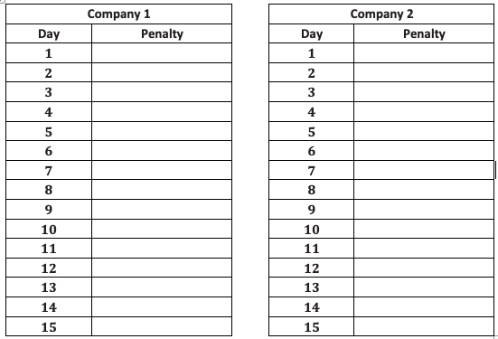
Warm Up/example, continued
Which company has a greater $15$-day late charge?
Describe how the amount of the late charge changes from any given day to the next successive day in both Companies.
How much would the late charge have been after $20$ days under Company 2?

Slide 40
Workshop
Must Do
May Do
Classwork exercises 1-4
KhanAcademy
Crossing the River/Carnival Bears
Exponents review
Linear practice

Slide 41
Summary/Discussion
Problem 3: Which of the two functions grows more quickly?
Problem 4: What exponential formula would work?
Would 2^{n} work? How could we make it work?
What if the first square began with 5 grains of rice, how much rice would be on the first 5 squares?
Would we still use powers of 2?

Slide 42
Lesson 6-7
Warm Up, example, notes classwork

Slide 43
Warm Up/Intro
Look at the two graphs and compare their rates of change.

Slide 44
Warm Up/Intro
How is this graph very different than the others?

Slide 45
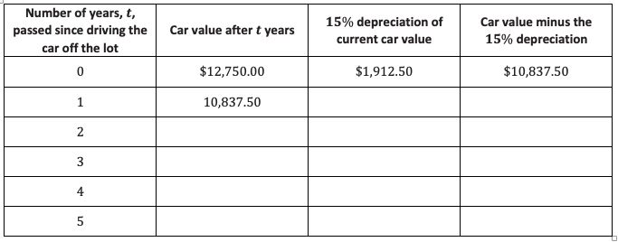
Example
Malik bought a new car for $\$15,000$. As he drove it off the lot, his best friend, Will, told him that the car’s value just dropped by $15\%$ and that it would continue to depreciate $15\%$ of its current value each year. If the car’s value is now $\$12,750$ (according to Will), what will its value be after $5$ years?

Slide 46
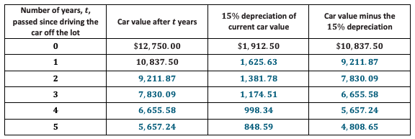
Example, continued
Write an explicit formula for the sequence that models the value of Malik’s car $t$ years after driving it off the lot.
Use the formula to determine the value of Malik’s car five years after its purchase. Round your answer to the nearest cent. Compare the value with the value in the table. Are they the same?
Use the formula to determine the value of Malik’s car $7$ years after its purchase. Round your answer to the nearest cent.

Slide 47
Notes
For classwork 6: percent change is calculated as:
New amount – initial amount
initial amount
f(n) = a(b)^{x}
INITIAL VALUE
x = 0
GROWTH OR DECAY RATE
>1 growth
<1 decay
*If growing 12% the rate is 1.12
*If shrinking 12% the rate is .88

Slide 48
Workshop
Must Do
May Do
Classwork6-7 exercises 1-9
KhanAcademy
Study/review lessons 1-7

