Slide 1
Lesson 15
Warm up, classwork, notes, example, classwork

Slide 2
Entry/Warm Up
Recall that the absolute value of a number is the distance from $0$ of a point on the number line. Because distance is being measured, the absolute value of a nonzero number is always positive.
Solve each equation for x (should get two answers).
Determine at least five solutions for each two-variable equation. Make sure some of the solutions include negative values for either $x$ or $y$.
$$\left|x\right|=6$$
$$\left|x−5\right|=4$$
$$2\left|x+3\right|=−10$$
$$y=\left|x\right|$$
$$y=\left|x−5\right|$$
$$x=\left|y\right|$$

Slide 3
Workshop, pt. 1
Must Do
May Do
Classwork15 #1
Khan Academy
Carnival Bears/Crossing the River
Exponents review
Linear equation practice
Slope practice

Slide 4
Discussion/Notes
Remember: creating a graph of a solution set to an equation is the same as graphing a function; sift through values to find ones that make the equation true and plot.
Functions have the rule that each input only has one output, but not all equations have that expectation. When talking about FUNCTIONS, y and f(x) are used interchangeably.
The absolute value function is defined by setting $f(x)=|x|$ for all real numbers. Another way to write this is as a piecewise linear function:
$$f\left(x\right)=\left\{\begin{matrix}−x & x<0 \\ x & x≥0\end{matrix}\right.$$
Given a number of nonoverlapping intervals piecewise linear function the union of the intervals such that the function is defined by different linear functions on each interval.

Slide 5
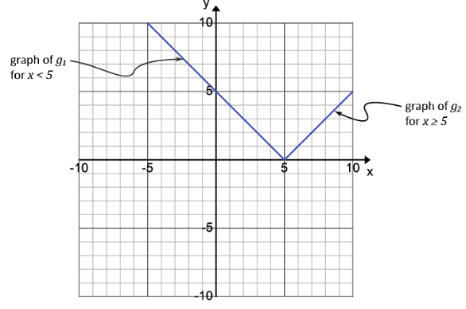
Example
Let $g(x)=|x−5|$. The graph of $g$ is the same as the graph of the equation $y=|x−5|$ you drew classwork#1, part(b). Use the redrawn graph below to rewrite the function $g$ as a piecewise function.

Slide 6
Workshop, pt. 2
Must Do
May Do
Classwork15 #2-3
Summary/reflection
Khan Academy
Carnival Bears/Crossing the River
Exponents review
Linear equation practice
Slope practice

Slide 7
Lesson 16
Warm up/example, notes, example, classwork

Slide 8
Warm Up
Solve for $x$ in the following equation: $\left|x+2\right|−3=0.5x+1$.

Slide 9
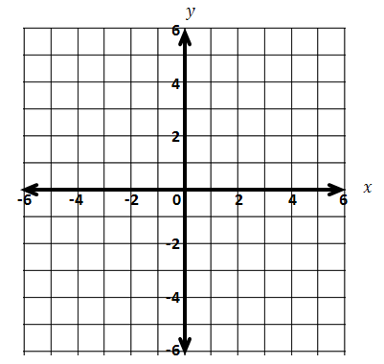
Example1
If we say $f(x)=|x+2|−3$ and $g\left(x\right)=0.5x+1$, solving the warm up equation is the same as asking “when does $f\left(x\right)=g(x)$?”
Graph $f(x)$ and $g(x)$ on the same set of axes.
Where, visually, do we see $f\left(x\right)=g(x)$?
How do we check that they are both really solutions?

Slide 10
Notes –
Graphs can be used to estimate solutions to equations.
The x-coordinate of points of intersection are the solutions to the equation $f\left(x\right)=g(x).$
Advantages: Can be easier when equations are complicated (or impossible) to solve algebraically.
Disadvantages: estimated values
--More exact when done on a graphing calculator (see
handbook for instructions)

Slide 11
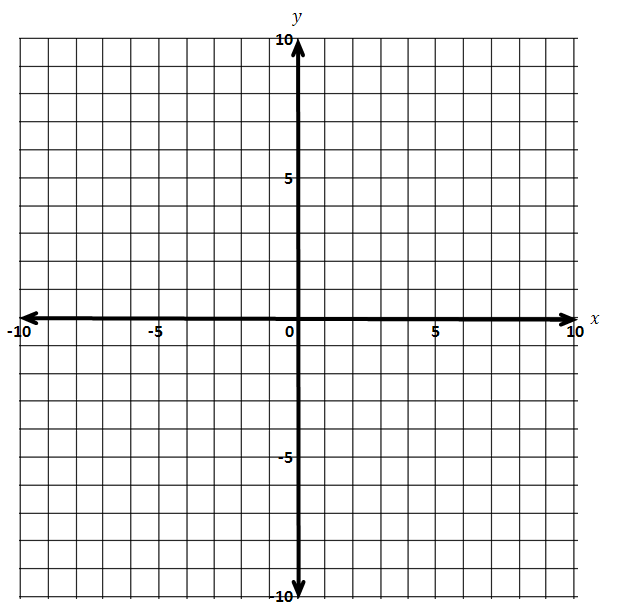
Example 2
Solve this equation by graphing two functions on the same Cartesian plane: $−\left|x−3\right|+4=\left|0.5x\right|−5$. $$f\left(x\right)=−\left|x−3\right|+4 \\ g\left(x\right)=\left|0.5x\right|−5$$

Slide 12
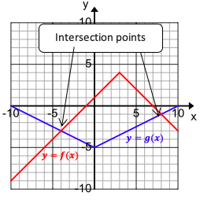
Example 2, continued
Solve this equation by graphing two functions on the same Cartesian plane: $−\left|x−3\right|+4=\left|0.5x\right|−5$. $$f\left(x\right)=−\left|x−3\right|+4 \\ g\left(x\right)=\left|0.5x\right|−5$$
From the graph, we see that the intersection points are:
Thus, the expressions $−\left|x−3\right|+4$ and $\left|0.5x\right|−5$ are equal when $x=$ _______ or when$x=$ _______.
Therefore, the solution set to the original equation: $−\left|x−3\right|+4=\left|0.5x\right|−5$ is ___________.

Slide 13
Example 3
Solve this equation graphically: $−\left|x−3.5\right|+4=−0.25x−1$
Write the two functions represented by each side of the equation.
Enter into calculator
Graph
Calculate intersection

Slide 14
Workshop
Must Do
May Do
Exit ticket 15
Classwork16 #1-5
Summary/reflection
Complete cw #15
Khan Academy
Crossing River/Carnival Bears
Linear Equation practice
Exponents
Slope practice

Slide 15
Lesson 17
Classwork, notes

Slide 16
Workshop
Must Do
May Do
Exit ticket 15-16
Classwork17 #1-3
Reflection/summary
Complete cw #15-16
Extension activity
Khan Academy
Crossing River/Carnival Bears
Linear Equation practice
Exponents
Slope practice

Slide 17
Notes
We did NOT have to use $f\left(x\right)=\left|x\right|$ like we did in this lesson – these transformations will hold true for any parent function.
Adding/subtracting a constant ($y=f\left(x\right)+k$) to the equation shifts a graph up (+) or down (-) vertically.
Multiplying by a constant ($y=k∙f(x)$) stretches, shrinks, or flips a graph vertically.
positive fraction – shrinks vertically
positive whole number – stretches vertically
negative number – flips over x-axis

Slide 18
Notes, continued
These transformations will hold true for any parent function – most basic form of a function family
linear: $f\left(x\right)=x$
quadratic: $f\left(x\right)=x^{2}$
exponential: $f\left(x\right)=b^{x}$
cubic: $f\left(x\right)=x^{3}$
absolute value: $f\left(x\right)=\left|x\right|$
square root: $f\left(x\right)=\sqrt{x}$

Slide 19
Workshop
Must Do
May Do
Exit ticket 15-16
Classwork17 #1-3
Reflection/summary
Complete cw #15-16
Extension activity
Khan Academy
Crossing River/Carnival Bears
Linear Equation practice
Exponents
Slope practice

Slide 20
Lesson 18
Warm up, example/classwork, notes

Slide 21
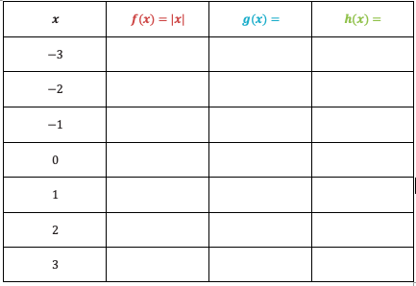
Entry Task – Look back at classwork 10
Let $f\left(x\right)=\left|x\right|$, $g\left(x\right)=f(x−3)$, and $h\left(x\right)=f(x+2)$, where $x$ can be any real number.
Write the formula for $g(x)$ in terms of $\left|x\right|$, without using $f(x)$ in the formula
Write the formula for $h(x)$ in terms of $\left|x\right|$, without using $f(x)$ in the formula
Complete the table of values for these functions.

Slide 22
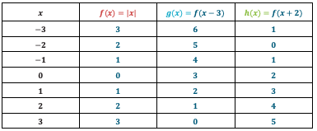
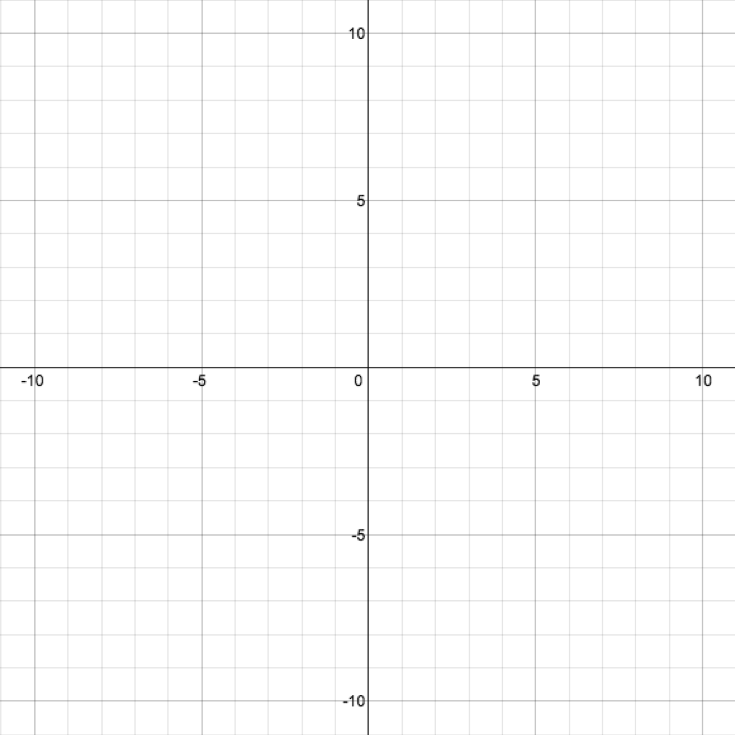
Example
Graph the equations:

Slide 23
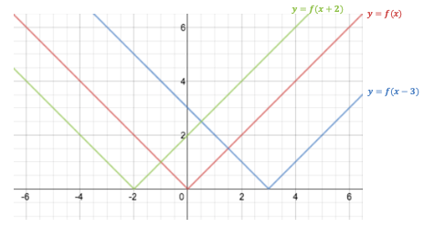
Example, continued
How does the graph of $y=f\left(x\right)$ relate to the graphs of $y=f\left(x−3\right)$ and $y=f(x+2)$?
How is the different from $y=f\left(x\right)+2$or $y=f\left(x\right)−3$?

Slide 24
Notes -
Like in the last lesson, we did not have to use $f\left(x\right)=\left|x\right|$ like we did in this lesson – these transformations will hold true for any parent function.
Adding or subtracting a value to the input of an equation shifts the graph left or right.
Counterintuitively, adding shifts left and subtracting
shifts right.
AGAIN: $y=f\left(x\right)+3$ is NOT the same as $y=f(x+3)$

Slide 25
Workshop
Must Do
May Do
Complete classwork17
Classwork 18 #1-5
Complete cw #15-16
Extension activity
Khan Academy
Crossing River/Carnival Bears
Linear Equation practice
Exponents
Slope practice

Slide 26
Lesson 19
Entry, examples, classwork, notes, summary

Slide 27
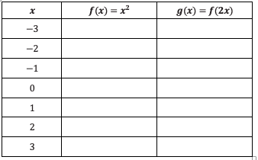
Entry/example
Let $f\left(x\right)=x^{2}$ and $g\left(x\right)=f(2x)$, where $x$ can be any real number.
Write the formula for $g$ in terms of $x^{2}$ without using $f(x)$ in the formula.
Complete the table of values for these functions.

Slide 28
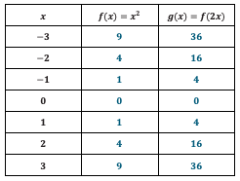
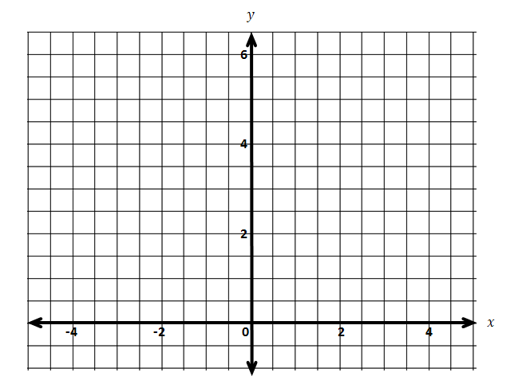
Example
Graph the equations:

Slide 29
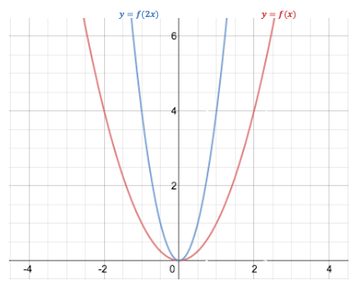
Example, continued
How does the graph of $y=f\left(x\right)$ relate to the graph of $y=f\left(2x\right)$?

Slide 30
Notes -
Like in the last lesson, we did not have to use $f\left(x\right)=x^{2}$ like we did in this lesson – these transformations will hold true for any parent function.
Multiplying a value by the input of an equation stretches or shrinks the graph horizontally.
positive fraction – shrinks horizontally
positive whole number – stretches horizontally
negative number – flips over y-axis
Side note – a function that satisfies $f\left(x\right)=f(−x)$ for all x values is called an even function. It will be symmetrical across y-axis

Slide 31
Workshop
Must Do
May Do
Exit ticket 17-18?
Classwork 19 #1-2
Complete cw #15-18
Extension activity
Khan Academy
Crossing River/Carnival Bears
Linear Equation practice
Exponents
Slope practice

Slide 32
Lesson 20
Warm up, summarize, classwork

Slide 33
Warm Up
A transformation of the absolute value function $f\left(x\right)=\left|x−3\right|$ is rewritten here as a piecewise function. Describe in words how to graph this piecewise function.
$$f\left(x\right)=\left\{\begin{aligned}−x+3, x<3 \\ x−3, x≥3\end{aligned}\right.$$

Slide 34
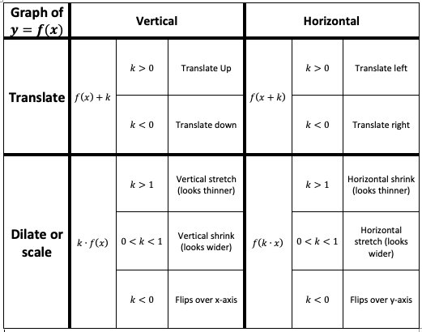
Summary/Review
Fill in the blanks of the table with the appropriate heading or descriptive information.

Slide 35
Workshop
Must Do
May Do
Classwork20 #1-3
Exit ticket 19-20
Complete cw #15-19
Extension activity
Khan Academy
Crossing River/Carnival Bears
Linear Equation practice
Exponents
Slope practice

