Slide 1
Lesson 11
Warm up, intro, example, notes, classwork

Slide 2
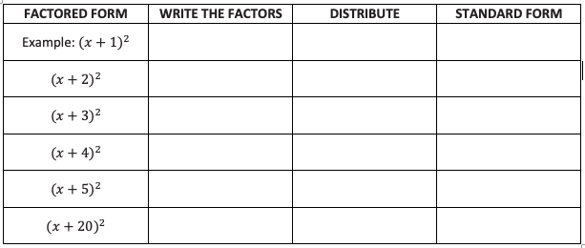
Warm Up
Rewrite the following perfect square quadratic expressions in standard form. Describe patterns in the coefficients for the factored form, ${\left(x+A\right)}^{2}$, and the standard form, $x^{2}+bx+c$.
$$(x+1)(x+1)$$
$$x^{2}+1x+1x+1$$
$$x^{2}+2x+1$$

Slide 3
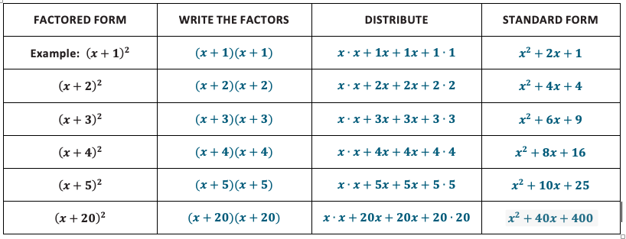
Warm Up
Rewrite the following perfect square quadratic expressions in standard form. Describe patterns in the coefficients for the factored form, ${\left(x+A\right)}^{2}$, and the standard form, $x^{2}+bx+c$.

Slide 4
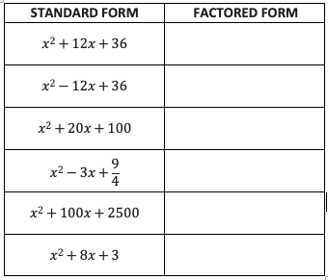
Example, part 1
Now try working backward. Rewrite the following standard form quadratic expressions as perfect squares.
What’s different about the last row?
How could you change it so that it could be a perfect square?

Slide 5
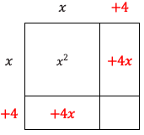
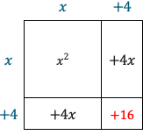
Example, part 2
Find an expression equivalent to $x^{2}+8x+3$ that includes a perfect square binomial.
To be a perfect square, want the same factors on each side of the square.
To “complete the square” the corner should have 16, but we only have 3.
To adjust, we need to add 13, but this would not be balanced, so we add AND subtract 13:
$$x^{2}+8x+3+13−13$$
Regroup:
$${(x}^{2}+8x+16)−13$$
$${(x+4)}^{2} −13$$

Slide 6
Notes – Completing the Square
In order to rewrite a quadratic expression or equation as a perfect square binomial, the 3rd term (c) must be half of the middle term (b), squared.
If it isn’t already, you can adjust the expression or equation. In doing so, make sure you maintain equivalency:
Expression (Lesson 11-12): add AND subtract the same number (so you are really just adding 0).
Equation (Lesson 13 and beyond): do the same thing to both sides of the equation

Slide 7
Classwork
Must Do
May Do
Classwork11 #1 - 8
Reflection questions
Khan Academy
Exponents review
Linear equation practice
Slope practice
Test completion
Classwork11 #9-10

Slide 8
Lesson 12
Warm Up, example, notes, example, classwork

Slide 9
Warm Up
Rewrite each expression by completing the square. (Think about structure)
$z^{2}−5z+8$ $x^{2}+0.6x+1$

Slide 10
Example 1
Complete the square for$2x^{2}+16x+3$.

Slide 11
Notes – Business Application Vocab
Unit Price: The price per item a business sets to sell its product.
Quantity: The number of items sold.
Revenue: The total income based on sales.
Unit or Production cost: The cost of producing one item.
Profit: The amount of money a business makes.
The following business formulas are used in this and the remaining lessons in the unit:
$$Total Production Costs=(unit cost)(quantity of items sold)$$
$$Total Revenue=(unit price)(quantity of items sold)$$
$$Profit=Total Revenue−Total Production Costs$$

Slide 12
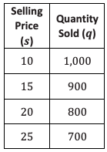
Example 2
A certain business is marketing its product and has collected data on sales and prices for the past few years. The company determined that when it raised the selling price of the product, the number of sales went down. The cost of producing a single item is $\$10$.
Using the data the company collected in this table, determine a linear expression to represent the quantity sold, $q$.
Now find an expression to represent the profit, P.

Slide 13
Workshop
Must Do
May Do
Classwork12 #1-6
Summary/Reflection
Complete cw #11
Khan Academy
Crossing River/Carnival Bears
Linear Equation practice
Exponents review
Slope practice

Slide 14
Lesson 13
Warm up, example, notes, example classwork

Slide 15
Warm Up
Solve the equation for $b$: $2b^{2}−9b=3b^{2}−4b−14$
Rewrite by completing the square: $\frac{1}{2}b^{2}−4b+13$

Slide 16
Example 1
Solve for $x: 12=x^{2}+6x$

Slide 17
Example 1, follow up
-3 is an example of a rational number and $\sqrt{21}$ is an example of an irrational number. Use this to try and find what each column has in common.

Slide 18
Notes
Rational number: Any real number that CAN be written as a fraction. This includes repeating and terminating decimals.
Irrational number: Any real number that CANNOT be written as a fraction. This includes square roots of non-perfect squares, decimals that do not repeat or terminate, and $π$
The sum or product of two rational numbers is always a rational number.
The sum or product of a rational number and an irrational number is an irrational number (unless the rational number is 0 in multiplication).
Completing the square is good for solving quadratics with irrational solutions (nearly impossible by factoring).

Slide 19
Example 2
Solve for $x: 4x^{2}−40x+94=0.$ TWO APPROACHES
$$4x^{2}−40x+94=0$$
$$4{(x−5)}^{2} − 6=0$$
$$4{(x−5)}^{2} =6$$
$$4x^{2}−40x=−94$$
$$4{(x−5)}^{2} =6$$

Slide 20
Classwork
Must Do
May Do
Exit ticket 11-12
Classwork13 #1-4
Reflection/summary question
Khan Academy
Exponents review
Linear practice
Slope practice
Test rewrites

Slide 21
Lesson 14
Warm up, intro, notes, examples, classwork

Slide 22
Warm Up
Solve for $x$ by completing the square: $x^{2}+2x=8$.
Solve for $p$ by completing the square: $7p^{2} 12p+4=0$.
Which of these problems makes more sense to solve by completing the square? Which makes more sense to solve by factoring? How could you tell early in the problem solving process which strategy to use?

Slide 23
Intro
Solve this equation for $x: ax+b=0$
Using the same basic process, but MUCH more complicated as shown on the next slide, the QUADRATIC FORMULA was derived from the standard form of a quadratic equation: $ax^{2}+bx+c=0$

Slide 24
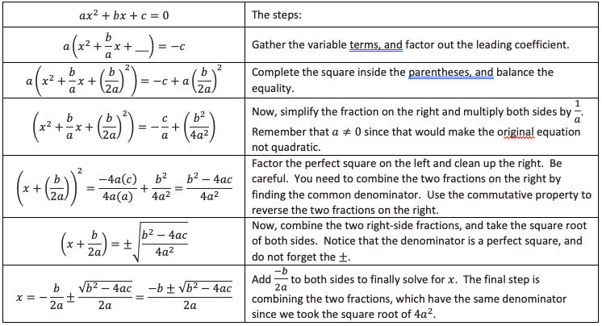

Slide 25
Notes – The Quadratic Formula
The method that will ALWAYS work for any quadratic equation, when in STANDARD FORM and equal to 0, is the
quadratic formula: $x=\frac{−b±\sqrt{b^{2}−4ac}}{2a}$
“x equals the opposite of b plus or minus the square root of the quantity (b-squared minus 4ac), all divided by 2a”
** Note that this can be split into two parts:
$\frac{−b}{2a}±\frac{\sqrt{b^{2}−4ac}}{2a}$
The axis of symmetry/vertex
Step left and right this amount to the x-intercepts

Slide 26
Example
Let’s return to the opening problems and check answers using the quadratic formula:
$x^{2}+2x=8$ $7p^{2}−12p+4=0$

Slide 27
Classwork
Must Do
May Do
Classwork14 #1-6
Summary/reflection
Khan Academy
Exponents review
Linear practice
Slope practice
Test rewrites

Slide 28
Lesson 15
Warm up, classwork, discussion, notes, classwork

Slide 29
Warm Up
Solve the following:
$4x^{2}+5x+3=2x^{2}−3x$ $c^{2}−14=5c$
What are the differences between the two? Is there more than one way to solve? Is one pathway MORE correct than another?

Slide 30
Classwork, part 1
Complete problems 1-5 using the quadratic formula.
THINK:
#1 – what is an easier way to solve this problem?
#2 – what’s confusing about this problem?
#3–5 – how many solutions do these equations have?

Slide 31
Discussion
Describe the solutions of these quadratic equations. What makes these equations different?

Slide 32
Notes
The expression under the radical (square root) is called the discriminant. In the quadratic formula that’s $b^{2}−4ac$.
The value of the discriminant determines the number and type of solutions.
$\sqrt{positive number}$ - two solutions
$\sqrt{0}$ - one solution
$\sqrt{negative number}$ - no solution

Slide 33
Classwork
Must Do
May Do
Exit ticket #11-12
Classwork15 #1-10
Summary question
KhanAcademy
Crossing the River/Carnival Bears
Exponents review
Linear practice
Slope practice
Classwork15 #11-12
Make up classwork 11-14

Slide 34
Lesson 16
Warm up, review, examples, notes, classwork

Slide 35
Warm Up
On your graphing calculator, graph the equations
$y=x^{2}$, $y={\left(x−2\right)}^{2}$ and $y={\left(x+2\right)}^{2}$
on the x-interval $−3≤x≤3$.
How are the graphs similar? How are they different?
Now, what would you expect the graph of $y={\left(x−5\right)}^{2}$ to look like?

Slide 36
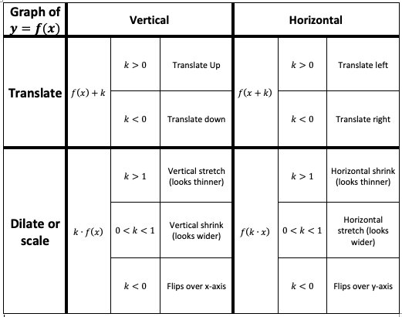
Recall
This chart holds true for quadratic functions.
For the parent function y=x², the vertex is (0,0). Translations move the vertex.

Slide 37
Examples
Without graphing, state the vertex for each of the following quadratic equations.
$y={(x−5)}^{2} + 3$
$y=x^{2}−2.5$
$y={(x+4)}^{2}$
Write a quadratic equation whose graph will have the given vertex.
$(1.9, −4)$
$(0, 100)$
$(−2,\frac{3}{2})$

Slide 38
Notes
Transformations learned in module 3 work for all functions, including quadratic functions.
For the parent function $y=x^{2}$, the vertex is at (0, 0). Translations of this function move the vertex.
For an equation in vertex form: $f\left(x\right)=a{(x−h)}^{2}+k$, the vertex of the graph is at (h, k)
The leading coefficient determines vertical dilation:
Fraction = vertical shrink
Whole number = vertical stretch
Negative = flip over x-axis

Slide 39
Workshop
Must Do
May Do
Exit ticket 14-15
Classwork16
Summary/reflection questions
KhanAcademy
Linear equation practice
Exponents review
Slope practice
Vocabulary work
Lesson 15 extensions

Slide 40
Lesson 17
Warm up to example, notes, classwork

Slide 41
Warm Up
A high school baseball player throws a ball straight up into the air for his math class. The math class was able to determine that the relationship between the height of the ball and the time since it was thrown could be modeled by the function $h\left(t\right)=−16t^{2}+96t+6$, where $t$ represents the time (in seconds) since the ball was thrown, and $h$ represents the height (in feet) of the ball above the ground.
a) What does the domain of the function represent in this context?
b) What does the range of this function represent?
c) At what height does the ball get thrown?

Slide 42
Example (continued from warm up)
The height of the ball in relation to time is modeled by the function $h\left(t\right)=−16t^{2}+96t+6$, where $t$ represents the time (in seconds) since the ball was thrown, and $h$ represents the height (in feet) of the ball above the ground.
d) After how many seconds does the ball hit the ground?

Slide 43
Example (continued from warm up)
The height of the ball in relation to time is modeled by the function $h\left(t\right)=−16t^{2}+96t+6$, where $t$ represents the time (in seconds) since the ball was thrown, and $h$ represents the height (in feet) of the ball above the ground.
Rewritten in (d) as: $h\left(t\right)=−16{\left(t−3\right)}^{2}+150$
e) What is the maximum height that the ball reaches in the air? How long until the ball reaches maximum height?
What features are visible in standard form? What about in vertex form?

Slide 44
Example Summary / Notes
An equation given in standard form quickly reveals the y-intercept (c) and general shape and direction (a) of the graph.
To graph it you can:
--Factor it to find the x-intercepts (when y = 0) and then find the vertex by averaging the x-intercepts.
-- Complete the square to find the vertex and then set equal to 0 and solve to find the x-intercepts
--Use the quadratic formula to find the x-intercepts. Stilll need the vertex.
--Plot the points you know (at least 3 required)

Slide 45
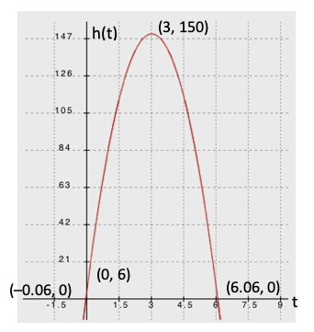
Example, last part
The height of the ball in relation to time is modeled by the function $h\left(t\right)=−16t^{2}+96t+6$, where $t$ represents the time (in seconds) since the ball was thrown, and $h$ represents the height (in feet) of the ball above the ground. Rewritten in (d) as: $h\left(t\right)=−16{\left(t−3\right)}^{2}+150$
Key Features: x and y-intercepts and the vertex
What is an appropriate domain? Range?
What do the 3 and 150 represent?
What do the zeros of the function tell us about the ball’s flight?

Slide 46
Workshop
Must Do
May Do
Classwork17 #1-7
Summary/reflection question
KhanAcademy
Classwork15 extensions
Linear equation practice
Exponents review
Slope practice
Vocabulary section

