Slide 1
Lesson 18
Warm up, opening, classwork/discussion, notes

Slide 2
Warm Up
Evaluate $x^{2}$ when $x=7$.
Evaluate $\sqrt{x}$ when $x=81$.
Evaluate $x^{3}$ when $x=5$.
Evaluate $\sqrt[3]{x}$ when $x=27$.

Slide 3
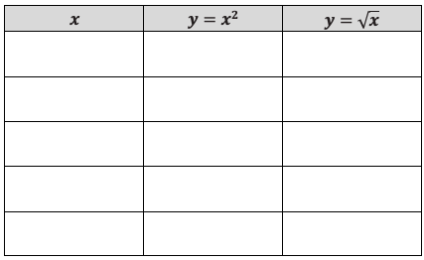
Opening Activity
Use your graphing calculator to create a data table for the functions $y=x^{2}$ and $y=\sqrt{x}$ for a variety of $x$-values. Use both negative and positive numbers, and round decimal answers to the nearest hundredth.

Slide 4
Discussion
Why are all $y$-values for $y=x^{2}$positive?
Why do all negative $x$-values produce an error for $y=\sqrt{x}$?
What is the domain of $y=x^{2}$ and $y=\sqrt{x}$?
What is the range of $y=x^{2}$ and $y=\sqrt{x}$?

Slide 5
Part 2
Complete #1 on your classwork (graph the two equations).
What additional observations can we make when comparing the graphs of these functions?
Why do they intersect at $(0, 0)$ and $(1, 1)$?

Slide 6
Part 3
Complete #2 on your classwork (graph the two equations).
Using the table and graphs, what observations can you make about the relationships between $y=x^{3}$ and $y=\sqrt[3]{x}$?
What are the domain and range of each function?
How are the graphs related to each other?
Describe the symmetry that exists within the tables and graphs.

Slide 7
Notes – Square root, cube, cube root
The square root parent function is a reflection of the quadratic parent function across the line $y=x$, when $x$ is non-negative.
The domain of quadratic, cubic, and cube root parent functions is all real numbers. The domain of the square root parent function is $x≥0$.
The range of quadratic and square root parent functions is $[0, ∞)$. The range of the cubic and cube root parent functions is all real numbers.
The cube root and cubic parent functions are symmetrical about the origin and are reflections of each other across the line $y=x$; the two operations reverse each other.

Slide 8
Classwork
Must Do
May Do
Classwork16-18
Khan Academy
Exponents review
Linear equation practice
Slope practice
Start homework 18

Slide 9
Lesson 19
Warm Up, example, classwork

Slide 10
Warm Up

Slide 11
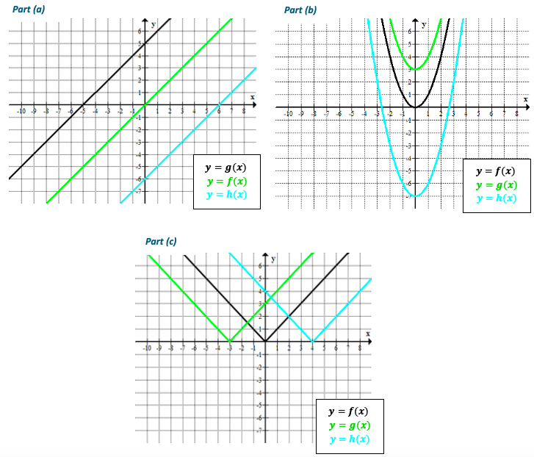

Slide 12
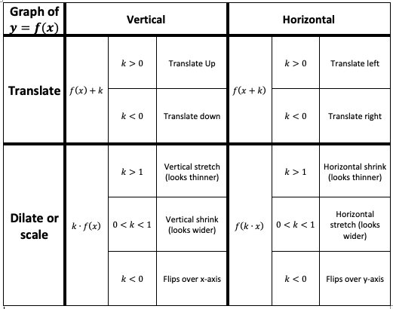

Slide 13
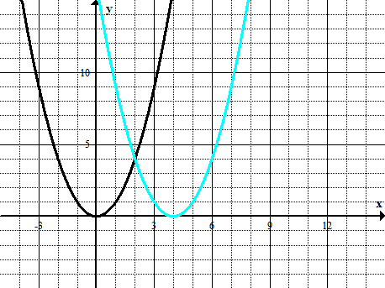
Example
For each graph, answer the following:
What is the parent function?
How does the translated graph relate to the graph of the parent function?
Write the formula for the function depicted by the translated graph.

Slide 14
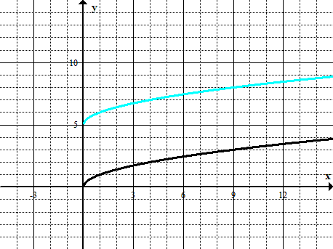
Example
For each graph, answer the following:
What is the parent function?
How does the translated graph relate to the graph of the parent function?
Write the formula for the function depicted by the translated graph.

Slide 15
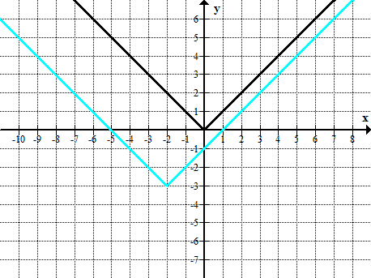
Example
For each graph, answer the following:
What is the parent function?
How does the translated graph relate to the graph of the parent function?
Write the formula for the function depicted by the translated graph.

Slide 16
Workshop
Must Do
May Do
Classwork19 #1-3
Summary/Reflection
Khan Academy
Crossing River/Carnival Bears
Linear Equation practice
Exponents review
Slope practice

Slide 17
Lesson 20-21 Combo
Warm up, review, examples, classwork

Slide 18
Warm Up, part 1
The graph of a quadratic function defined by $f\left(x\right)=x^{2}$ has been translated $5$ units to the left and $3$ units up. What is the formula for the function, $g$, depicted by the translated graph?
Sketch the graph of the equation $y=g(x)$.

Slide 19
Warm Up, part 2
A quadratic function is defined by $g\left(x\right)={2x}^{2}+12x+1$. Write this in the completed-square (vertex) form.
Where is the vertex of the graph of this function located?
Look at the completed-square form of the function. Can you name the parent function? How do you know?
What transformations have been applied to the parent function to arrive at function $g$? Be specific.

Slide 20
Recall

Slide 21
Example 1
Consider the function $f(x)=|x|$. Complete the table of values for $f(x)$ and each transformation of the function $f$. Then graph all 5 equations.

Slide 23
Example 2
The graph of a quadratic function $f(x)=x^{2}$ has been translated $3$ units to the right, vertically stretched by a factor of $4$, and moved $2$ units up. Write the formula for the function that defines the transformed graph.

Slide 24
Classwork
Must Do
May Do
Classwork20-21 #1-6
Reflection/summary question
Khan Academy
Exponents review
Linear practice
Slope practice
Complete old classwork

Slide 25
Lesson 22
Warm up, discussion, notes, examples, classwork

Slide 26
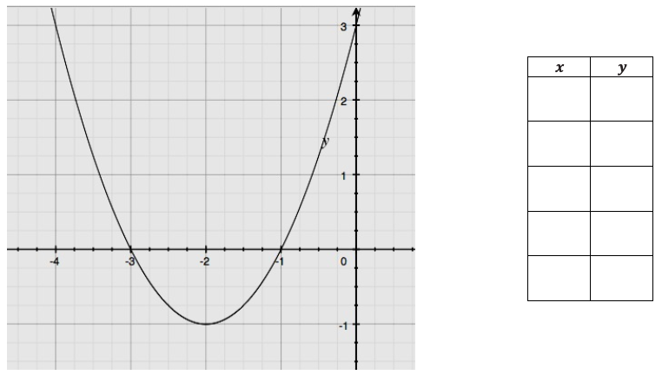
Warm Up
Populate the table on the right with values from the graph.

Slide 27
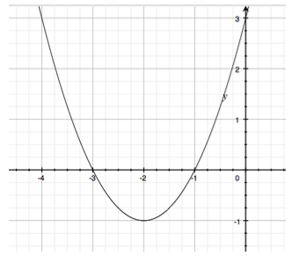
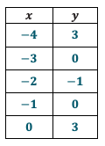
Discussion
What is the vertex of the function? Where in table/graph?
What is the y-intercept? Where in table/graph?
What are the x–intercepts? Where in table/graph?
What components of equations tell us something about graph?
How can features of graph help write equation?

Slide 28
Summary
 | Equation to Graph | Table/Graph to Equation
Standard/Expanded Form: $f\left(x\right)=ax^{2}+bx+c$ | y-intercept given Complete the square to find vertex Factor or quadratic formula to find x-intercepts | Write factored or vertex form first. Then expand and simplify for standard form.
Factored Form: $$f\left(x\right)=a(x−m)(x−n)$$ | x-intercepts given Average the x-coordinates and substitute to get vertex | Substitute x-intercepts. Then use any other point to solve for a.
Vertex Form: $$f\left(x\right)=a{(x−h)}^{2} + k$$ | vertex given Set equal to 0 and solve to get x-intercepts | Substitute the vertex (h, k). Then use any other point for (x, y) and solve for a

Slide 29
Classwork
Must Do
May Do
Exit ticket 19-21?
Classwork22 #1-3
Khan Academy
Exponents review
Linear practice
Slope practice
Note sheet
Folder organize
Complete all cw/hw 1-22

Slide 30
Lesson 23
Warm up reading, long examples, classwork

Slide 31
Warm Up - Read
Any object that is free falling or projected into the air without a power source is under the influence of gravity. All free-falling objects on Earth accelerate toward the center of Earth (downward) at a constant rate ($−32 ft/s^{2}$, or $−9.8$ $m/s^{2}$)
The relationship of the height of the object with respect to the time is the formula: $h\left(t\right)=\frac{1}{2}gt^{2}+v_{0}t+h_{0}$.
For this reason, the leading coefficient for a quadratic function that models the position of a falling, launched, or projected object must either be $−16$ or $−4.9$.
$v_{0}$ indicates the initial velocity (i.e., the velocity at $0$ seconds);
$h_{0}$ tells us the height of the object at$0$ seconds, or the initial position.

Slide 32
Example 1
Chris stands on the edge of a building at a height of $60 ft.$ and throws a ball upward with an initial velocity of $68 ft/s$. The ball eventually falls all the way to the ground. What is the maximum height reached by the ball? After how many seconds will the ball reach its maximum height? How long will it take the ball to reach the ground?
What units will we be using to solve this problem?
What information from the contextual description do we need to use in the function equation?

Slide 33
Example 1, continued
$$h\left(t\right)=−16t^{2}+68t+60$$
What is the maximum point reached by the ball? After how many seconds will it reach that height?
How long will it take the ball to land on the ground after being thrown?

Slide 34
Example 1, continued
$$h\left(t\right)=−16t^{2}+68t+60$$
t-intercepts are $−\frac{3}{4}$ and 5 and vertex at (2.125, 132.25)
Graph the function of the height, $h$, of the ball in feet to the time , $t$, in seconds. Include and label key features of the graph such as the vertex, axis of symmetry, and $t$- and $y$-intercepts.

Slide 35
Example 2
A theater decided to sell special event tickets at $\$10$ per ticket to benefit a local charity. The theater can seat up to $1,000$ people, and the manager of the theater expects to be able to sell all $1,000$ seats for the event. To maximize the revenue for this event, a research company volunteered to do a survey to find out whether the price of the ticket could be increased without losing revenue. The results showed that for each $\$1$ increase in ticket price, $20$ fewer tickets would be sold.
Let $x$ represent the number of $\$1.00$ price-per-ticket increases. Write an expression to represent the expected price for each ticket.

Slide 36
Example 2, continued
A theater decided to sell special event tickets at $\$10$ per ticket to benefit a local charity. The theater can seat up to $1,000$ people, and the manager of the theater expects to be able to sell all $1,000$ seats for the event. To maximize the revenue for this event, a research company volunteered to do a survey to find out whether the price of the ticket could be increased without losing revenue. The results showed that for each $\$1$ increase in ticket price, $20$ fewer tickets would be sold.
Price for each ticket: 10 + 1x, x= number of $1 increases
b) Use the survey results to write an expression representing the possible number of tickets sold.

Slide 37
Example 2, continued
Price for each ticket: 10 + 1x, x= number of $1 increases
Number of tickets sold: 1000 – 20x
c) Write the function, $R$, to represent the total revenue in terms of the number of $\$1$-ticket price increases.

Slide 38
Example 2, continued
Price for each ticket: 10 + 1x, x= number of $1 increases
Number of tickets sold: 1000 – 20x
Revenue = $−20x^{2}+800x+10000$
d) How many $\$1$-ticket price increases will produce the maximum revenue? What is the price that produces maximum revenue and what is the maximum revenue?

Slide 39
Example 2, continued
Price for each ticket: 10 + 1x, x= number of $1 increases
Number of tickets sold: 1000 – 20x
Revenue = $−20x^{2}+800x+10000$
Maximum revenue = $18,000 and $30 per ticket
e) How many tickets will the theater sell to reach the maximum revenue?

Slide 40
Classwork
Must Do
May Do
Exit ticket 22
Classwork22 #1-2
KhanAcademy
Crossing the River/Carnival Bears
Exponents review
Linear practice
Slope practice
Note sheet
Folder organize
Complete all cw/hw 1-23

Slide 41
Lesson 24
Warm up, review, examples, notes, classwork

Slide 42
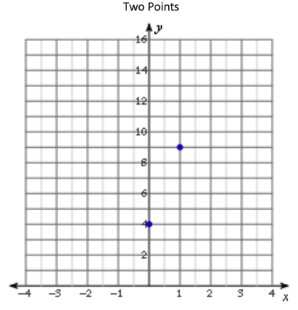
Warm Up
Draw as many quadratic graphs as possible through the following two points on the graph. Check with your neighbors for ideas. These points are $(0,4)$ and $(1,9)$.

Slide 43
Example
Use the points $(0, 4)$, $(1, 9)$, and $(−3, 1)$ to write the equation for the quadratic function whose graph contains the three points.

Slide 44
Workshop
Must Do
May Do
Exit ticket 22
Classwork24 #1-2
KhanAcademy
Linear equation practice
Exponents review
Slope practice
Vocabulary work
Note sheet
Folder
Complete all cw/hw 1-24

Slide 45
Test Content
Matching functions to their graphs
All parent types we’ve talked about
Explain how you knew
Compare linear, exponential, and quadratic functions
Falling object problem
Complete square
Find max, when hits ground
Distributing and factoring
Solving quadratics – you choose method
Solve quadratic, find zeros, vertex, graph

