Slide 1
Lesson 1
Warm up, example, notes, classwork

Slide 2
Warm Up
Take out the function summary chart from yesterday. Talk with your neighbor to fill in any information you missed:
Function type
Overall shape
x- and y-intercepts
Vertex
Symmetry
End behavior
Domain and range (restrictions)

Slide 3
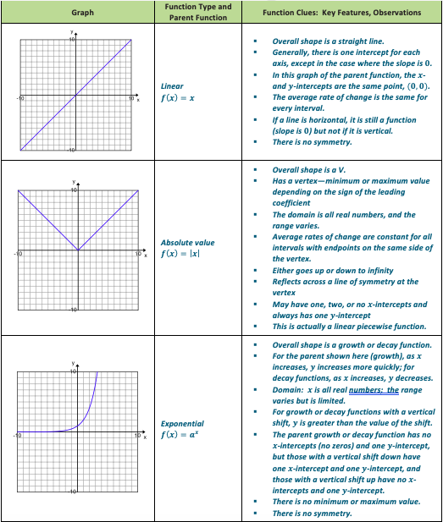

Slide 4
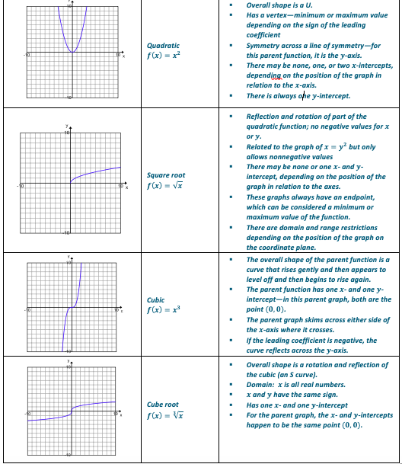

Slide 5
Discussion
When presented with a graph, what is the most important key feature that helps you recognize the type of function it represents?
Which graphs have a minimum or maximum value?
Which have domain restrictions? What are those restrictions?
Which have restrictions on their range?
Which have lines of symmetry?
Which of the parent functions are transformations of other parent functions?
How are you able to recognize the function if the graph is a transformation of the parent function?

Slide 6
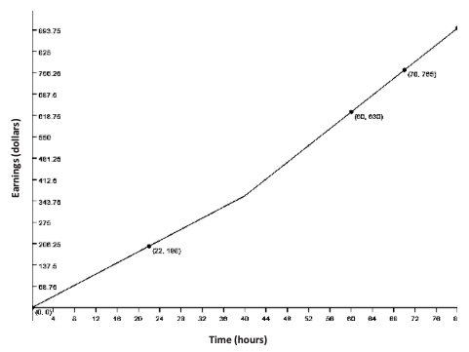
Example
Eduardo has a summer job that pays him a certain rate for the first $40$hours each week and time-and-a-half for any overtime hours. The graph below shows how much money he earns as a function of the hours he works in one week.
Units?
Define the relationship.
Story from graph.
Function type?
4 points enough for equations?
What do you notice about the pieces?

Slide 7
Notes
Graphs can be used to represent a function/model a context.
Advantages: overall picture/story
Disadvantages: estimated values
Advantage of writing an equation to model the situation:
Precise values, predict for values beyond the graph
To write equation:
Identify variables and general relationship
Recognize the parent function and note key features
Notice transformations on the parent function

Slide 8
Classwork
Must Do
May Do
Function summary chart
Classwork1 #1 - 6
Khan Academy
Exponents review
Linear equation practice
Slope practice
Vocabulary in notebook
Flashcards

Slide 9
Lesson 2
Warm up, notes, example, classwork

Slide 10
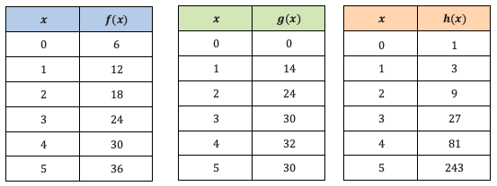
Warm Up
When tables are used to model functions, we typically have just a few sample values of the function and therefore have to do some detective work to figure out what the function might be. Look at these three tables. Can you determine what type of function each represents?

Slide 11
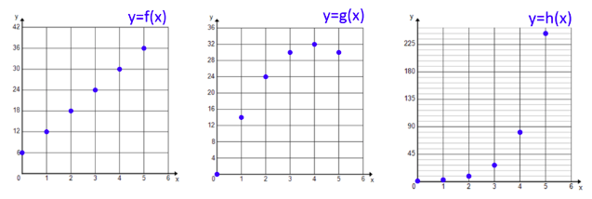
Warm Up
Can you justify your choices with graphs?

Slide 12
Notes
You can determine some functions from their tables:
Linear – constant rate of change in the first differences
Quadratic – pattern in the first differences; second differences are equal; symmetrical (increase then decrease or other way around)
Exponential – multiplying by a constant rate
Absolute value – symmetrical but with constant rate
Square root, cubic, and cube root are really difficult to tell from a table.
Cubic – constant 3rd differences…

Slide 13
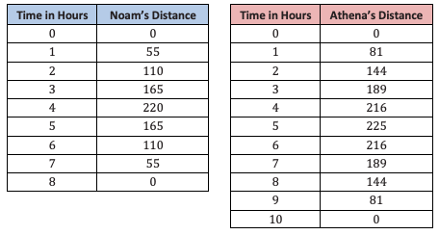
Example
Noam and Athena had an argument about whether it would take longer to get from NYC to Boston and back by car or by train. To settle their differences, they made separate, nonstop round trips from NYC to Boston. On the trip, at the end of each hour, both recorded the number of miles they had traveled from their starting points in NYC. The tables below show their travel times, in hours, and the distances from their starting points, in miles. The first table shows Noam’s travel time and distance from the starting point, and the second represents Athena’s. Use both data sets to justify your answers to the questions below.

Slide 14
Example
Who do you think is driving and who on the train?
How far apart are NYC and Boston?
How long did it take each person to make the round trip?
Which was faster?
What if you compare rates of change?
Noam says both are quadratic. Do you agree?

Slide 15
Classwork
Must Do
May Do
Classwork2 #1 - 2
Khan Academy
Exponents review
Linear equation practice
Slope practice
Vocabulary in notebook
Flashcards
Classwork1
PARCC practice packet

Slide 16
Lesson 3
Warm up, notes, examples, classwork

Slide 17
Placement Test Prep
A spinner for a game is circular shaped and has 5 equal sections. Each section is labeled with the numbers 1-5. Draw it.
What is the sample space of the spinner?
What is the probability of spinning a 2? 3? 5? 0?
What is the experimental probability of landing on 3 when the spinner is spun 700 times and the spinner lands on 3 240 times?
How does the answer for c relate to the theoretical probability in b?
Would you consider this spinner to be “fair”?

Slide 18
Warm Up
Take a minute and brainstorm situations we have looked at that are generally represented by linear, exponential, and quadratic functions.
Linear Exponential Quadratic

Slide 19
Notes
Linear relationships: relating two quantities, usually in different units and at uniform or consistent rate (indicated with “per”).
EX: distance/time, dollars/pound, students/class, miles/gallon,, pills/bottle… possibilities are limitless!
--May also include inequalities with a maximum or minimum
Quadratic relationships: free falling objects or projectiles, area problems where side lengths are linear and variable
Exponential relationships: growth or decay of money, percent growth or decay, radioactive material, population
Special case: compound interest problems use the formula
$P\left(n\right)=P_{0}{(1+\frac{r}{n})}^{nt}$, where
$P_{0}$ is the initial investment,
r is the rate as a decimal,
n is the number of times compounded per year, and
t is in years.

Slide 20
Example 1
Gregory plans to purchase a video game player. He has $\$500$ in his savings account and plans to save $\$20$ per week from his allowance until he has enough money to buy the player. He needs to figure out how long it will take. What type of function should he use to model this problem? Justify your answer mathematically.

Slide 21
Example 2
One of the highlights in a car show event is a car driving up a ramp and flying over approximately five cars placed end-to-end. The ramp is $8 ft$ at its highest point, and there is an upward speed of $88 ft/sec$ before it leaves the top of the ramp. What type of function can best model the height, $h$, in feet, of the car $t$ seconds after leaving the end of the ramp? Justify your answer mathematically.

Slide 22
Example 3
Margie got $\$1,000$ from her grandmother to start her college fund. She is opening a new savings account and finds out that her bank offers a $2\%$ annual interest rate, compounded monthly. What type of function would best represent the amount of money in Margie’s account? Justify your answer mathematically.

Slide 23
Classwork
Must Do
May Do
Classwork3 #1 – 4
Summary question
Khan Academy
Exponents review
Linear equation practice
Slope practice
Vocabulary in notebook
Flashcards
PARCC practice packet

Slide 24
Lesson 4
Warm up, example, classwork

Slide 25
Placement Test Prep
You roll two (6-sided) number cubes, a red one and a white one. Find each probability:
P(5,2)
P(5, odd #)
P(3,3)
P(even #, odd #)
P(4,4)
P(less than 5, 6)

Slide 26
Warm Up
Look at the card you were given (equation or a graph).
--If you have an equation, try to picture what the graph will look like.
--If you have a graph, try to think about what the equation should be.
Go find your match!

Slide 27
Modeling
Lessons 1-3 (and the matching warm up) focused on the first two or three steps of the this cycle:
Given a problem, formulate the function/model with an equation, graph, and/or table.
Lessons 4-9 focus on the entire cycle

Slide 28
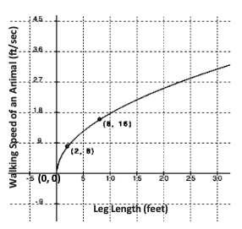
Example
The relationship between the length of one of the legs, in feet, of an animal and its walking speed, in feet per second, can be modeled by the graph below. Note: This function applies to walking not running speed. Obviously, a cheetah has shorter legs than a giraffe but can run much faster. However, in a walking race, the giraffe has the advantage.
A T-Rex’s leg length was $20$ ft. What was the T-Rex’s speed in $ft/sec$?
First – estimate an answer using the graph to get a ballpark answer!

Slide 29
Example
A T-Rex’s leg length was $20$ ft. What was the T-Rex’s speed in $ft/sec$?
Now, what are the units involved?
What type of function does this graph represent?
Possible transformations:
$a\sqrt{x}$, $\sqrt{ax}$, $\sqrt{x}±b$, $\sqrt{x±b}$

Slide 30
Example
A T-Rex’s leg length was $20$ ft. What was the T-Rex’s speed in $ft/sec$?
$$\sqrt{x}±b$$
$$\sqrt{x±b}$$
Not these two because vertex at (0,0) like the parent function.
$$a\sqrt{x}$$
$\sqrt{ax}$
Use the points and see:

Slide 31
Example
A T-Rex’s leg length was $20$ ft. What was the T-Rex’s speed in $ft/sec$?
Finish the problem!
$f\left(x\right)=\sqrt{32x}$

Slide 32
Classwork
Must Do
May Do
Classwork4 #1 – 3
Khan Academy
Exponents review
Linear equation practice
Slope practice
Vocabulary in notebook
Flashcards
PARCC practice packet

Slide 33
Lesson 5
Warm up, review, examples, classwork

Slide 34
Placement Test Prep
Find the probability of each event. Use a standard deck of 52 playing cards P(5,2) a) P (heart) b) P (heart, heart) [without replacement]
c) P (heart, heart, heart) [w/ replacement]
d) P (heart, heart, heart, heart) [w/o replacement]

Slide 35
Warm Up
Open your notebook and review your notes and examples from module 3 lessons 1, 2, and 3 (about arithmetic and geometric sequences).

Slide 36
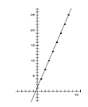
Recall
A sequence is a list of numbers or objects in a special order.
Arithmetic Sequence: goes from one term to the next by adding (or subtracting) the same value.
This form is called the explicit formula and may also be written using subscripts, $a_{n}=3n+1$.
For some sequences, it is appropriate to use a recursive formula, which defines the terms of the sequence based on the term before. In this case, $f\left(n+1\right)=f\left(n\right)+3$, $f(1)=4$, or using subscript notation, $a_{n+1}=a_{n}+3$.

Slide 37
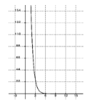
Recall
A sequence is a list of numbers or objects in a special order.
Geometric Sequence: goes from one term to the next by multiplying (or dividing) by the same value.
The explicit formula for this sequence, $f(n)=400{\left(\frac{1}{4}\right)}^{(n−1)}$
The recursive formula, in this case, g$\left(n+1\right)=\frac{1}{4}g\left(n\right)$, $g(1)=400$, or using subscript notation, $a_{(n+1)}={\frac{1}{4}a}_{n}$.

Slide 38
Example 1
Determine whether the sequence below is arithmetic or geometric, and find the function that will produce any given term in the sequence:
$$16, 24, 36, 54, 81, …$$
Is this sequence arithmetic?
Is the sequence geometric?
What is the analytical representation of the sequence?

Slide 39
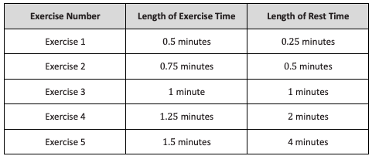
Example 2
A soccer coach is getting her students ready for the season by introducing them to High Intensity Interval Training (HIIT). She presents the table below with a list of exercises for a HIIT training circuit and the length of time that must be spent on each exercise before the athlete gets a short time to rest. The rest times increase as students complete more exercises in the circuit. Study the chart and answer the questions below.
Quantities and variables?
What type(s)?

Slide 40
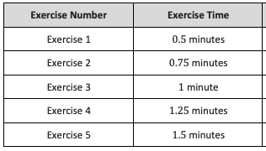
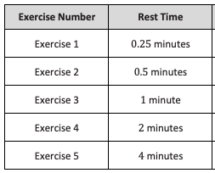
Example 2, continued
Exercise time: Rest time:
Type? Type?
Equation? Equation?
How long for 10th exercise? How much rest?

Slide 41
Example 2, continued
If a student has up to $30$ minutes of actual gym time during a soccer practice, how many exercises in the circuit would she be able to complete? Explain your answer.
Exercise # | Ex. Time | Rest Time | Total Time

Slide 42
Classwork
Must Do
May Do
Classwork5 #1 – 3
Summary question
Khan Academy
Exponents review
Linear equation practice
Slope practice
Vocabulary in notebook
Flashcards
PARCC practice packet

Slide 43
Lesson 6
Warm up, example, classwork

Slide 44
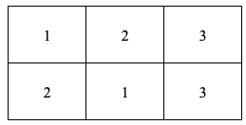
Placement Test Prep
For a certain carnival game, you can win a prize by throwing two darts at the square board pictured below. Find the following probabilities:
a. P (even number the first dart) =
b. P (even number, odd number) =
c. P (even, even) =
d. P (2, 3) =
e. P (sum of 4) =
f. P (2,2) =

Slide 45
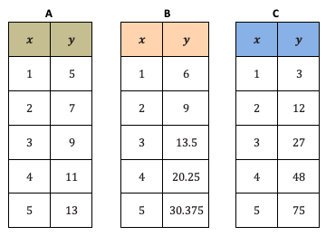
Warm Up
For your assigned table: identify the type of function, write an equation, and make a graph.

Slide 46
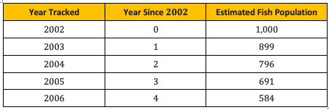
Example
Enrique is a biologist who has been monitoring the population of a rare fish in Lake Placid. He has tracked the population for $5$years and has come up with the following estimates:
Create a graph.
Predict when fish population will be
gone.

Slide 47
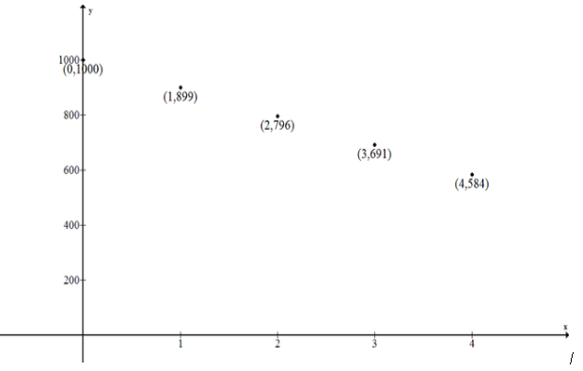
Example
Although the graph looks linear, the first differences are 101, 103, 105, 107.. Indicating a constant second difference and quadratic pattern. SCALES ON GRAPHS CAN MAKE THINGS DECEIVING

Slide 48
Example
Use points to find equation: (0, 1000) (1, 899) (2, 796)
Use equation to find when population gone.
How else could you have answered question?

Slide 49
Classwork
Must Do
May Do
Classwork6 #1 – 3
Khan Academy
Exponents review
Linear equation practice
Slope practice
Vocabulary in notebook
Flashcards
PARCC practice packet

Slide 50
Lesson 7
Warm up/review, examples, classwork

Slide 51
Warm Up
Go back through your MODULE 2 notes to review the content about data collection and statistics.

Slide 52
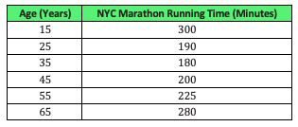
Example
What is this data table telling us about?
What function type appears to best suit this data?
Can we model this data precisely using methods from lessons 1-6?
What questions might we want to ask?

Slide 53
Review
Remember that in Module 2, we used a graphing calculator to find a linear regression model and then analyze how well the model actually fit the data. The calculator can do these same calculations for quadratic and exponential regressions, too.
Get our your calculator handbook and review calculating/graphing a regression line, residual plot, and the correlation coefficient.
The only new piece that when judging the strength of a quadratic model, we use the $r^{2}$ (coefficient of determination).
This is because it won’t ever be negative (squared…) and you don’t want the direction for non-linear functions.

Slide 54
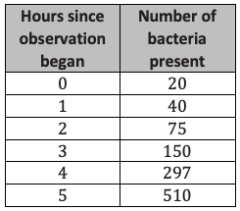
Example 2
Enter this into your calculator.
Find the exponential regression equation, store in Y1, and create scatterplot with the regression curve.
Make sure DIAGNOSTIC ON is selected under CATALOG and find the values of $r$ and $r^{2}$. What do these values mean?

Slide 55
Example 1, revisited
Enter this into your calculator.
Find the regression equation that best fits the data.
--How exact do our numbers need to be?
--Why is all data in quadrant 1 and no zeros?
--What is the best age to run a marathon?
--Based on model, what time would a 50-year old get?

Slide 56
Classwork
Must Do
May Do
Classwork7 #1 – 2
Summary question
Exponents review
Linear equation practice
Slope practice
Vocabulary in notebook
Flashcards
PARCC practice packet

Slide 57
Lesson 8
Warm up/review, examples, classwork

Slide 58
Warm Up
Go back through your MODULE 4 notes to review the material on business: revenue, costs, and profit.
Also review the notes from lesson 5 of this module about compound interest.

Slide 59
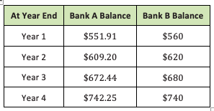
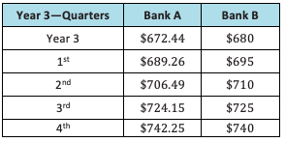
Example 1
Christine has $\$500$ to deposit in a savings account, and she is trying to decide between two banks. Bank A offers $10\%$ annual interest compounded quarterly (4 times per year).
Bank B offers to add $\$15$quarterly to any account with a balance of less than $\$1,000$ for every quarter, as long as there are no withdrawals.
Christine has decided that she will neither withdraw, nor make a deposit for a number of years. Develop a model that will help Christine decide which bank to use.
Bank A: $A(t)=500{\left(1+\frac{0.10}{4}\right)}^{4t}$ or $500{\left(1.025\right)}^{4t}$
Bank B: $B(t)=500+60t$ (Since her money earns $\$15$quarterly, then $\$15\left(4\right)$, or $\$60$ per year.)

Slide 60
Example 2
The revenue of a company for a given month is represented as $R\left(x\right)=1,500x−x^{2}$ and its costs as $C\left(x\right)=1,500+1,000x$. What is the selling price, $x$, of its product that would yield the maximum profit? Show or explain your answer.

Slide 61
Classwork
Must Do
May Do
Classwork8 #1 – 3
Exponents review
Linear equation practice
Slope practice
Vocabulary in notebook
Flashcards
PARCC practice packet
Note sheet
Folder

Slide 62
Lesson 9
Warm up, classwork

Slide 63
Warm Up
What does it mean to attend to precision when modeling in mathematics?

Slide 64
Classwork
Must Do
May Do
Create a poster for your assigned problem.
Title
Answer all parts
Work shown
Graphs/tables/equations included as dictated
Should show the modeling cycle!
Khan Academy
Exponents review
Linear equation practice
Slope practice
Vocabulary in notebook
Flashcards
PARCC practice packet
Note sheet
Folder

Slide 65
Test Content
Comparing two options for payment to determine which is best (module 3)
-- Write equations, sketch graph and determine when each option better
Choose best type of function from table (module 4)
-- Choose type and explain why; Write equation; Analyze
Cost/Revenue/Profit problem
Using regressions to choose best model and then predict (modules 2, 5)
Analyzing quadratic (module 4)
-- Use vertex to write equation
-- Rate of change comparison
Compare quadratic and absolute value functions (module 5)
-- Tables; Graphs; Equations
Flatland questions

