Slide 1
Congruence
Eureka Math
8th Grade Module 2

Slide 2
Lesson 1
Notes, workshop

Slide 3
Given two segments, how can we find out if they are the same length without measuring them?

Slide 4
For example, given a quadrilateral where all angles are 90 degrees, are the opposite sides equal?

Slide 5
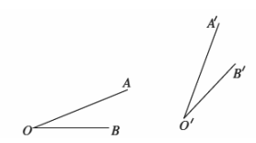
Given two angles, how can we tell if they have the same degree without measuring?

Slide 6
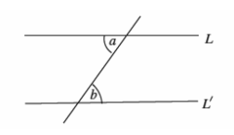
For example, given two parallel lines cut by another line, how can we tell if angles a and b are the same degree?

Slide 7
Notes: Transformations
So if we want to know if two figures (lines, angles, or shapes) are the same, we need to see if we can move one onto the other and if they line up perfectly.
There are three standard moves we can use: slides, flips, and turns.
Key question: How do we move things around while keeping the lines and angles the same?

Slide 8
Transformation - Vocabulary
Transformation – Moving things around on a plane
Image – the copy or duplicate figure
P’ / “P-prime” – Used for referring to points on the image. Sometimes called F(P)
Map – A verb used to describe transforming an original onto an image
Distance-preserving – Keeping line segments equal length
Rigid motion – Another name for distance preserving transformations

Slide 9
Workshop
Must Do
May Do
Exploratory challenge
Khan Academy
Test corrections
Test make up
PARCC tasks
24 or Set
Fluency games

Slide 10
Lesson 2
Notes, Examples, workshop

Slide 11
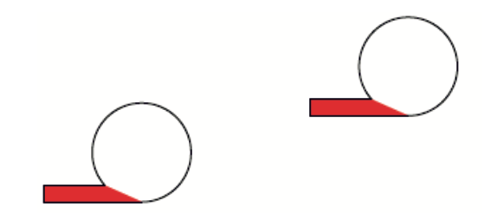
What’s the easiest transformation?

Slide 12
Notes - Translations
Vector – a directed line segment
Translation – a slide along a given vector

Slide 13
Example 1

Slide 14
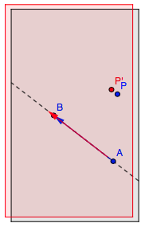
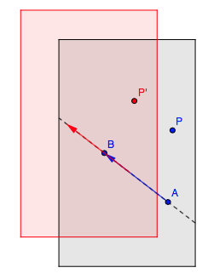
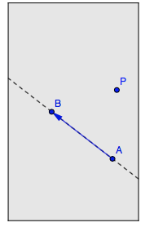
Example 2
http://www.harpercollege.edu/~skoswatt/?RigidMotions/translation.html

Slide 15
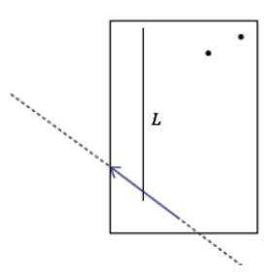
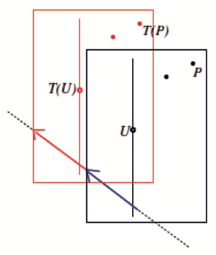
Example 3

Slide 16
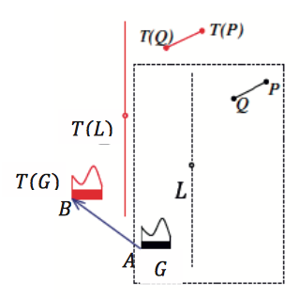
Example 4

Slide 17
Workshop
Must Do
May Do
Classwork #1 & 2
Khan Academy
Fluency practice
Integer coloring
Integer practice online
Integer war
Flashcards
Test rewrites
PARCC questions

Slide 18
Lesson 3
Example, notes, workshop

Slide 19
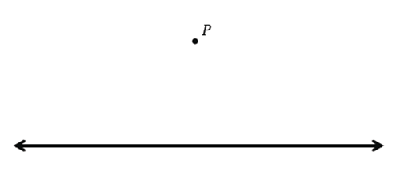
Example (exercise1)

Slide 20
Notes - Translations
Translation – a slide along a given vector
Map lines to lines and angles to angles
Distances and angle measures are preserved
Translating a line creates the same line or a parallel line

Slide 21
Workshop
Must Do
May Do
Classwork #2 - 6
Khan Academy
Fluency practice
Integer coloring
Integer practice online
Integer war
Flashcards
Test rewrites
PARCC questions

Slide 22
Lesson 4
Exit ticket, Example & notes, workshop?

Slide 23
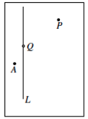
Example 1
http://www.harpercollege.edu/~skoswatt/RigidMotions/reflection.html

Slide 24
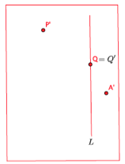
Example 1
http://www.harpercollege.edu/~skoswatt/RigidMotions/reflection.html

Slide 25
Example 1
http://www.harpercollege.edu/~skoswatt/RigidMotions/reflection.html

Slide 26
Notes - Reflections
Reflection – a flip over a given line
Maps points to points, lines to lines and angles to angles, etc.
All points are the same distance from the line of reflection as their reflection points.
The line connecting a point and its reflection is perpendicular to the reflection line.
Other vocab:
Parallel – lines that will never intersect
Perpendicular – lines that meet at right angles (90°)

Slide 27
Notes – so far…
Translation – a slide along a given vector
Maps lines to lines and angles to angles, etc.
Distances and angle measures are preserved
Translating a line creates the same line or a parallel line
Reflection – a flip over a given line
Maps points to points, lines to lines and angles to angles, etc.
All points are the same distance from the line of reflection as their reflection points.
The line connecting a point and its reflection is perpendicular to the reflection line.

Slide 28
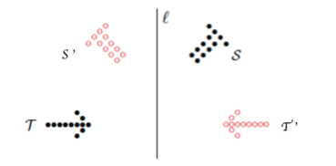
Example 2

Slide 29
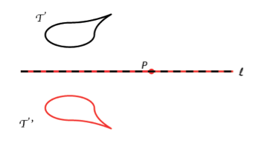
Example 3

Slide 30
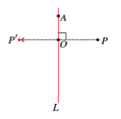
Example 4

Slide 31
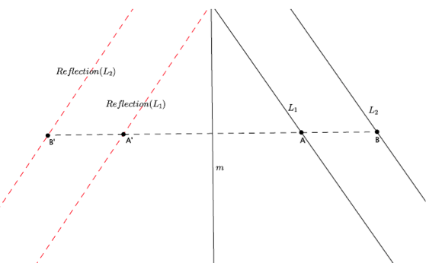
Example 5

Slide 32
Notes
Translation – a slide along a given vector
Maps lines to lines and angles to angles, etc.
Distances and angle measures are preserved
Translating a line creates the same line or a parallel line
Reflection – a flip over a given line
Maps lines to lines and angles to angles, etc.
Distances and angle measures are preserved
All points are the same distance from the line of reflection as their reflection points.
The line connecting a point and its reflection is perpendicular to the reflection line.

Slide 33
Workshop
Must Do
May Do
Classwork #1 - 9
Khan Academy
Fluency practice
Integer coloring
Integer practice online
Integer war
Flashcards
Test rewrites
PARCC questions

Slide 34
Lesson 5
Examples & notes, workshop, notes

Slide 35
Example 1
What is the simplest transformation that maps one figure to the other?

Slide 36
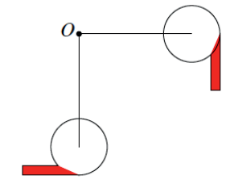
Example 1

Slide 37
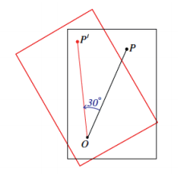
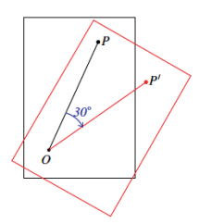
Example 2
Negative rotation
Positive rotation
Notice that the center of rotation never moves.

Slide 38
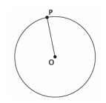
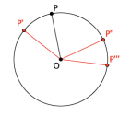
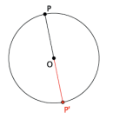
Example 3

Slide 39
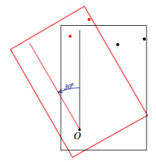
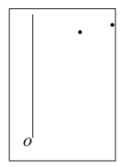
Example 4
http://www.harpercollege.edu/~skoswatt/RigidMotions/rotateccw.html
http://www.harpercollege.edu/~skoswatt/RigidMotions/rotatecw.html

Slide 40
Notes - Rotations
Rotation – a turn around a given point
Center of rotation – the fixed point around which a
figure turns
Maps points to points, lines to lines, angles to angles, etc.
Preserves distances and angle measures
Center of rotation does not move
Positive degrees = counterclockwise, negative degrees = clockwise

Slide 41
Notes – so far
Translation – a slide along a given vector
Maps lines to lines and angles to angles, etc.
Distances and angle measures are preserved
Translating a line creates the same line or a parallel line
Reflection – a flip over a given line
Maps lines to lines and angles to angles, etc.
Distances and angle measures are preserved
All points are the same distance from the line of reflection as their reflection points.
The line connecting a point and its reflection is perpendicular to the reflection line.
Rotation – a turn around a given point
Maps points to points, lines to lines, angles to angles, etc.
Preserves distances and angle measures
Center of rotation does not move
Positive degrees = counterclockwise, negative degrees = clockwise

Slide 42
Workshop
Must Do
May Do
Finish lesson 4 #1-9
Lesson 5 cw #1 - 8
Khan Academy
Fluency practice
Integer coloring
Integer practice online
Integer war
Flashcards
Test rewrites
PARCC questions

Slide 43
Lesson 6
Examples, notes, workshop, exit ticket

Slide 44
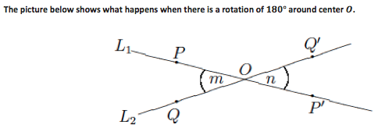
Example 1
The picture below shows what happens when there is a rotation of 180 degrees around center O.

Slide 45
Example 1 continued
The picture below shows what happens when there is a rotation of 180 degrees around center O.

Slide 46
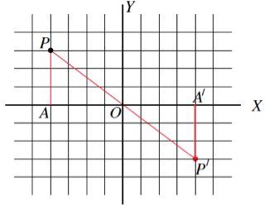
Example 2
The picture below shows what happens when a rotation is 180 degrees around the origin.

Slide 47
Example 2 continued
The picture below shows what happens when a rotation is 180 degrees around the origin.

Slide 48
Notes – so far…
Translation – a slide along a given vector
Maps lines to lines and angles to angles, etc.
Distances and angle measures are preserved
Translating a line creates the same line or a parallel line
Reflection – a flip over a given line
Maps lines to lines and angles to angles, etc.
Distances and angle measures are preserved
All points are the same distance from the line of reflection as their reflection points.
The line connecting a point and its reflection is perpendicular to the reflection line.
Rotation – a turn around a given point
Maps points to points, lines to lines, angles to angles, etc.
Preserves distances and angle measures
Center of rotation does not move
Positive degrees = counterclockwise, negative degrees = clockwise
A 180 degree rotation is special because points fall on the same line, the coordinates become the opposite sign, and lines become parallel

Slide 49
Workshop
Must Do
May Do
Finish lesson 4 #1-9
Finish Lesson 5 cw #1 -8
Lesson 6 cw #1-7
Khan Academy
Fluency games
PARCC questions (sci. notation)

Slide 50
Lesson 7
Examples, notes, workshop, exit ticket

Slide 51
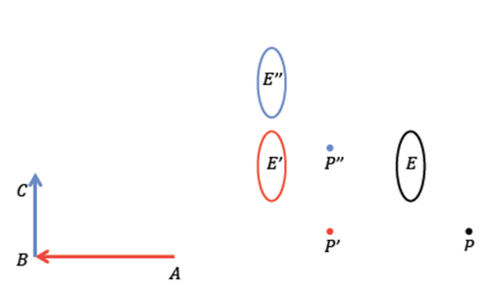
Example 1
Is it possible to translate a figure more than one time?
Suppose we have two translations of point P and ellipse E.

Slide 52
Example 1 - ANIMATED
Is it possible to translate a figure more than one time?
Suppose we have two translations of point P and ellipse E.

Slide 53
Example 1
Is it possible to translate a figure more than one time?
Suppose we have two translations of point P and ellipse E.

Slide 54
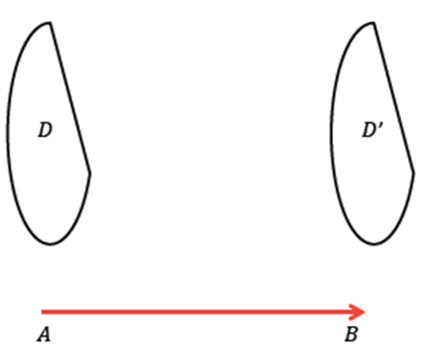
Example 2 - ANIMATED
Why do we need multiple transformations?
How can we translate an image and map it back to itself?

Slide 55
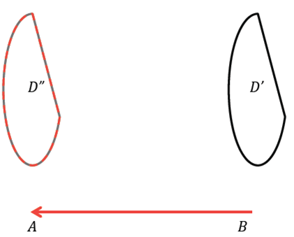
Example 2 continued - ANIMATED
Why do we need multiple transformations?
How can we translate an image and map it back to itself?

Slide 56
Notes – Multiple translations
When you translate a figure along a vector and then translate it again along the same vector in the other direction, you map a figure on to itself.
Use P’’ and P’’’ notation for multiple transformations

Slide 57
Workshop
Must Do
May Do
Finish lesson 6 cw #1-7
Exit ticket
Lesson 7 classwork #1-6
Khan Academy
PARCC tasks on white boards
Fluency

Slide 58
Lesson 8
Examples, notes, workshop,

Slide 59
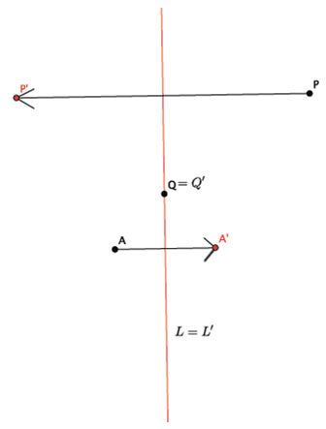
Example 1

Slide 60
Example 2
Let there be a reflection across line L and then a translation along vector AB.
L
A
E
B
E’

Slide 61
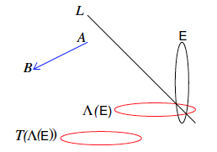

Slide 62
Example 2
Let there be a translation along vector AB then a reflection across line L.
L
A
E
B
E’
E’

Slide 63
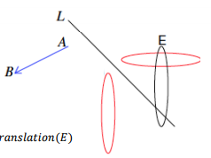

Slide 64
http://youtu.be/O2XPy3ZLU7Y

Slide 65
Notes – multiple reflections/translations
When you reflect a figure over a line and then back again, you map the figure back onto itself.
A reflection then translation does not create the same image as a translation then a reflection. Therefore, the order of transformations matters.

Slide 66
Workshop
Must Do
May Do
Finish lesson 7 cw #1-6
Lesson 8 #1-6
Khan Academy
PARCC Scientific notation
Fluency practice
Online
Puzzles
Flash cards
Integer games

Slide 67
Lesson 9
Workshop, exit ticket, notes

Slide 68
Workshop
Must Do
Can Do
Finish Lesson 8 #1-6
Exit ticket (lesson 7&8)
Lesson 9 #1-5
Khan Academy
Algebra practice (for alg. Students)
Extra practice sheet
PARCC tasks on white boards

Slide 69
Notes
Sequences of rotations still preserve side and angle measures.
The order of rotations around different centers matters.
The order of rotations around the same center does not matter.

Slide 70
Lesson 10
Examples, video, notes, workshop

Slide 71
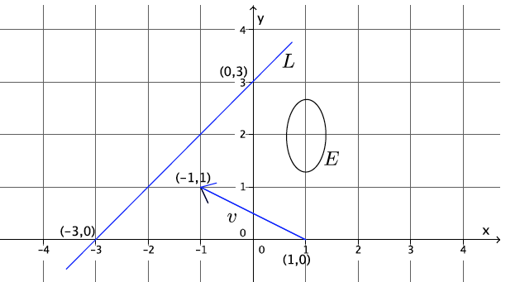
Example
Let E denote the ellipse in the coordinate plane. Let there be a translation along the vector from (1,0) to (-1,1) and let there be a rotation 90 degrees around (-1,1) and a reflection across the line joining (-3,0) and (0,3).
E’
E’’
E’’’

Slide 72
http://youtu.be/O2XPy3ZLU7Y

Slide 73
Notes
Summary: we can move figures around a plane by using and combining translations, reflections, and rotations.
When describing them:
Translations – need to give/show a vector that tells distance and direction.
Reflections – need to give/draw the line of reflection
Rotations – need to give a center and direction of rotation.

Slide 74
Notes – Using the transparency
Translation:
Trace entire figure(s) and the vector
Slide the transparency along the vector
Re-draw the figure (the image) and label it
Reflection:
Travel entire figure(s) and line of reflection
Pick up transparency and flip over the line
Re-draw the figure (image) and label it
Rotation:
Trace the entire figure(s) and center of rotation
Keep center in place and turn transparency
Positive = counterclockwise; negative = clockwise

Slide 75
Workshop
Must Do
May Do
Finish Lesson 9 #1-5
Lesson 10 #1-5
Khan Academy
PARCC tasks on white boards
Fluency games
Notes sheet
Folder organize
Make up work

Slide 76
Workshop
Must Do
May Do
Finish ALL CW & HW problems!!!
Khan Academy
Extra practice sheet
PARCC tasks on transparency sheets (sci. notation)
Folder organize
Note sheet

Slide 77
Lesson 11
Examples, notes, workshop

Slide 78
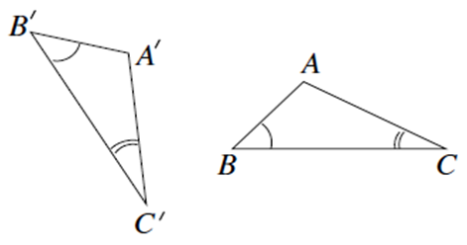
Example 1
Describe a sequence of rigid motions (transformations) that show these two triangles are congruent.
Therefore we have shown that these figures are congruent through a translation and rotation, which we know preserve lengths and angles.

Slide 79
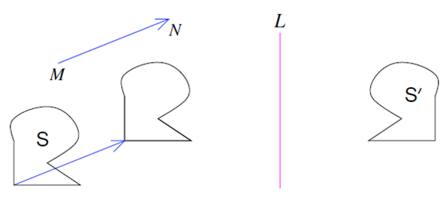
Example 2
Congruency works in both directions (S $≅$S’ and S’ $≅$S) because you can undo transformations.
S

Slide 80
Lesson 11 Notes
Congruency –
Two figures are congruent if they have the same size and shape because one can map onto the other using transformations. Therefore line and angle measures are preserved and the shape doesn’t change.
Because transformations can be undone, congruency works both ways (it has the commutative property).
Congruent: shapes that have the same size and shape; symbol is $≅$

Slide 81
Workshop
Must Do
May Do
Lesson 11 cw #1-2
Khan Academy
Test re-writes
Fluency practice or retests
PARCC tasks on “white boards”

Slide 82
Lesson 12
Workshop, discussion, notes

Slide 83
Workshop
Must Do
May Do
Finish Lesson 11 cw #1-2
Lesson 12 cw #1-2
Protractor Directions:
--Extend rays
--Put hole on vertex
--Line one ray up with 0
--See where other ray is
--acute is <90
--obtuse is >90
Khan Academy
Test re-writes
PARCC tasks on white boards

Slide 84
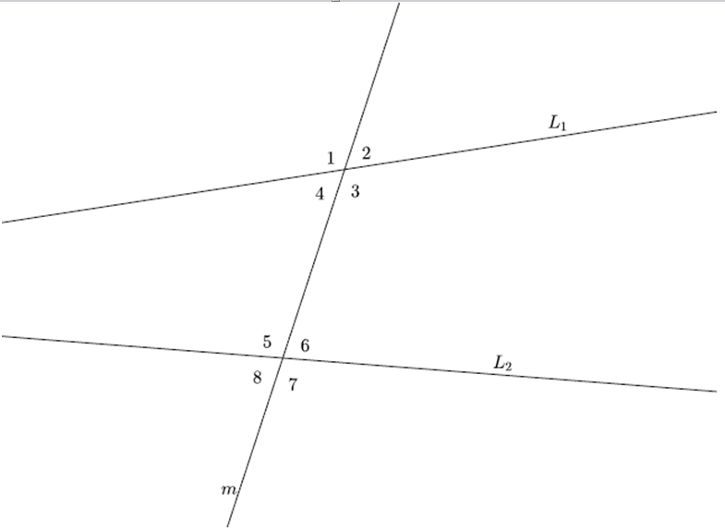
Which angles were equal to each other? Why are they equal? Can we map one on to the other?

Slide 85
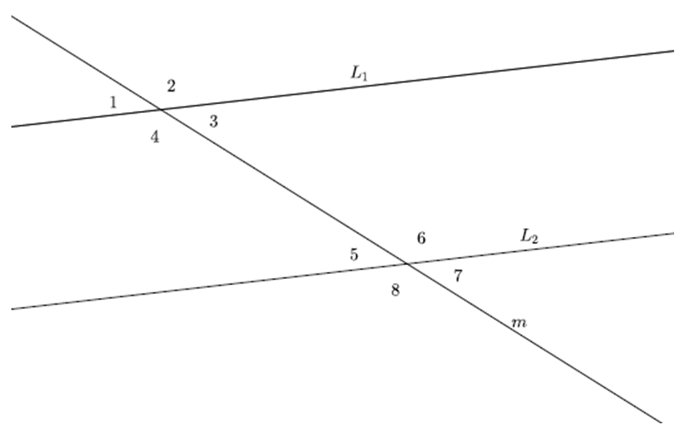
Which angles were equal to each other? Why are they equal? Can we map one on to the other?

Slide 86
Notes -
Transversal: a line cutting through parallel lines
Corresponding angles: same position around a
transversal
Alternate interior angles: opposite sides of the
transversal and between the parallel lines
Alternate exterior angles: opposite sides of the
transversal and outside the parallel lines

Slide 87
Notes
When parallel lines are cut by a transversal, angles 1, 7, 3, and 5 are equal in measure and angles 2, 8, 4, and 6 are also equal in measure.
You can translate angles 1, 8, 2, and 7 onto angles 3, 6, 4, and 5
Corresponding angle pairs:
1 & 3 8 & 6 2 & 4 7 & 5
Alternate interior pairs:
2 & 6 3 & 7
Alternate exterior pairs:
1 & 5 8 & 4

Slide 88
Lesson 13
Triangle review, workshop, discussion

Slide 89
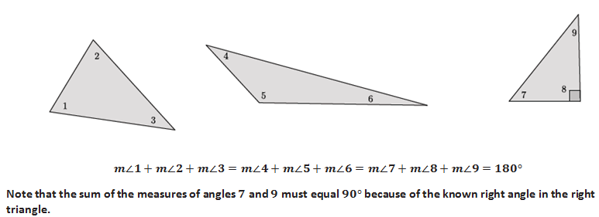
Recall:
The sum of the 3 angles in a triangle total 180 degree.
Also remember:
Straight lines makes 180 degrees
Corresponding angles of parallel lines are congruent
Alternate interior angles of parallel lines are congruent

Slide 90
Workshop
Must Do
May Do
Finish 12 cw #1-2
Lesson 13 cw #1-2
Khan Academy
Test re-writes
Fluency practice
PARCC tasks

Slide 91
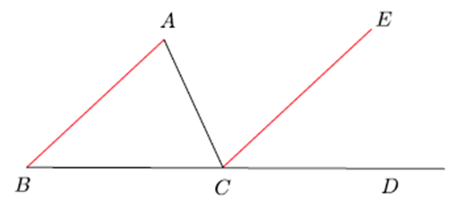

Slide 92
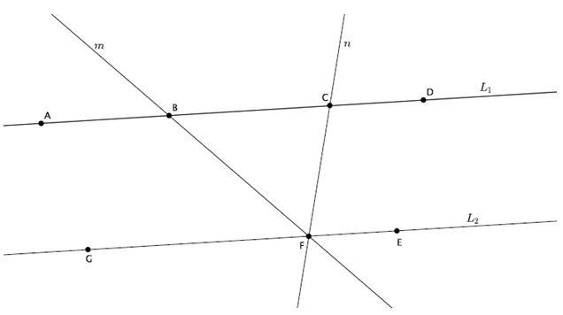

Slide 93
Lesson 14
Examples, workshop

Slide 94
Example 1

Slide 95
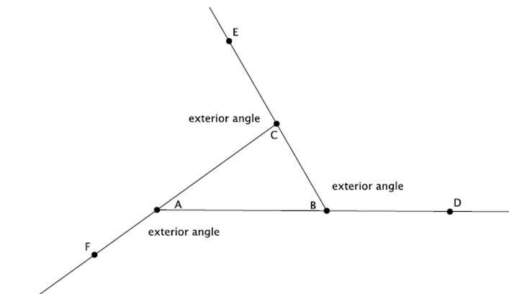
Example 2
The measure of the exterior angle must equal the sum of the other two angles in the triangle because a triangle and a straight line both add up to 180°.

Slide 96
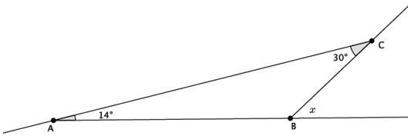
Example 3

Slide 97
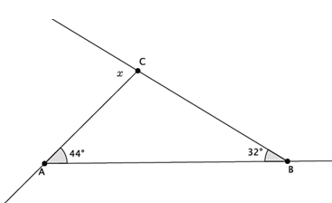
Example 4

Slide 98
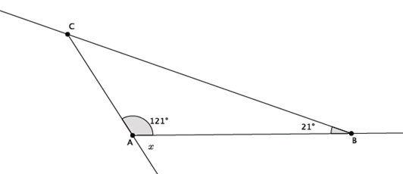
Example 5

Slide 99
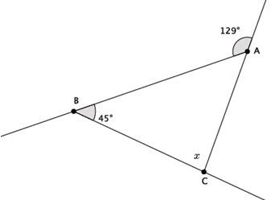
Example 6

Slide 100
Workshop
Must Do
May Do
Finish lesson 13 cw
Lesson 14 cw #1-6
Khan Academy
PARCC task on sheet protector
Test corrections
Fluency work

Slide 101
Lesson 15
Notes, discussion, examples, workshop

Slide 102
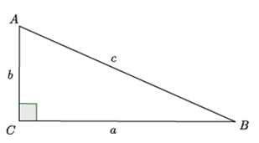
Notes
The Pythagorean Theorem States:
a² + b² = c²
leg² + leg² = hypotenuse²
Legs – the shorter two sides of a right triangle (a and b)
Hypotenuse – the longest side of a right triangle across from
the right angle (c)

Slide 103
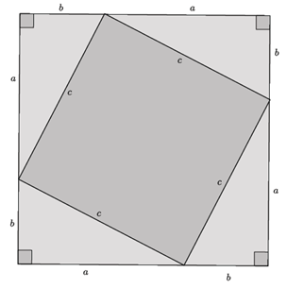

Slide 104
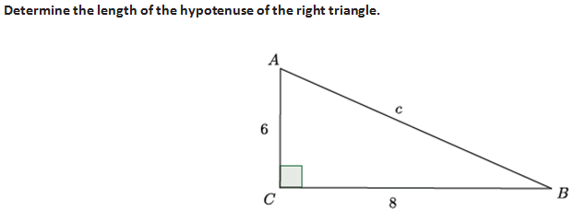
Example 1

Slide 105
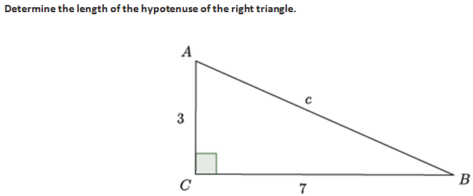
Example 2

Slide 106
Workshop
Must Do
May Do
Lesson ALL 11-14 classwork and homework
Lesson 15 #1-5
Khan Academy
PARCC task on sheet protector
Extra practice sheets
Notes sheet
Organize folder

Slide 107
Lesson 16
Examples, workshop

Slide 108
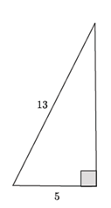
Example 1
Given a right triangle with a hypotenuse length of 13 units and a leg length of 5 units, as shown, what is the length of the other leg?

Slide 109
Example 2
Real world: Suppose you have a ladder of length 13 feet and to make it sturdy you need it to be placed 5 feet away from a building. How far up the wall can it reach?

Slide 110
Example 3
Given a right triangle with a hypotenuse of 15 units and a leg length of 9 units, what is the length of the other leg?

Slide 111
Example 4
The Pythagorean Theorem also helps us find distances on a coordinate plane.

Slide 112
Example 5
The Pythagorean Theorem also applies to the length of a diagonal in a rectangle.

Slide 113
Workshop
Must Do
May Do
Lesson ALL 11-14 classwork and homework
Lesson 15 #1-5
Lesson 16 #1-6
Khan Academy
PARCC task on sheet protector
Extra practice sheets
Notes sheet
Organize folder

