Slide 1
Geometry Functions
Eureka Math
8th Grade Module 5
Topic A

Slide 2
Lesson 1
Notes, examples(2), video, workshop

Slide 3
Notes – Functions
Function – a clearly defined rule that assigns each value of one quantity to exactly one value of a second quantity.
Often times functions come with a formula (equation) but sometimes they are unclear or difficult to write.
You need to be mindful of context when giving answers. Not all numeric answers make sense in the situation.
$$average speed=\frac{total distance}{total time}$$

Slide 4
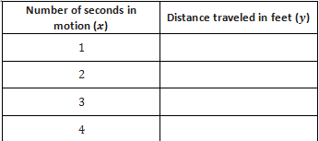
Example 1
Suppose a moving object travels 256 feet in 4 seconds. Assume that the object travels at a constant speed. Write a linear equation for the situation and use it to predict how far the object has moved in the four times below.

Slide 5
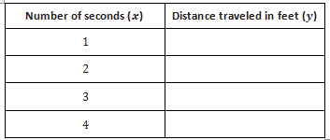
Example 2
The object, a stone, is dropped from a height of 256 feet. It takes exactly 4 seconds for the stone to hit the ground. How far does it travel in the first 3 seconds? What about the last 3 seconds? Can we assume a constant speed?

Slide 6
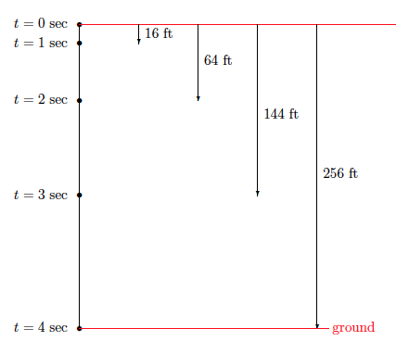
Video
http://www.youtube.com/watch?v=KrX_zLuwOvc

Slide 7
Example 2
The object, a stone, is dropped from a height of 256 feet. It takes exactly 4 seconds for the stone to hit the ground. How far does it travel in the first 3 seconds? What about the last 3 seconds? Can we assume a constant speed?
16
64
144
256

Slide 8
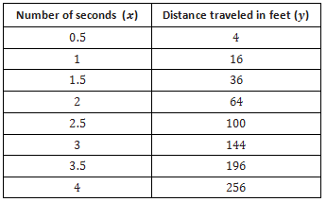
Example 2
The object, a stone, is dropped from a height of 256 feet. It takes exactly 4 seconds for the stone to hit the ground. How far does it travel in the first 3 seconds? What about the last 3 seconds? Can we assume a constant speed?

Slide 9
Workshop
Must Do
May Do
Lesson 1 cw #1-6
Khan academy
Independent work packet
Linear equation practice
Slope extra practice
PARCC tasks
Test rewrites

Slide 10
Lesson 2
Opener, notes, examples(1), workshop

Slide 11
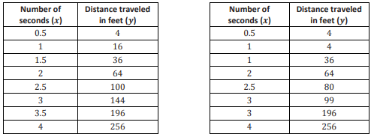
Opening
Shown below is the table from Example 2 of the last lesson and another table of values for the alleged motion of a second moving object. What do you NOTICE or WONDER?

Slide 12
Notes – Functions
Function – a clearly defined rule that assigns each value of one quantity to exactly one value of a second quantity.
Often times functions come with a formula (equation) but sometimes they are unclear or difficult to write.
You need to be mindful of context when giving answers. Not all numeric answers make sense in the situation.

Slide 13
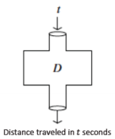
Opening
Let’s formalize this “assigning.”
Like an input-output machine.

Slide 14
Notes – Functions
Function – a clearly defined rule that assigns each value of one quantity to exactly one value of a second quantity.
Often times functions come with a formula (equation) but sometimes they are unclear or difficult to write.
You need to be mindful of context when giving answers. Not all numeric answers make sense in the situation.
Motion of falling object equation: $D=16t^{2}$

Slide 15
Example
Let $D$ be the distance traveled in time$t$. Use the equation $D=16t^{2}$ to calculate the distance the stone dropped for the given time $t$.
Are the distances you calculated equal to the table from Lesson 1?
Does the function $D=16t^{2}$ accurately represent the distance the stone fell after a given time $t$? In other words, does the function described by this rule assign to $t$ the correct distance? Explain.

Slide 16
Workshop
Must Do
May Do
Lesson 1 cw #1-6
Lesson 2 cw #1-6
Khan academy
Independent work packet
Linear equation practice
Slope extra practice
PARCC tasks
Test rewrites

Slide 17
Lesson 3
Opener, examples(4), workshop

Slide 18
Opening
Is this a function?
Is it linear?

Slide 19
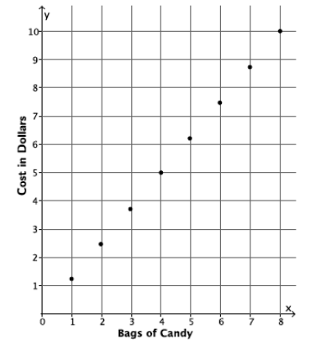
Opening
What’s the rule for this linear function?
Notice the format: y=mx+b
Does the table represent all inputs possible?
What inputs are not possible/don’t make sense?

Slide 20
Example 1 - COPY
Walter walks at a constant speed of 8 miles every 2 hours. Describe a linear function for the number of miles he walks in x hours. What is a reasonable range of x-values for this function?

Slide 21
Example 2 - COPY
Veronica runs at a constant speed. The distance she runs is a function of the time she spends running. The function has the table of values shown below.

Slide 22
Example 3 – DON’T COPY
Water flows from a faucet into a bathtub at the constant rate of 7 gallons of water pouring out every 2 minutes. The bathtub is initially empty, and its plug is in. Determine the rule that describes the volume of water in the tub as a function of time. If the tub can hold 50 gallons of water, how long will it take to fill the tub?

Slide 23
Example 3 continued – DON’T COPY
Now assume that you are filling the same 50-gallon bathtub with water flowing in at the constant rate of 3.5 gallons per minute, but there were initially 8 gallons of water in the tub. Will it still take about 14 minutes to fill the tub?

Slide 24
Example 4 - COPY
Water flows from a faucet at a constant rate. Assume that 6 gallons of water are already in a tub by the time we notice the faucet is on. This information is recorded in the first column of the table below. The other columns show how many gallons of water are in the tub at different numbers of minutes since we noticed the running faucet.

Slide 25
Workshop
Must Do
May Do
Exit ticket #1-2
Lesson 3 cw #1-5
Khan academy
Independent work packet
Linear equation practice
Slope extra practice
PARCC tasks
Test rewrites

Slide 26
Lesson 4
Opener, vocab, examples(4), workshop

Slide 27
Opener
vs

Slide 28
Notes – Vocabulary
Function – a clearly defined rule that assigns each value of one quantity to exactly one value of a second quantity.
Discrete – a function is restricted to whole values
Not Discrete – when values are continuous (fractions ok)
Linear – Constant rate of change between two variables
Nonlinear – Not a constant rate of change between variables
Domain – All possible input (x) values
Range – All possible output (y) values

Slide 29
Example 1 – COPY b and f
Classify each as discrete or not discrete
a) The function that assigns to each whole number the cost of buying that many cans of beans in a particular grocery store.
b) The function that assigns to each time of day on Wednesday the temperature of Sammy’s fever at that time.
c) The function that assigns to each real number its first digit.
d) The function that assigns to each day in the year 2015 my height at noon that day.
e) The function that assigns to each moment in the year 2015 my height at that moment.
f) The function that assigns to each color the first letter of the name of that color.
g) The function that assigns the number $23$ to each and every real number between $20$ and $30.6$.
h) The function that assigns the word YES to every yes/no question.

Slide 30
Example 2 – Don’t Copy
Water flows from a faucet into a bathtub at a constant rate of $7$ gallons of water every $2$ minutes. Regard the volume of water accumulated in the tub as a function of the number of minutes the faucet has be on. Is this function discrete or not discrete?

Slide 31
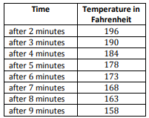
Example 3 –Don’t copy
You have just been served freshly made soup that is so hot that it cannot be eaten. You measure the temperature of the soup, and it is $210°F$. Since $212°F$ is boiling, there is no way it can safely be eaten yet. One minute after receiving the soup, the temperature has dropped to $203°F$. If you assume that the rate at which the soup cools is constant, write an equation that would describe the temperature of the soup over time.

Slide 32
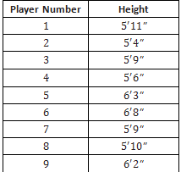
Example 4 –Copy
Consider the function that assigns to each of nine baseball players, numbered 1 through 9, his height. The data for this function is given below.

Slide 33
Workshop
Must Do
May Do
Exit ticket 1-2
Lesson 4 cw #1-4
Khan academy
Independent work packet
Linear equation practice
Slope extra practice
PARCC tasks
Test rewrites

Slide 34
Break
PARCC warm up, workshop

Slide 35
Workshop
Must Do
Can Do
Complete classwork 1-4
Exit ticket 1-3
Khan academy
Algebra practice
Independent work packet
PARCC practice
Homework 1-4

Slide 36
Lesson 5
Notes, examples(1or4), workshop

Slide 37
Notes – Vocabulary
The graph of a function is all the points (x, y) with x being an input for the function and y being its matching output
If a function has an equation, the graph of the function is the same as the graph of the equation, except only for valid values of the input
It is not possible for two different points of the graph to have the same x-coordinate (this would be one input, x, having two outputs, y).

Slide 38
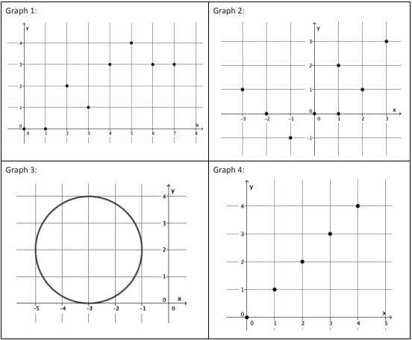
Example – Try to Copy
Which of these graphs are functions?

Slide 39
Workshop
Must Do
May Do
Exit ticket 2-3
Lesson 4 #1-4
Lesson 5 cw #1-4
Khan academy
Independent work packet
Linear equation practice
Slope extra practice
PARCC tasks
Test rewrites

Slide 40
Lesson 6
Opening, Review/Notes, examples(2), workshop, fluency

Slide 41
Fluency
Set 1:
Set 2:

Slide 42
Opener
Which of these functions is linear? How do you know?

Slide 43
Notes – Recall
SLOPE
CONSTANT RATE RATE OF CHANGE
Y-INTERCEPT
INITIAL VALUE
FIXED AMOUNT
(0, b)
X=0

Slide 44
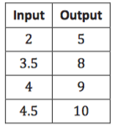
Example 1 –Copy
This is a function.
Can it be described by a linear equation, y = mx + b ?
What will the graph look like?
How do you write the equation?

Slide 45
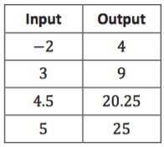
Example 2 –Copy
Is this a function?
Is it linear?

Slide 46
Workshop
Must Do
May Do
Lesson 6 cw #1-3
Khan academy
Independent work packet
Linear equation practice
Slope practice
Exponents review
PARCC tasks

Slide 47
Lesson 7
Fluency, Workshop, Discussion

Slide 48
Fluency

Slide 49
Workshop
Must Do
May Do
Lesson 7 cw #1-4
Khan academy
Independent work packet
Linear equation practice
Slope practice
Exponents review
PARCC tasks

Slide 50
Discussion
Was one style of presentation easier to work with over the others? Does everyone agree?
Was it easier to read off certain pieces of information about a linear function (its initial value, its constant rate of change, for instance) from one presentation of that function over another?

Slide 51
Lesson 8
Reminder, Workshop

Slide 52
Recall - Linear Functions
SLOPE
CONSTANT RATE RATE OF CHANGE
Y-INTERCEPT
INITIAL VALUE
FIXED AMOUNT
Linear functions have a constant rate of change
Nonlinear functions don’t

Slide 53
Linear Functions
 | SLOPE | Y-INTERCEPT
GRAPH
TABLE
Slope-Intercept EQUATION
WORDS
Standard Form EQUATION

Slide 54
Workshop
Must Do
May Do
Lesson 7 cw #1-4
Lesson 8 cw #1-10
Exit ticket 7-8
Khan academy
Independent work packet
Linear equation practice
Slope practice
Exponents review
PARCC tasks

Slide 55
Geometry Functions
Eureka Math
8th Grade Module 5
Topic B

Slide 56
Lesson 9
Notes, Examples(2), workshop

Slide 57
Notes – part 1
Area– the space inside a 2-dimensional figure
Perimeter - the distance around a 2-dimensional figure
Volume - the space inside a 3-dimensional figure
Composite figure - a figure made up of 2 or more traditional shapes joined by their sides/edges

Slide 58
Notes – Formulas
Perimeter of rectangles/parallelograms: Perimeter of squares:
Circumference of Circle:
Area of rectangles/parallelograms:
Area of Squares:
Area of triangles:
Area of Circles:
Volume of rectangular prism:
Volume of cube:

Slide 59
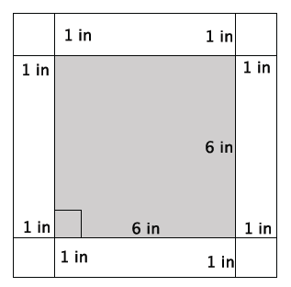
Example 1 –Copy
What is the side length of the smaller, inner square?
What is the area of the smaller, inner square?
What is the length of the larger, outer square?
What is the area of the larger, outer square?
What is the area of the 1-inch border?

Slide 60
Example 2 –Copy
w = 4cm
h = 4cm
V = 300cm³
w = 3cm
L = 10cm
L = 15cm
What is the volume of this prism?
What is the height of the prism?

Slide 61
Workshop
Must Do
May Do
Exit ticket 7 & 8
Lesson 9 cw #1-9
Khan academy
Independent work packet
Linear equation practice
Slope practice
Exponents review
PARCC tasks

Slide 62
Lesson 10
Opening, Notes, Example, workshop

Slide 63
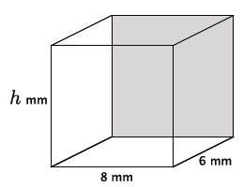
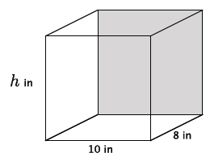
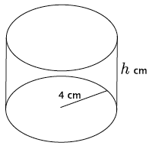
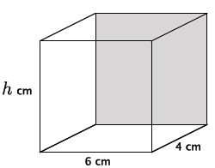
Opening
Write an equation to determine the volume of these figures.

Slide 64
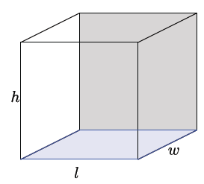
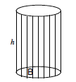
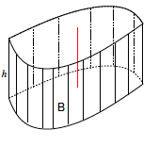
$$V=\left(area of base\right)∙height$$
$$V=\left(area of base\right)∙height$$
Don’t know HOW to calculate the area of the base, but the volume would still be Bh.
$$V=(πr^{2})h$$

Slide 65
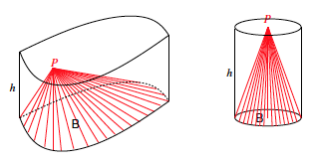
http://youtu.be/0ZACAU4SGyM
Since it took 3 cones to fill the cylinder, the volume is 1/3 that of a cylinder with the same base.
$$V=\frac{1}{3}πr^{2}h$$

Slide 66
Notes – Volume
Volume of upright figures is found but calculating the area of the base, B, and multiplying it by the height.
Volume of rectangular prism:
Volume of cube:
Volume of cylinder:
Volume of cone:
Diameter – distance all the way across circle
Radius – distance from center to outside of circle; half diameter
$$V=πr^{2}h$$
$$V=\frac{1}{3}πr^{2}h$$

Slide 67
Example
Write an equation to determine the volume of these figures.

Slide 68
Workshop
Must Do
May Do
Lesson 10 cw #1-5
Lesson 9 cw #1-9
Khan academy
Independent work packet
Linear equation practice
Slope practice
Exponents review
PARCC tasks
Complete all cw and hw
Notes sheet
Folder organize

Slide 69
Lesson 11
Opening, Notes, Example, workshop

Slide 70
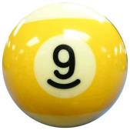
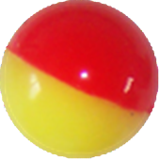
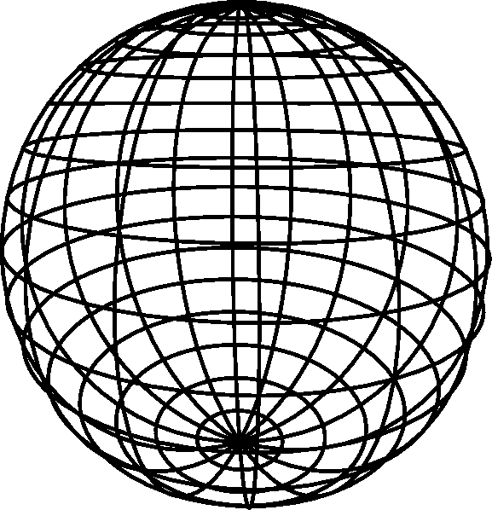
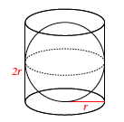
Opener
Archimedes, Zu Chongshi & Zu Geng, Cavalieri
http://www.youtube.com/watch?v=aLyQddyY8ik

Slide 71
Sphere
What is the volume of the cylinder?
What is the height of the cylinder?
If the volume of the sphere is $\frac{2}{3}πr^{2}h$, what is a simpler formula we can write?

Slide 72
Notes – Volume
Volume of upright figures is found but calculating the area of the base, B, and multiplying it by the height.
Volume of rectangular prism:
Volume of cube:
Volume of cylinder:
Volume of cone:
Volume of sphere: or
$$V=πr^{2}h$$
$$V=\frac{1}{3}πr^{2}h$$
$$V=\frac{4}{3}πr^{3}$$
$$V=\frac{2}{3}πr^{2}h$$

Slide 73
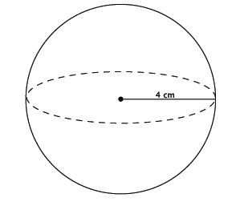
Example 1 - Copy
Compute the volume of the sphere. Leave your answer in terms of pi.
Use 3.14 for pi.

Slide 74
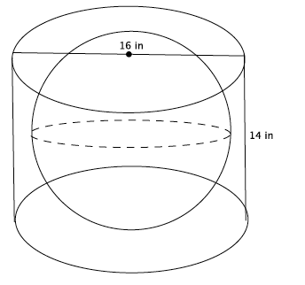
Example 2 – Copy (JUST LIKE TEST Q)
A cylinder has a diameter of 16 inches and a height of 14 inches. What is the volume of the largest sphere that fits inside? Leave your answer in terms of pi.
Use 3.14 for pi.

Slide 75
Workshop
Must Do
May Do
Lesson 11 cw #1-6
Khan academy
Independent work packet
Linear equation practice
Slope practice
Exponents review
PARCC tasks
Complete all cw and hw
Notes sheet
Folder organize

