Slide 1
Linear Functions
Eureka Math
8th Grade Module 6
Topic A

Slide 2
Lesson 1
Recall, workshop, discussion

Slide 3
Recall AGAIN
SLOPE
CONSTANT RATE
RATE OF CHANGE
Y-INTERCEPT
INITIAL VALUE
FIXED AMOUNT
(0, b)
X=0

Slide 4
Workshop
Must Do
May Do
Lesson 1 cw #1-16
Khan academy
Independent work packet
Test rewrites
Slope practice
Linear equation practice
Exponents review
PARCC tasks

Slide 5
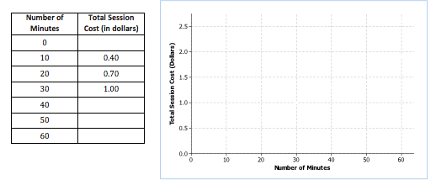
Set 1
…However, the company’s website says that a 10-minute session costs $0.40, a 20-minute session costs $0.70, and a 30-minute session costs $1.00. Lenore decides to use these pieces of information to determine both the fixed access fee for connecting and the usage rate.

Slide 6
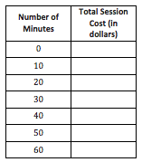
Set 2
A second wireless access company has a similar method for computing its costs. Unlike the first company that Lenore was considering, this second company explicitly states its access fee is $0.15, and its usage rate is $0.04 per minute.

Slide 7
Lesson 2
Example, recall, workshop

Slide 8
Recall AGAIN
SLOPE
CONSTANT RATE
RATE OF CHANGE
Y-INTERCEPT
INITIAL VALUE
FIXED AMOUNT
(0, b)
X=0
Positive - increasing line/rate
Negative - decreasing line/rate
Steeper - faster rate

Slide 9
Example - COPY
In the last lesson, you encountered an MP3 download site that offers downloads of individual songs with the following price structure: a $3 fixed fee for a monthly subscription plus a fee of $0.25 per song. The linear function that models the relationship can be written as y=0.25x+3.
  In your own words, explain the meaning of 0.25 within the context of the problem.
  In your own words, explain the meaning of 3 within the context of the problem.

Slide 10
Workshop
Must Do
May Do
Lesson 2 cw #1-9
Khan academy
Independent work packet
Test rewrites
Slope practice
Linear equation practice
Exponents review
PARCC tasks
Linear equation extra credit project

Slide 11
Lesson 3
Example, workshop, discussion

Slide 12
Warm Up
Write the linear equation for the line that goes through the point (0, 4) and has a slope of 3.
Write the linear equation for the line that goes through the point (3, 5) and has a slope of -2.

Slide 13
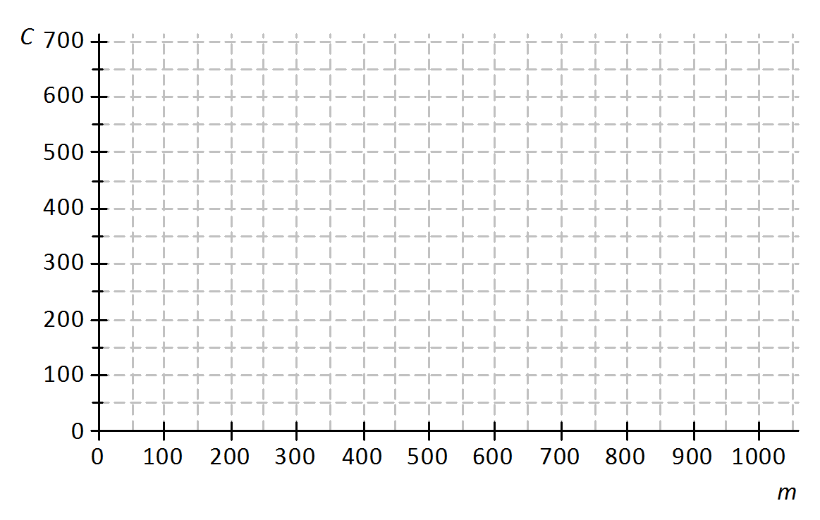
Example - COPY
A truck rental company charges a $150 rental fee in addition to a charge of $0.50 per mile driven. Graph the linear function relating the total cost of the rental in dollars, C, to the number of miles driven, m, on the axes below.
If the truck is driven 0 miles, what is the cost to the customer? How is this shown on the graph?’
What is the rate of change? Explain what it means within the context of the problem.
Write the equation.

Slide 14
Workshop
Must Do
May Do
Exit ticket #1-2
Lesson 3 cw #1-10
Khan academy
Independent work packet
Test rewrites
Slope practice
Linear equation practice
Exponents review
PARCC tasks
Linear equation extra credit project

Slide 15
Lesson 4
Notes, Opening/example, workshop

Slide 16
Warm Up
Write the equation for each line:
Through the point (0, -3) and has slope 2
Through the point (0, 5) and has slope -4
Through the point (3, 0) and has slope 1
Through the point (5, 2) and has slope -3
Through the point (2, -4) and has the slope ½

Slide 17
Recall AGAIN
SLOPE
CONSTANT RATE
RATE OF CHANGE
Y-INTERCEPT
INITIAL VALUE
FIXED AMOUNT
(0, b)
x=0
Positive - increasing line/rate
Negative - decreasing line/rate
Zero – flat, horizontal line
Steeper - faster rate

Slide 18
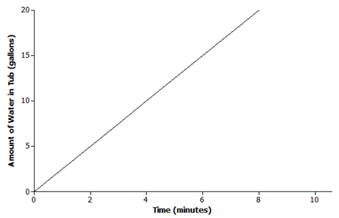
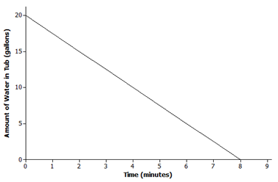
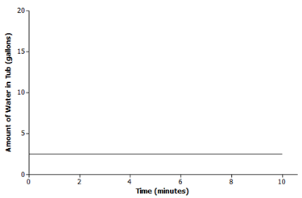
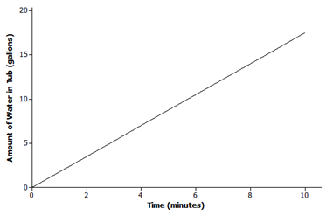
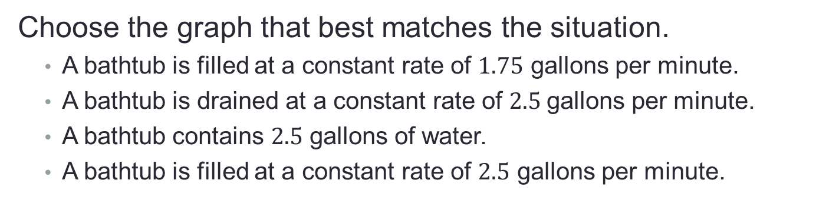
Example
Choose the graph that best matches the situation.
  A bathtub is filled at a constant rate of $1.75$ gallons per minute.
  A bathtub is drained at a constant rate of $2.5$gallons per minute.
  A bathtub contains $2.5$ gallons of water.
  A bathtub is filled at a constant rate of $2.5$ gallons per minute.
1)
2)
3)
4)

Slide 19
Example
Choose the graph that best matches the situation.
  A bathtub is filled at a constant rate of $1.75$ gallons per minute.
  A bathtub is drained at a constant rate of $2.5$gallons per minute.
  A bathtub contains $2.5$ gallons of water.
  A bathtub is filled at a constant rate of $2.5$ gallons per minute.
1)
2)
3)
4)

Slide 20
Workshop
Must Do
May Do
Lesson 4 cw #1-3
Khan academy
Independent work packet
Test rewrites
Slope practice
Linear equation practice
Exponents review
PARCC tasks
Linear equation extra credit project

Slide 21
Lesson 5
Examples(1), Notes, video, workshop

Slide 22
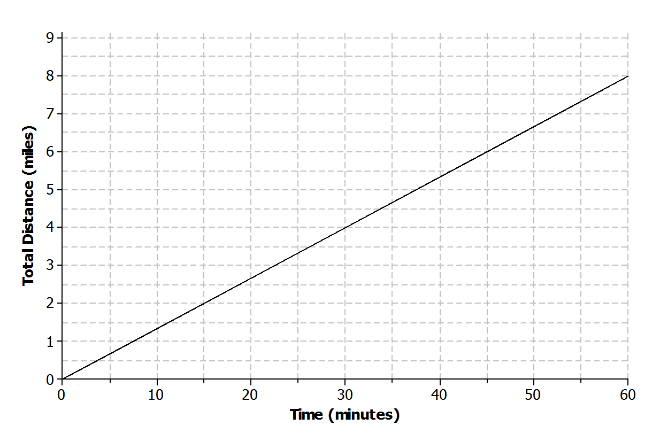
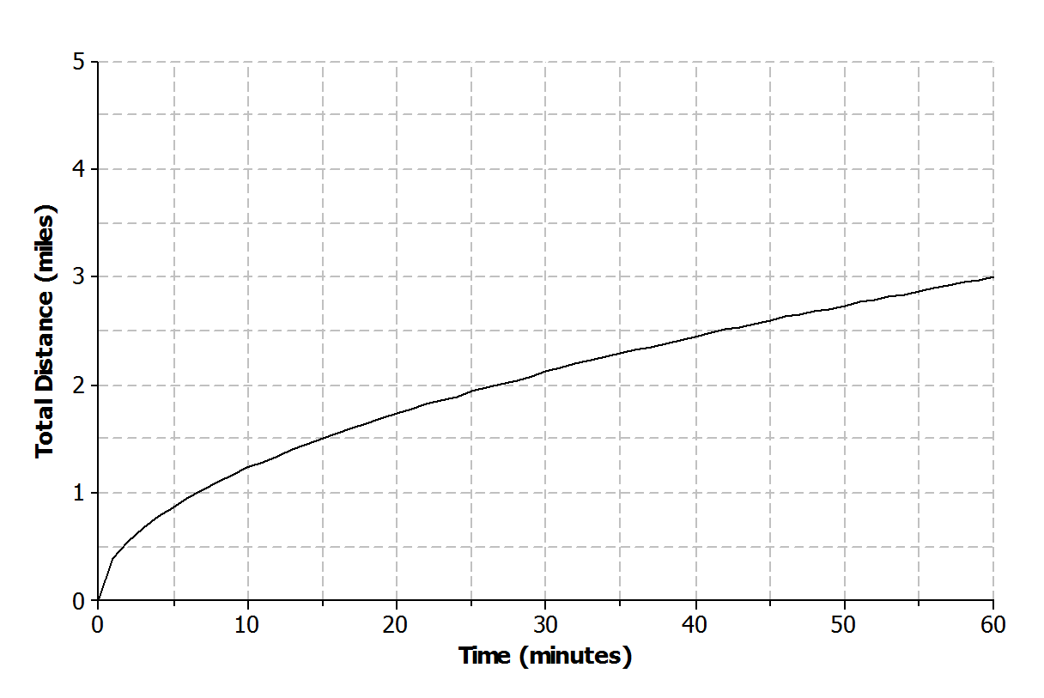
Example 1– Copy
Not all real-world situations can be modeled by a linear function. There are times when a nonlinear function is needed to describe the relationship between two types of quantities. Compare the two scenarios:
Aleph is running at a constant rate on a flat, paved road.
Shannon is running on a flat, rocky trail that eventually rises up a steep mountain.
0 to 15:
15 to 30:
30 to 45:
45 to 60:
0 to 15:
15 to 30:
30 to 45:
45 to 60:

Slide 23
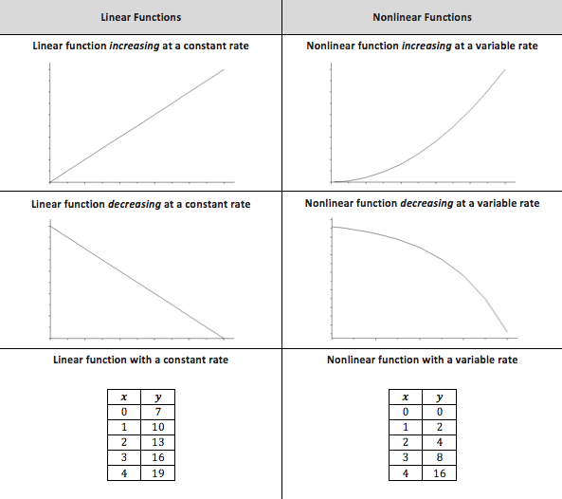

Slide 24
Video
www.graphingstories.com
Note - the classwork problem about ferris wheels connects to this video AND science!

Slide 25
Workshop
Must Do
May Do
Lesson 5 cw #1-4
Khan academy
Independent work packet
PARCC practice
Carnival Bears/Crossing the River
Extra credit project
Complete classwork 1-4

Slide 26
Linear Functions
Eureka Math
8th Grade Module 6
Topic B

Slide 27
Lesson 6
Notes, Examples(1), workshop

Slide 28
Notes- Scatterplots
Vocabulary:
Bivariate data set: observations made on two variables
Scatterplot: a graph of numerical data on two variables.
A pattern in a scatterplot suggests that there might be a relationship between the variables.
If the two variables seem to vary together in a predictable (linear) way, then they have a statistical relationship.
A statistical relationship does NOT mean that one variable causes the other to change.
A MODEL that lies CLOSE to the data can be used for approximate predictions.

Slide 29
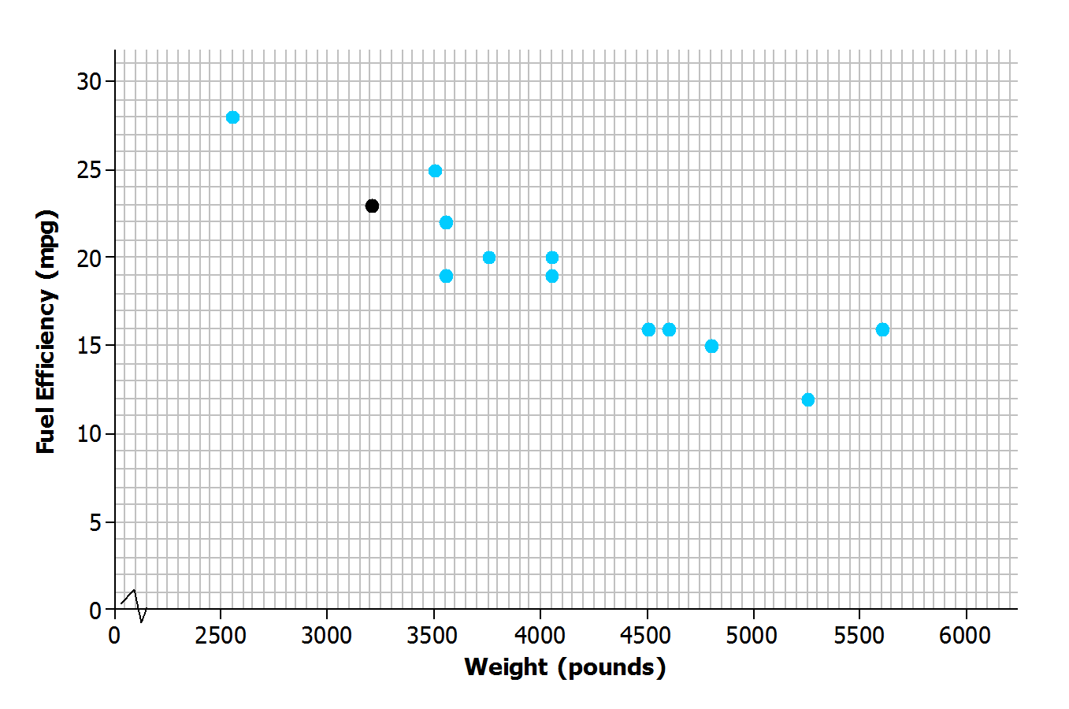
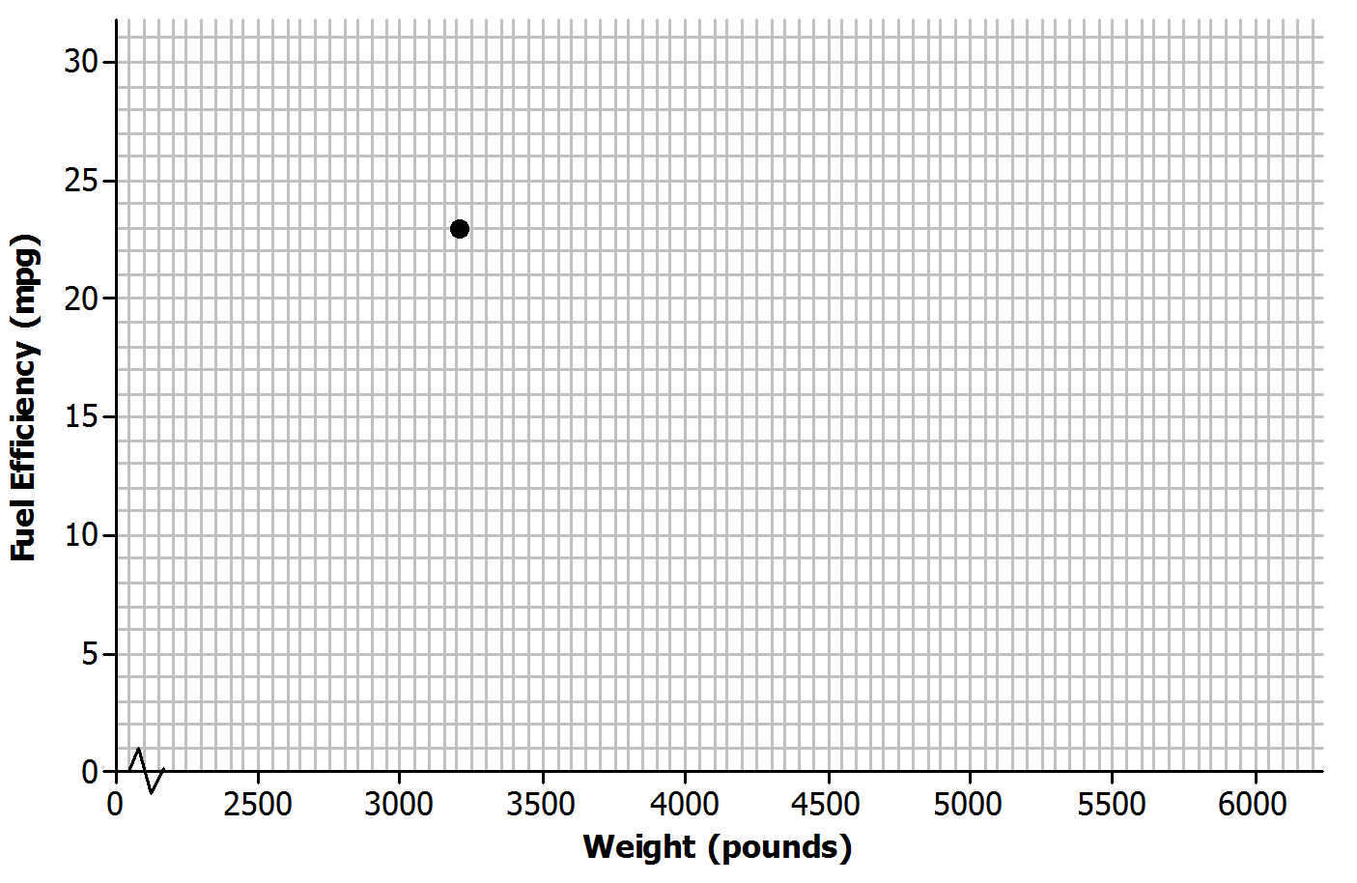
Example – Copy
Say you collect data on 13 cars. For each, you observe:
x: the weight of the car and y: the fuel efficiency of the car
Model | Weight (pounds) | Fuel Efficiency (mpg)

Slide 30
Workshop
Must Do
May Do
Quiz
Lesson 6 cw #1-7
Khan academy
Independent work packet
PARCC practice
Carnival Bears/Crossing the River
Extra credit project
Complete classwork 1-5
Start homework

Slide 31
Lesson 7
Notes, examples(2), workshop

Slide 32
Notes- Relationships in Scatterplots
Vocabulary:
Cluster - when there are two or more clouds of points
Outlier - points that seem unusual or far away from the others
When looking at scatterplot, ask/answer 3 questions:
  Does it look like there is a relationship between the variables? In other words, is there a pattern or are the points totally scattered randomly.
  If there’s a pattern, does the relationship look linear?
  Does the relationship appear positive or negative?

Slide 33
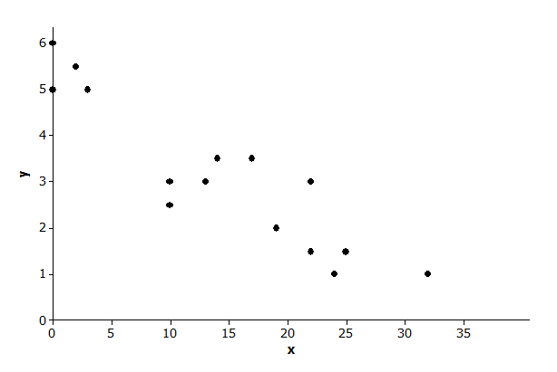
Example 1 - Copy
Is there a relationship?
If there is a relationship, does it appear to
be linear?
If the relationship appears to be linear, is it a positive or a negative linear relationship?

Slide 34
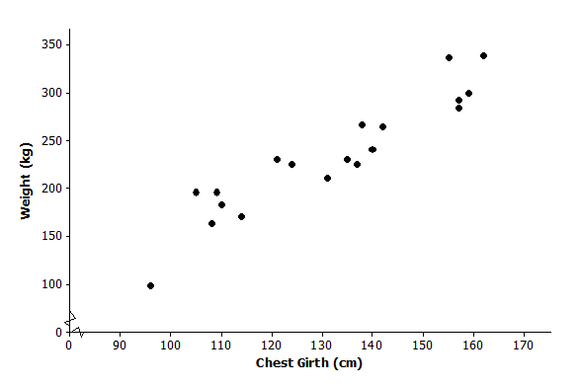
Example 2 - Copy
The scatter plot below shows the variables chest girth in centimeters (x) and weight in kilograms (y).
Any outliers? What do they mean?
Any clusters?

Slide 35
Workshop
Must Do
May Do
Lesson 7 cw #1-10
Lesson 6 cw #1-7
Khan academy
Independent work packet
PARCC practice
Carnival Bears/Crossing the River
Extra credit project
Complete classwork 1-6

Slide 36
Lesson 8
Notes, example (1 long one), workshop

Slide 37
Notes- Lines of Best Fit
When the scatterplot is approximately linear:
A line can be used to describe the linear relationship
A line that describes the relationship can be used to make predictions about the data (it won’t necessarily be exact)
When informally drawing the line, try to find the placement where the most points tend to be closest to the line.
Once the line is drawn, the actual data points are ignored and the line is used for analysis/prediction.

Slide 38
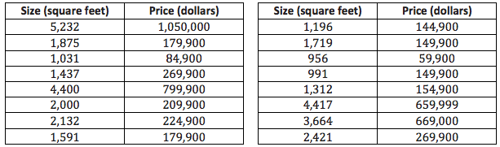
Example 1 - Copy
In a midwestern town, data was collected comparing house size to the price it sold for.

Slide 39
Example 1 continued
What can you tell about the price of large homes compared to the price of small homes?
What is the cost of the most expensive house, and where is that point on the scatter plot?
Estimate the cost of a 3,000-square-foot house.
Draw a line in the plot that you think would fit the trend in the data. Use your line to answer the following questions:
What is your prediction of the price of a 3,000-square-foot house?
What is the prediction of the price of a 1,500-square-foot house?
Consider the following general strategies students use for drawing a line.
Laure used the very first point and the very last point.
Phil wants to have the same number of points above and below the line.
Sandie tried to get a line that had the most points right on it.
Maree tried to get her line as close to as many of the points as possible.

Slide 40
Workshop
Must Do
May Do
Lesson 6-7 exit ticket
Lesson 8 cw #1-2
Khan academy
Independent work packet
PARCC practice
Carnival Bears/Crossing the River
Extra credit project

Slide 41
Lesson 9
Example, notes, workshop

Slide 42
Warm Up
Look back to module 1 for notes on how to do this!
(2 × 10³) + (5 × 10⁵)
(7 × 10⁸) (9 × 10⁶)

Slide 43
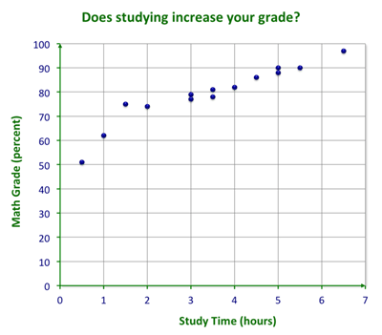
Example - Copy
Draw the line of best fit.
Write an equation for the line you drew.
Compare the line’s predicted value to the observed value for:
  2 hours
  4 hours
  1 hour

Slide 44
Notes- Lines of Best Fit
When the scatterplot is approximately linear:
A line can be used to describe the linear relationship
A line that describes the relationship can be used to make predictions about the data (it won’t necessarily be exact)
When informally drawing the line, try to find the placement where the most points tend to be closes to the line.
A line of best fit does NOT need to go through the origin
Since you are drawing a line, the equation should be y=mx+b

Slide 45
Workshop
Must Do
May Do
Lesson 9 cw #1-7
Independent work packet
PARCC practice
Carnival Bears/Crossing the River
Extra credit project
Finish all 1-9
Notes sheet
Folder organize
Generally study

Slide 46
Linear Functions
Eureka Math
8th Grade Module 6
Topic C

Slide 47
Lesson 10
Notes, examples (2), workshop

Slide 48
Notes- Lines of Best Fit
Some new, unnecessary vocabulary:
Independent variable - in statistics it can also be called the explanatory variable or predictor variable
Dependent variable - in statistics it can also be called the response variable or predicted variable

Slide 49
Example 1 - Don’t Copy
When doing statistics (like science actually), you often need to identify two variables you think have a relationship and determine independent and dependent variables.
Suppose you want to predict how well you are going to do on an upcoming statistics quiz. That would be the predicted variable (dependent). What are some potential independent variables connected?
Alternatively, if you know the cost age of a person, what are some dependent variables that might be related?

Slide 50
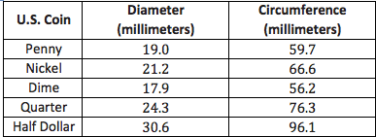
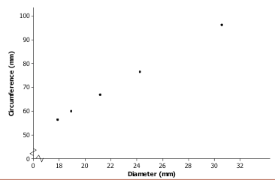
Example 2 - Copy
Omar and Olivia were curious about the size of coins. They measured the diameter and circumference of several coins and found the following data.
Do diameter and circumference seem related?
Find the equation.
What does the slope value look like?
What is the y-intercept?

Slide 51
Workshop
Must Do
May Do
Lesson 10 cw #1-8
Khan academy
Independent work packet
PARCC practice
Carnival Bears/Crossing the River
Extra credit project
Complete classwork 1-4

Slide 52
Lesson 11
Warm Up, workshop, discussion

Slide 53
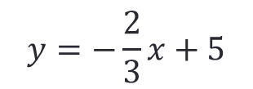
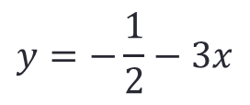
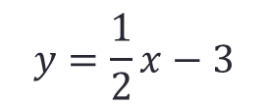
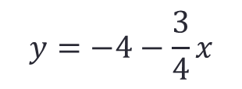


Warm Up
Identify the slope and y-intercept in each equation.
$$y=\frac{1}{2}x−3$$
$$y=−\frac{2}{3}x+5$$
$$y=−5x−2$$
$$y=−4−\frac{3}{4}x$$
$$y=−\frac{1}{2}−3x$$
$$y=7−4x$$

Slide 54
Remember… Summary.
In the real world, it is rare that two numerical variables are exactly linearly related. If the data are roughly linear, a line can be drawn through the data to model it. This line can then be used to make approximate predictions to answer questions.
For now this line is informally drawn, but in later grades you will use more formal methods for placing the line in the best-fitting place.

Slide 55
Workshop
Must Do
May Do
Lesson 10 cw #1-8
Lesson 11 cw #1-2
Independent work
Extra credit project
Writing equations
Slope practice
Crossing the River/Carnival Bears
Inky Puzzles

Slide 56
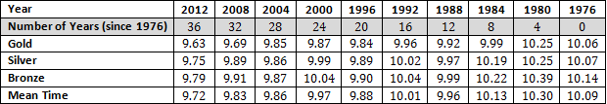
Discussion
The data in #2 can be modified to make the y-intercept make sense….

Slide 57
Lesson 12
Example, summary, workshop

Slide 58
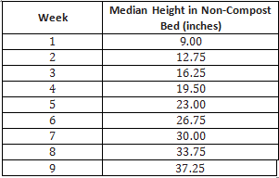
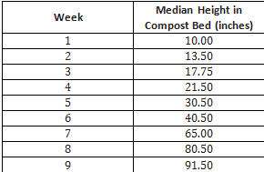
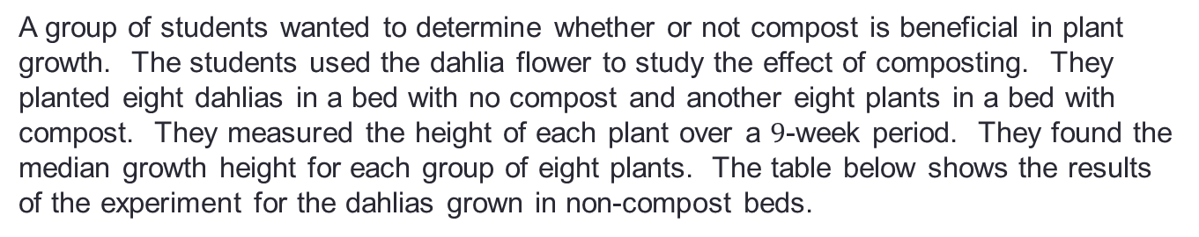
Example – Don’t Copy
A group of students wanted to determine whether or not compost is beneficial in plant growth. The students used the dahlia flower to study the effect of composting. They planted eight dahlias in a bed with no compost and another eight plants in a bed with compost. They measured the height of each plant over a $9$-week period. They found the median growth height for each group of eight plants. The table below shows the results of the experiment for the dahlias grown in non-compost beds.

Slide 59
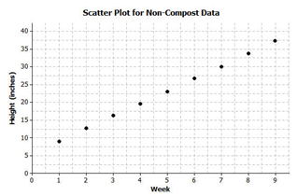
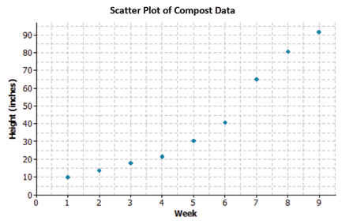
Example - Don’t Copy
A group of students wanted to determine whether or not compost is beneficial in plant growth. The students used the dahlia flower to study the effect of composting. They planted eight dahlias in a bed with no compost and another eight plants in a bed with compost. They measured the height of each plant over a $9$-week period. They found the median growth height for each group of eight plants. The table below shows the results of the experiment for the dahlias grown in non-compost beds.

Slide 60
Remember… Summary.
In the real world, it is rare that two numerical variables are exactly linearly related. If the data are roughly linear, a line can be drawn through the data to model it. This line and rate of change can then be used to make approximate predictions to answer questions.
For now this line is informally drawn, but in later grades you will use more formal methods for placing the line in the best-fitting place.
When data do NOT follow a linear pattern, there is no constant rate of change.

Slide 61
Workshop
Must Do
May Do
Exit ticket 10-11
Lesson 12 cw #1-14
Khan academy
Independent work packet
PARCC practice
Carnival Bears/Crossing the River
Extra credit project
Complete classwork 1-4

Slide 62
Linear Functions
Eureka Math
8th Grade Module 6
Topic D

Slide 63
Lesson 13
Notes, Warm up, example, classwork, example, classwork, example, classwork

Slide 64
Notes – Categorical Data
When one of your variables is CATEGORICAL, and NOT numerical (number-related) you cannot use a graph.
Examples of Categorical Data: seasons, colors, boys/girls
Univariate categorical data are displayed in a one-way table
Bivariate categorical data are displayed in a two-way table
Relative frequency is the frequency divided by the total

Slide 65
Warm Up
Complete #1-5 on your classwork.

Slide 66
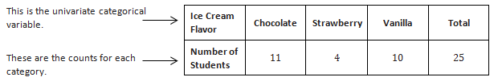

Example - Copy
The table below shows the ice cream flavors and the number of students who chose each flavor for a different class. This table is called a one-way frequency table because it shows the counts of a univariate categorical variable.
We compute the relative frequency for each ice cream flavor by dividing the count by the total number of observations.

Slide 67
Work
Complete #6-7 on your classwork.

Slide 68
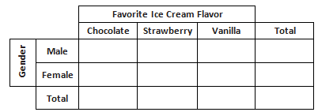
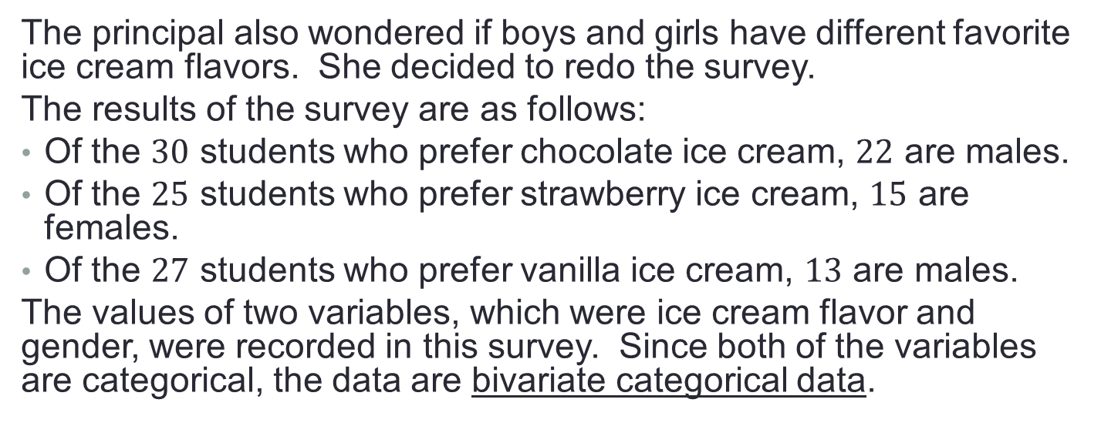
Example, continued - Copy
The principal also wondered if boys and girls have different favorite ice cream flavors. She decided to redo the survey.
The results of the survey are as follows:
Of the $30$ students who prefer chocolate ice cream, $22$ are males.
Of the $25$ students who prefer strawberry ice cream, $15$ are females.
Of the $27$ students who prefer vanilla ice cream, $13$ are males.
The values of two variables, which were ice cream flavor and gender, were recorded in this survey. Since both of the variables are categorical, the data are bivariate categorical data.

Slide 69
Work
Complete #8-12 on your classwork.

Slide 70
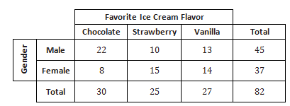
Example, continued - Copy
Sometimes we use row or column totals to calculate relative frequencies.
Calculate the proportion of male students who prefer chocolate ice cream.

Slide 71
Work
Complete #13-16 on your classwork.

Slide 72
Lesson 14
Warm Up, Notes, examples (1), workshop

Slide 73
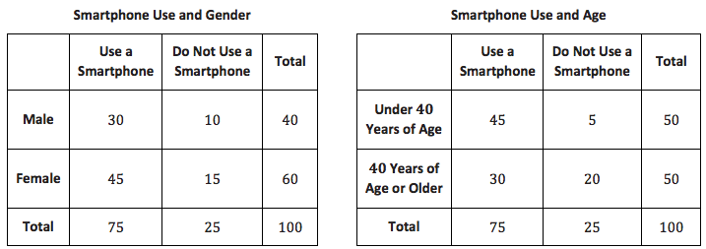
Warm Up
Suppose a random group of people are surveyed about their use of smartphones. The results of the survey are summarized in the tables below.

Slide 74
Notes – Association
When determining if two variables are related or have an association:
If relative frequencies are the same → no association
If relative frequencies are different → yes association
**Relative frequencies are found by using row or column totals rather than the entire group total.

Slide 75
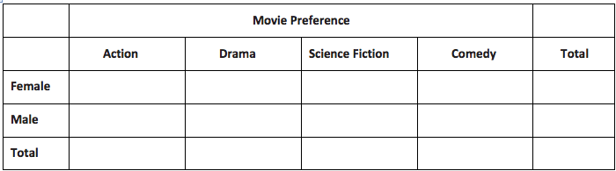
Example - Don’t Copy
In the survey described in Example 2, gender for each of the 400 participants was also recorded. Some results of the survey are given below:
160 participants preferred action movies.
80 participants preferred drama movies.
40 participants preferred science fiction movies.
240 participants were females.
78 female participants preferred drama movies.
32 male participants preferred science fiction movies.
60 female participants preferred action movies.

Slide 76

Example continued - Copy this part
60
78
8
94
240
100
2
32
96
160
160
80
40
120
400
Row
Relative Frequencies
Column →
Relative Frequencies

Slide 77
Workshop
Must Do
May Do
Lesson 14 cw #1-12
Khan academy
Independent work packet
PARCC practice
Extra credit project
Notes sheet
Complete all CW and HW
Study
Folder organize

Slide 78
End of Module Test
1a) Positive or negative association – why IN CONTEXT does that make sense?
1b) Linear or nonlinear – why IN CONEXT does that make sense?
1c) Outlier – IN CONTEXT what does it mean?
2a) Make two-way table from data
2b) Use frequencies to determine if the variables are related
3a) Interpret the meaning of the given slope IN CONTEXT
3b) Based on equations, which variable has biggest impact on the other
3c) Which option is the worst fit and why

