Slide 1
Lesson 8
Warm Up, notes, classwork

Slide 2
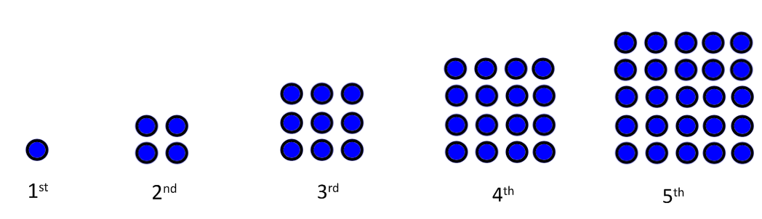
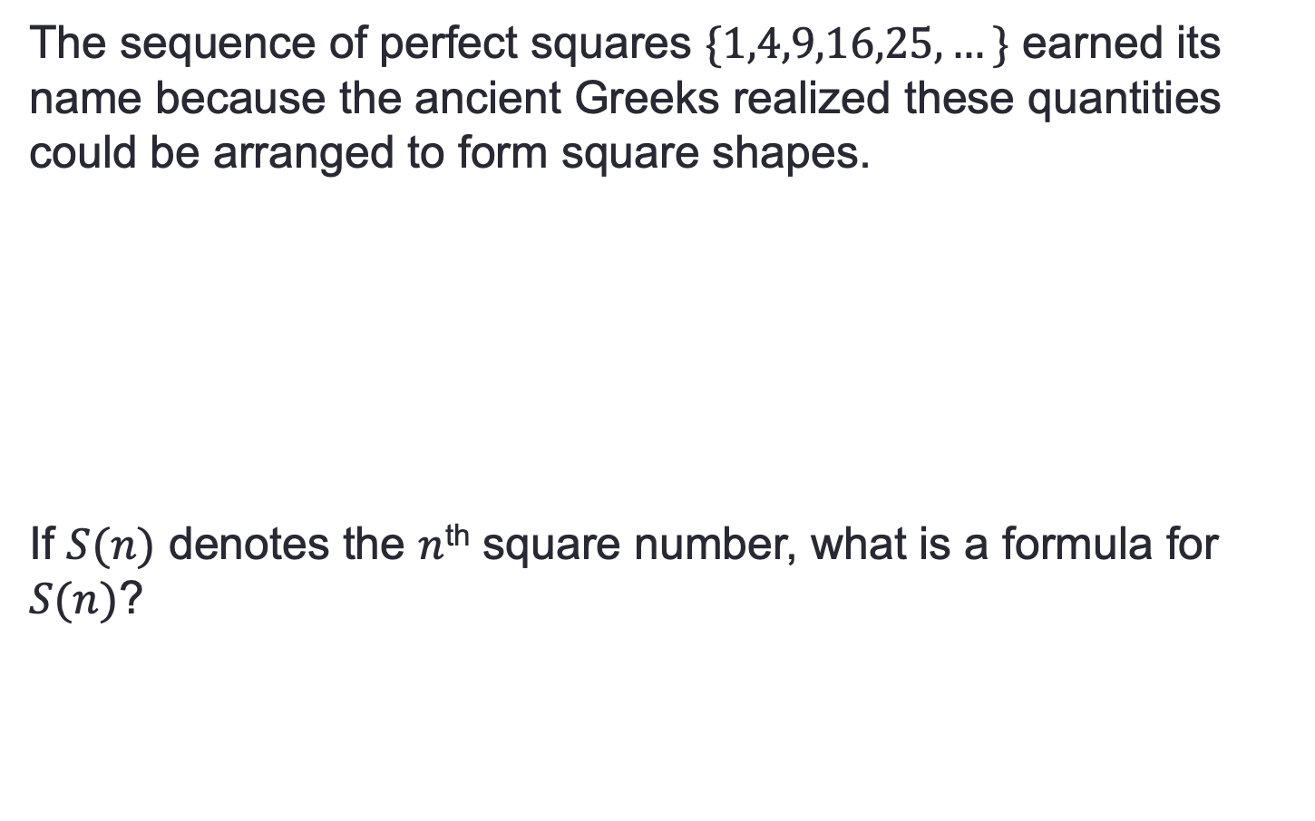
Warm Up
The sequence of perfect squares $\{1,4,9,16,25,…\}$ earned its name because the ancient Greeks realized these quantities could be arranged to form square shapes.
If $S(n)$ denotes the $n$^{th} square number, what is a formula for $S(n)$?

Slide 3

Warm Up, continued
$S(n)$ = n²
In this situation, what does $S(50)$ mean? What would this number look like?
In this situation, what does $S(0)$ mean? $S\left(π\right)$? $S(2.35)$?
In this situation, what does $S(−1)$ mean?
Remember, input and output values need to make sense in CONTEXT.

Slide 4
Notes
Formulas that represent a sequence of numbers have a set of inputs: each input number is a term number. The outputs of the formula form the sequence.
Formulas that represent different situations can have a set of inputs consisting of different subsets of the real number system because the inputs need to make sense in the situation, as do the outputs.

Slide 5

Workshop
Must Do
May Do
Exit ticket 6-7
Classwork8 #1 – 3
  HINT for #10: if you put two triangles together you have a rectangle… what is the number of dots for these rectangular numbers?
Khan Academy
Classwork1 #4
Carnival Bears/Crossing the River
Exponents review
Linear equation practice

Slide 6
Reflection Questions
For triangular numbers, does T(50) make sense?
Does T(280.3) make sense?
  Yes! It’s the 50th triangular number.
  Not really. Only if you allowed for decimal inputs rather than being a sequence of whole number inputs.

Slide 7
Lesson 9
Warm Up, intro, notes, examples, classwork

Slide 8
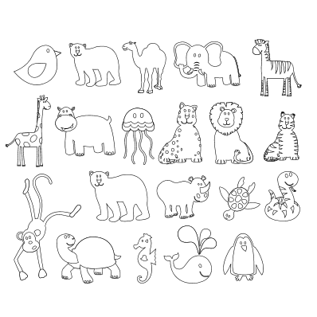
Warm Up/Intro
Match each animal to the correct word by drawing an arrow from the word to the picture… JUST DO IT!
Elephant
Camel
Polar Bear
Zebra
While you might have naturally matched the pictures with the words, there are certainly other ways to pair the pictures and words. For example, match the pictures to the words left to right and top to bottom. According to this method, the polar bear picture would be assigned to the word elephant.
Could one animal be assigned to two words? What would that mean, does it make sense?

Slide 9
Intro continued
For each student, match him/her to his/her science teacher. Think about how you are organizing your work.
Kimora
Josh
Emma
Zion
Grace
Madison
Mariya
Evan
Allie
Jada
Kenya
EJ
Tenard
Ms. Bovill
Mrs. Castillo
Mr. Gottlieb
Mr. Graeff
How does this relate to the warm up problem?
Did every student get assigned to a teacher?
Did every teacher have a student assigned?

Slide 10
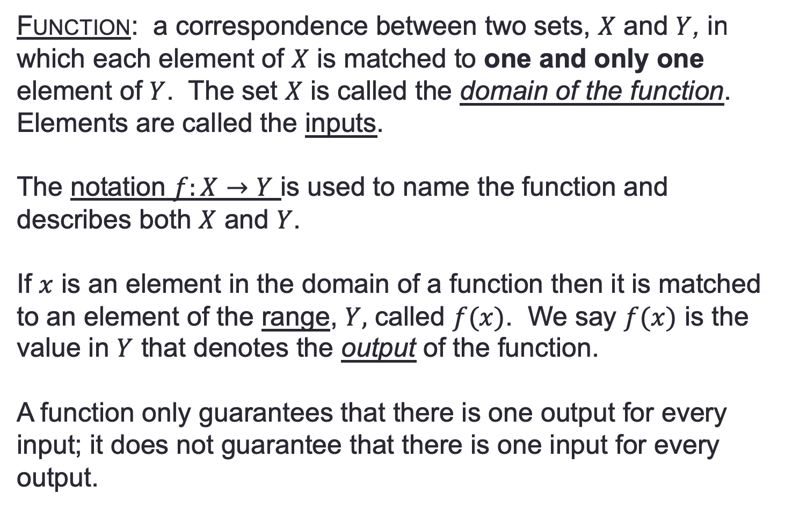
Notes – Functions
Function: a correspondence between two sets, $X$ and $Y$, in which each element of $X$ is matched to one and only one element of $Y$. The set $X$ is called the domain of the function. Elements are called the inputs.
The notation $f:X→Y$ is used to name the function and describes both $X$ and $Y$.
If $x$ is an element in the domain of a function then it is matched to an element of the range, $Y,$ called $f(x)$. We say $f(x)$ is the value in $Y$ that denotes the output of the function.
A function only guarantees that there is one output for every input; it does not guarantee that there is one input for every output.

Slide 11
Example 1
Define the Opening Exercise using function notation. State the domain and the range.

Slide 12
Example 2
Is the assignment of students to science teachers an example of a function? If yes, define it using function notation, and state the domain and the range.

Slide 13
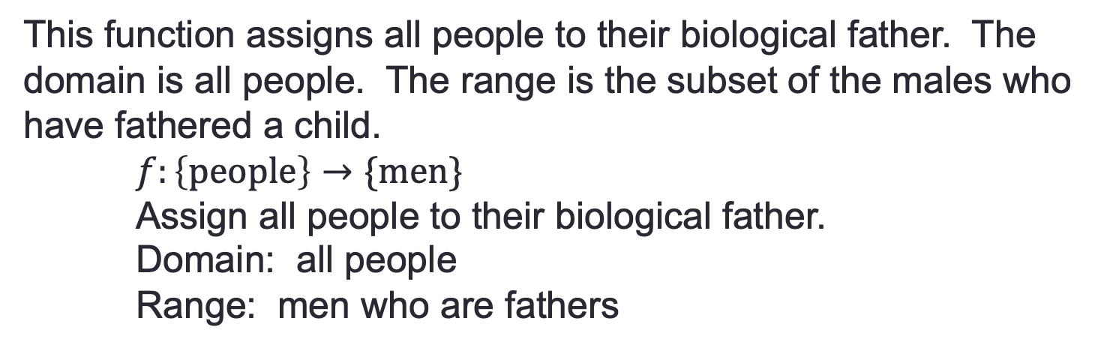
Example 3
This function assigns all people to their biological father. The domain is all people. The range is the subset of the males who have fathered a child.
$f:\left\{people\right\}→\{men\}$
Assign all people to their biological father.
Domain: all people
Range: men who are fathers
What is the meaning of f(Tom) = Peter?
What would it mean to say f(Tom) = Tom?
Ana’s father is George, how would we write that?
If we assigned fathers to their children, would this be a function?

Slide 14
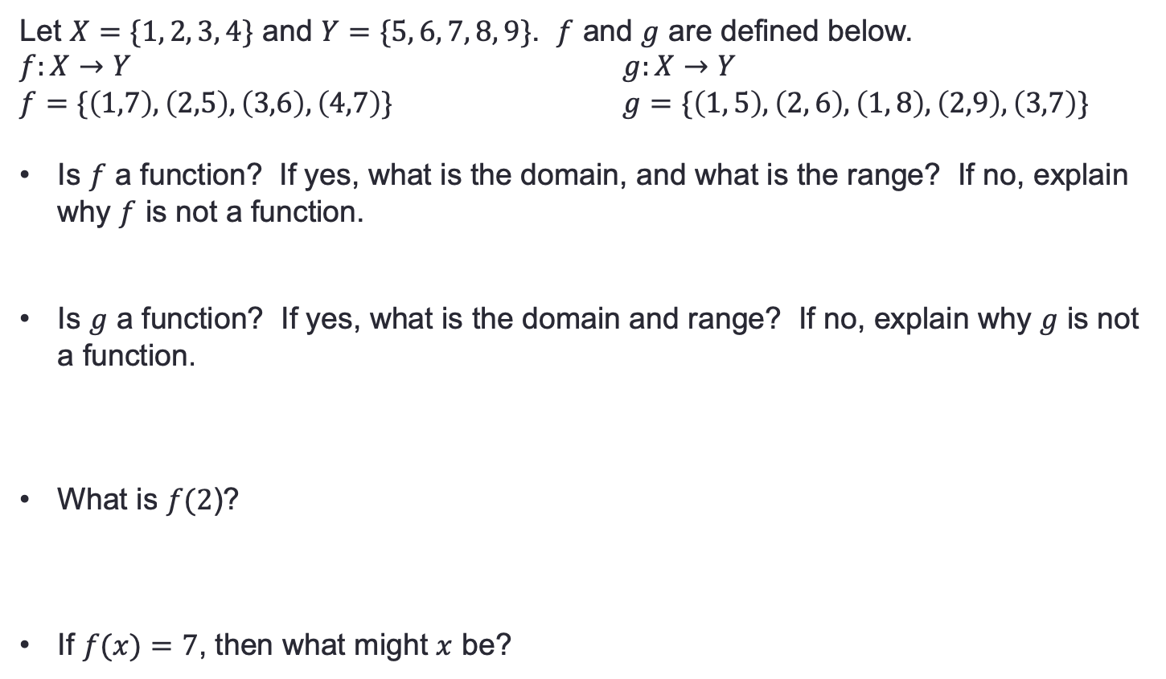
Example 4
Let $X=\{1, 2, 3, 4\}$ and $Y=\{5, 6, 7, 8, 9\}$. $f$ and $g$ are defined below.
$f:X→Y$ $g:X→Y$
$f=\{\left(1,7\right),\left(2,5\right),\left(3,6\right),\left(4,7\right)\}$ $g=\{\left(1, 5\right), \left(2, 6\right), \left(1, 8\right), \left(2,9\right), \left(3,7\right)\}$
Is $f$ a function? If yes, what is the domain, and what is the range? If no, explain why $f$ is not a function.
Is $g$ a function? If yes, what is the domain and range? If no, explain why $g$ is not a function.
What is $f(2$)?
If $f(x)=7$, then what might $x$ be?

Slide 15
Workshop
Must Do
May Do
Exit ticket 6-7
Classwork9 #1-3
Summary/Reflection
Complete cw #1
Khan Academy
Crossing River/Carnival Bears
Linear Equation practice
Exponents

Slide 16
Lesson 10
Warm up, example, notes, classwork

Slide 17
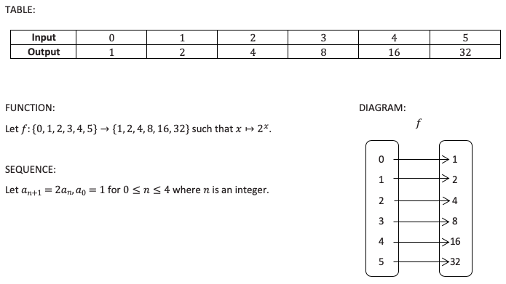

Warm Up/Entry Task
Study the $4$ representations of a function below. How are these representations alike? How are they different?

Slide 18

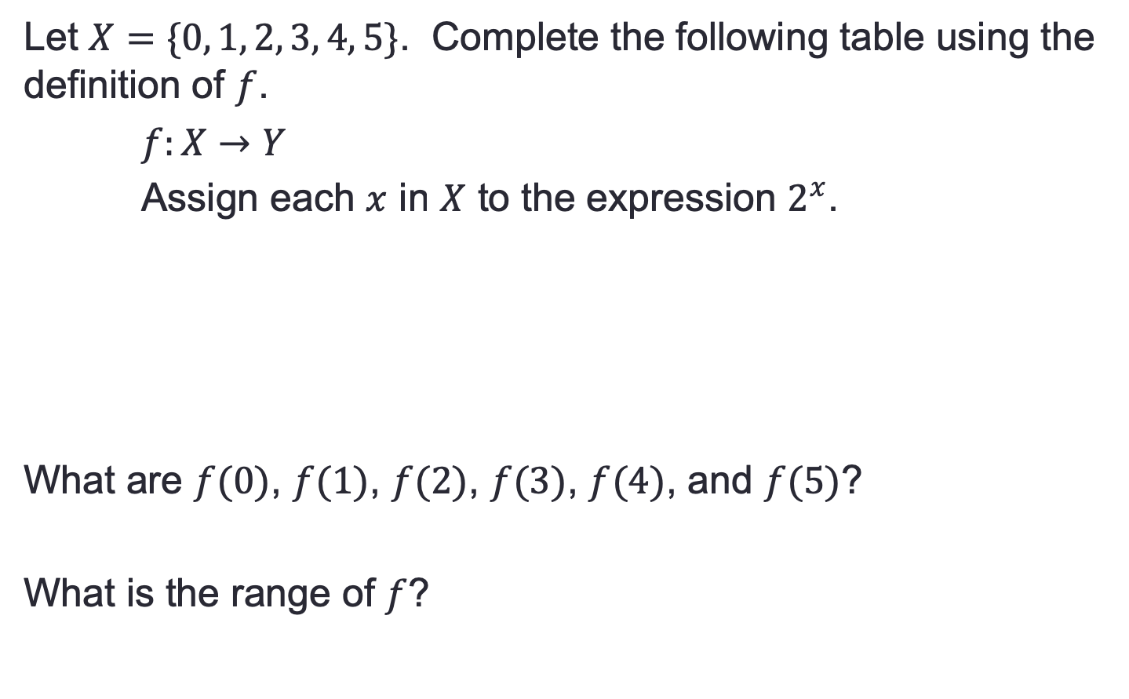
Example
Let $X=\{0, 1, 2, 3, 4, 5\}$. Complete the following table using the definition of $f$.
$f:X→Y$
Assign each $x$ in $X$ to the expression $2^{x}$.
What are $f(0)$, $f(1)$, $f(2)$, $f(3)$, $f(4)$, and $f(5)$?
What is the range of $f$?

Slide 19
Workshop
Must Do
May Do
Classwork10 #1-6
Reflection/summary
Classwork 9
KhanAcademy
Exponents review
Linear practice

Slide 20
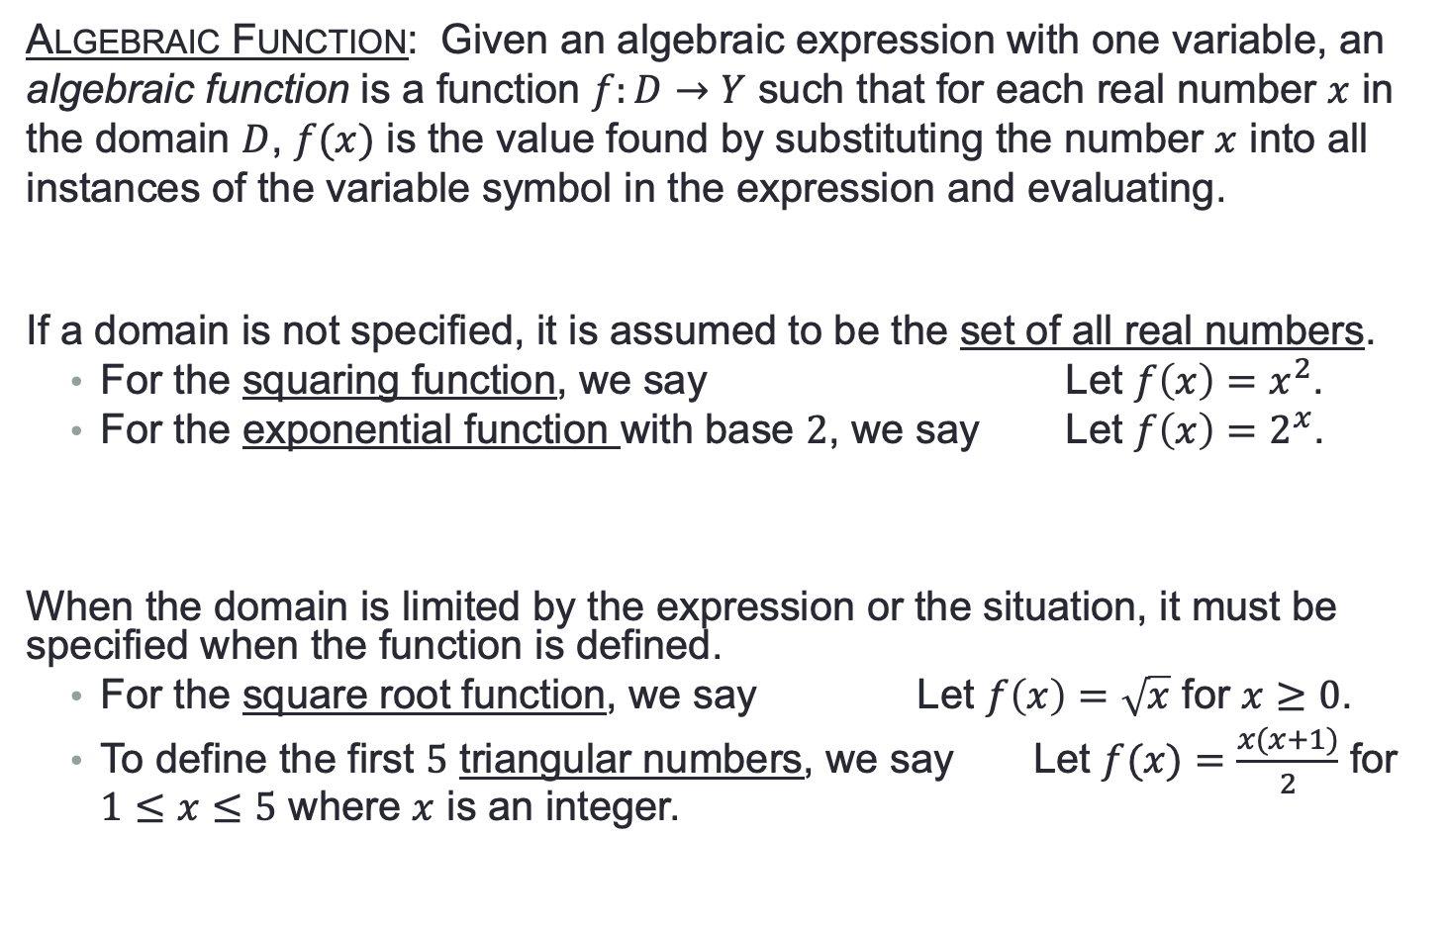
Notes
Algebraic Function: Given an algebraic expression with one variable, an algebraic function is a function $f:D→Y$ such that for each real number $x$ in the domain $D$, $f(x)$ is the value found by substituting the number $x$ into all instances of the variable symbol in the expression and evaluating.
If a domain is not specified, it is assumed to be the set of all real numbers.
  For the squaring function, we say Let $f\left(x\right)=x^{2}$.
  For the exponential function with base $2$, we say Let $f\left(x\right)=2^{x}$.
When the domain is limited by the expression or the situation, it must be specified when the function is defined.
  For the square root function, we say Let $f\left(x\right)=\sqrt{x}$ for $x≥0$.
  To define the first $5$ triangular numbers, we say Let $f(x)=\frac{x(x+1)}{2}$ for $1≤x≤5$ where $x$ is an integer.

Slide 21
Lesson 11
Warm up, example/classwork, notes

Slide 22
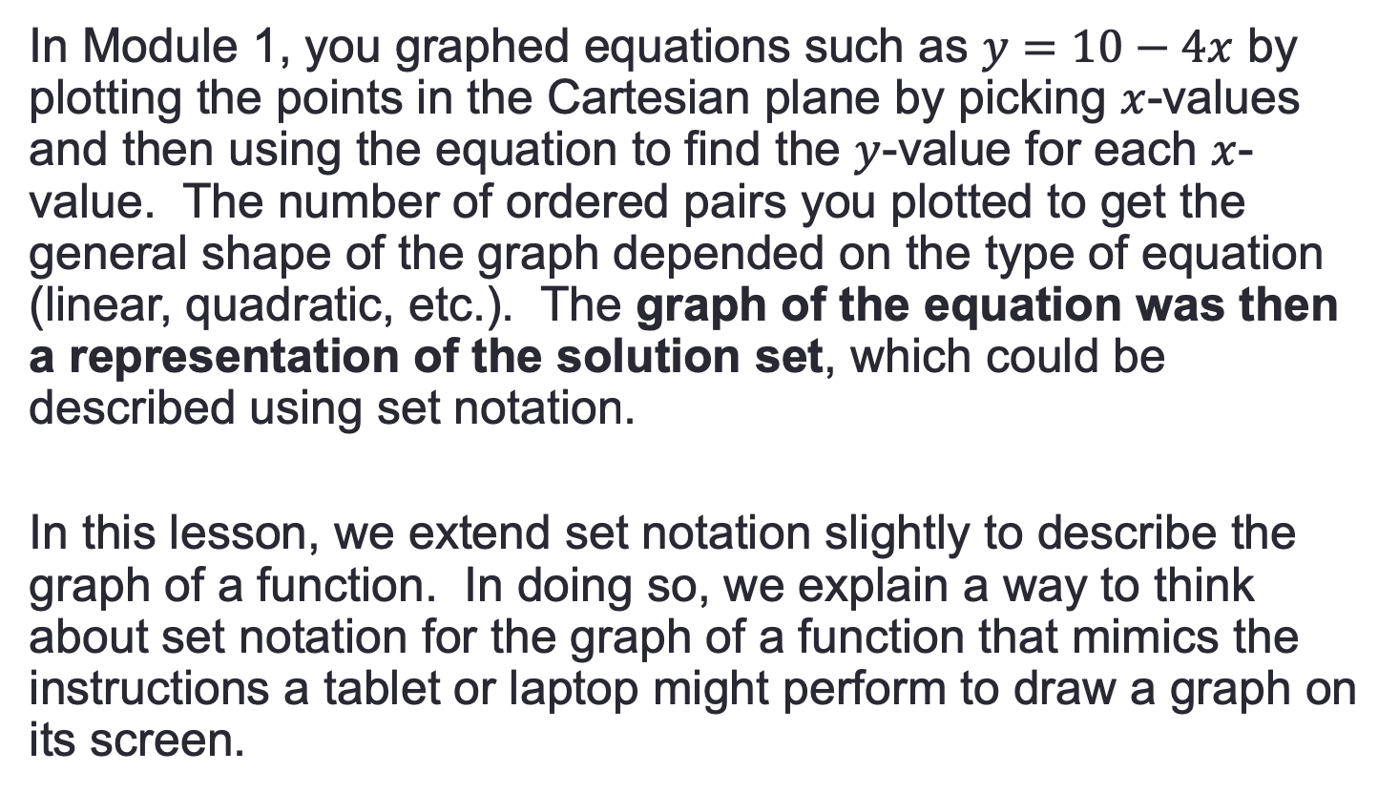
Entry Task: Read
In Module 1, you graphed equations such as $y=10−4x$ by plotting the points in the Cartesian plane by picking $x$-values and then using the equation to find the $y$-value for each $x$-value. The number of ordered pairs you plotted to get the general shape of the graph depended on the type of equation (linear, quadratic, etc.). The graph of the equation was then a representation of the solution set, which could be described using set notation.
In this lesson, we extend set notation slightly to describe the graph of a function. In doing so, we explain a way to think about set notation for the graph of a function that mimics the instructions a tablet or laptop might perform to draw a graph on its screen.

Slide 23
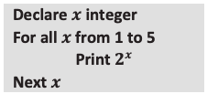
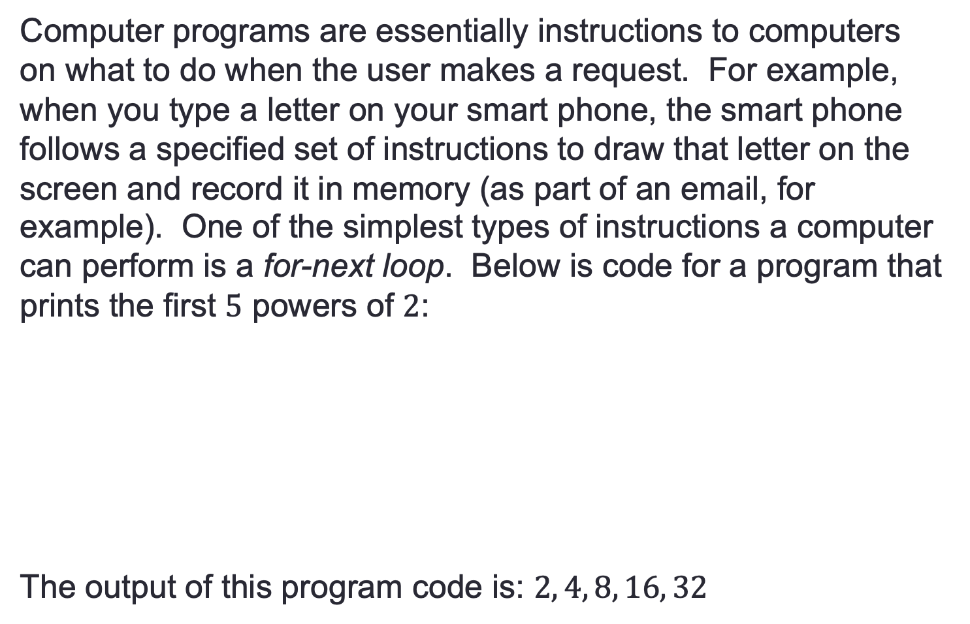
Example 1
Computer programs are essentially instructions to computers on what to do when the user makes a request. For example, when you type a letter on your smart phone, the smart phone follows a specified set of instructions to draw that letter on the screen and record it in memory (as part of an email, for example). One of the simplest types of instructions a computer can perform is a for-next loop. Below is code for a program that prints the first $5$ powers of $2$:
The output of this program code is: $2, 4, 8, 16, 32$
← x is quantified as an integer
← “For” starts the loop with x = 1
← “Print” means print to screen
← directions from “for” until ”next” are performed for all x-values

Slide 24
Example 1
← x is quantified as an integer
← “For” starts the loop with x = 1
← “Print” means print to screen
← directions from “for” until ”next” are performed for all x-values
What is the domain of x?
If f is a function given by evaluating 2^{x} for a number x, what is the domain given by the program?
What is the range of f?

Slide 25
You Try
Complete problem #1 on your classwork
Your answer should be a list of numbers.

Slide 26
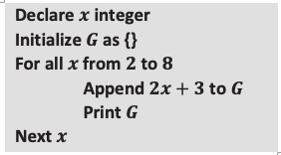
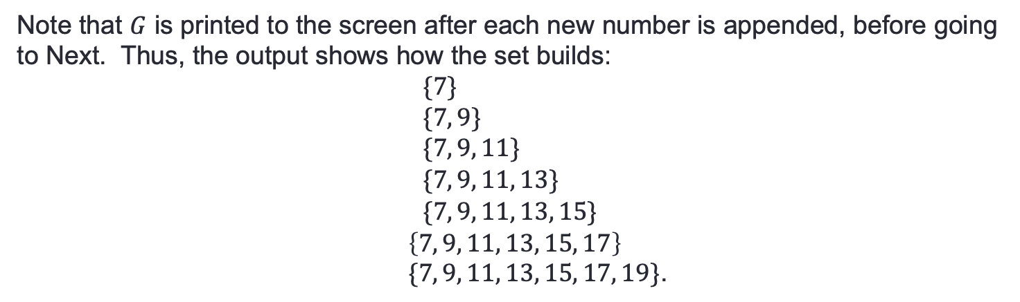
Example 2
We can use almost the same code to build a set: First, we start with a set with zero elements in it (called the empty set), and then we increase the size of the set by appending one new element to it in each for-next step.
← x is quantified as an integer
← Open a set called G
← “For” starts the loop with x = 2
Add the value to the set and
print to screen
← directions from “for” until ”next” are performed for all x-values
Note that $G$ is printed to the screen after each new number is appended, before going to Next. Thus, the output shows how the set builds:
$$\{7\} \\ \{7, 9\} \\ \{7, 9, 11\} \\ \{7, 9, 11, 13\} \\ \{7, 9, 11, 13, 15\}$$
$\left\{7, 9, 11, 13, 15, 17\right\}$
$\{7, 9, 11, 13, 15, 17, 19\}$.

Slide 27
You Try
Complete problem #2 on your classwork
Your answer should be a list of coordinate points.
Code from example2

Slide 28
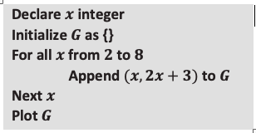
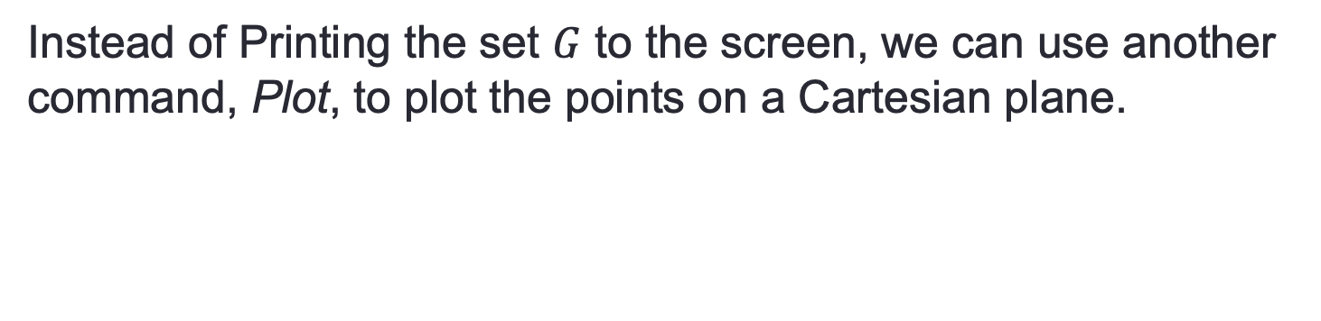
Example 3
Instead of Printing the set $G$ to the screen, we can use another command, Plot, to plot the points on a Cartesian plane.
← x is quantified as an integer
← Open a set called G
← “For” starts the loop with x = 2
Add the value to the set and
← directions from “for” until ”next” are performed for all x-values
Plot on coordinate plan
Graphing calculators slow the plotting down so you can get a sense of the plotting as it goes through the steps.
You can also building this set using set notation (Module 1):
$\left\{\left(x,2x+3\right) \right| x integer and 2≤x≤8\}$

Slide 29
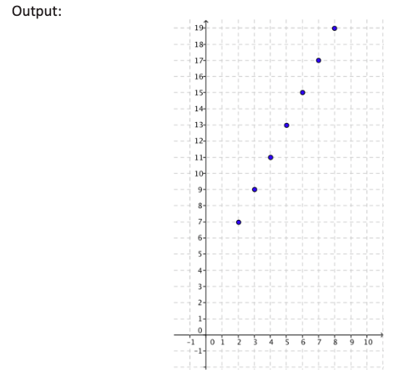

Slide 30

Notes - Graphs
Graph of $f$: Given a function, f, whose domain, D, and range are subsets of the real numbers, the graph of $f$ is the set of ordered pairs in the Cartesian plane given by
$\left\{\left(x,f\left(x\right)\right) \right|x∈D\}.$

Slide 31
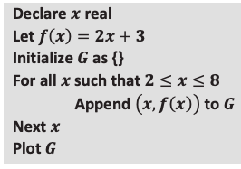
Example 4
We can now upgrade our notion of a for-next loop by doing a thought experiment: Imagine a for-next loop that steps through all real numbers in an interval (not just the integers). No computer can actually do this—computers can only do a finite number of calculations. But our human brains are far superior to that of any computer, and we can easily imagine what that might look like.
← x is quantified as real number
Function defined
← Open a set called G
← “For” starts the loop with x = 2
Add the value to the set and
← directions from “for” until ”next” are performed for all x-values
Plot on coordinate plan
How will this graph look different than the one in example 3?

Slide 32
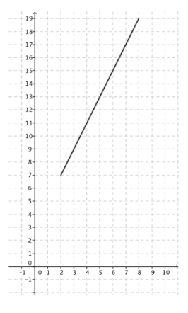

Slide 33
Workshop
Must Do
May Do
Exit ticket 9-10
Complete classwork11
Khan Academy
Linear Practice
Exponents review
Slope practice
Make up work

Slide 34
Lesson 12
Entry, examples, classwork, notes, summary

Slide 35
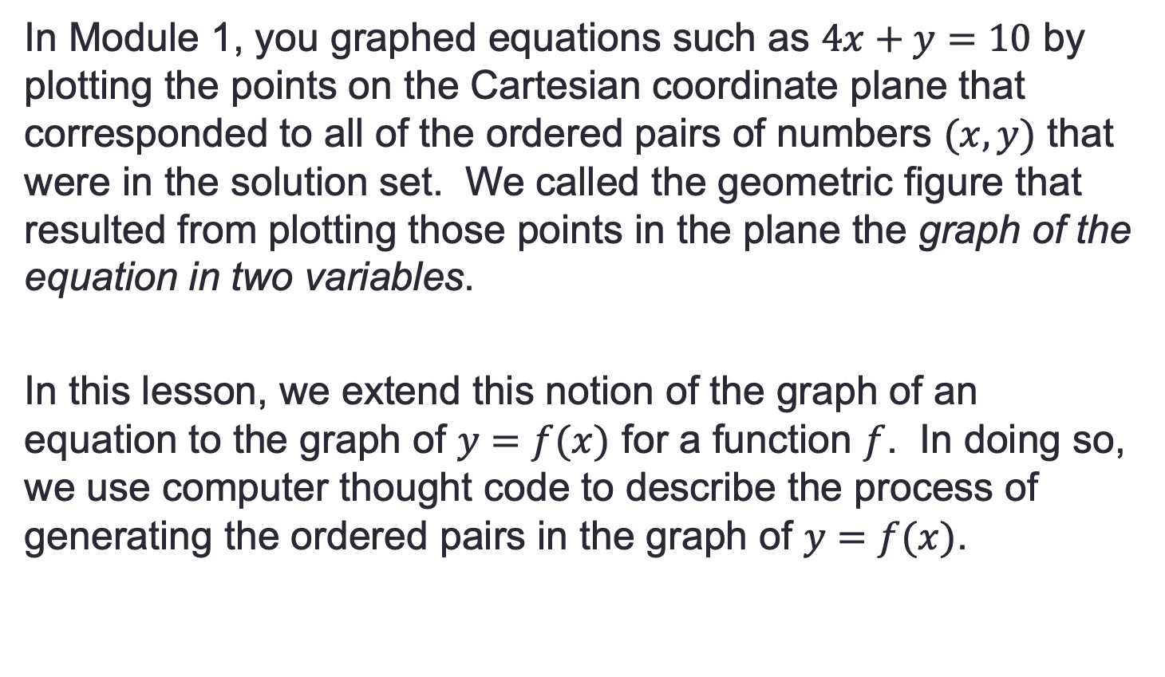
Entry - read
In Module 1, you graphed equations such as $4x+y=10$ by plotting the points on the Cartesian coordinate plane that corresponded to all of the ordered pairs of numbers $(x,y)$ that were in the solution set. We called the geometric figure that resulted from plotting those points in the plane the graph of the equation in two variables.
In this lesson, we extend this notion of the graph of an equation to the graph of $y=f(x)$ for a function $f$. In doing so, we use computer thought code to describe the process of generating the ordered pairs in the graph of $y=f(x)$.

Slide 36

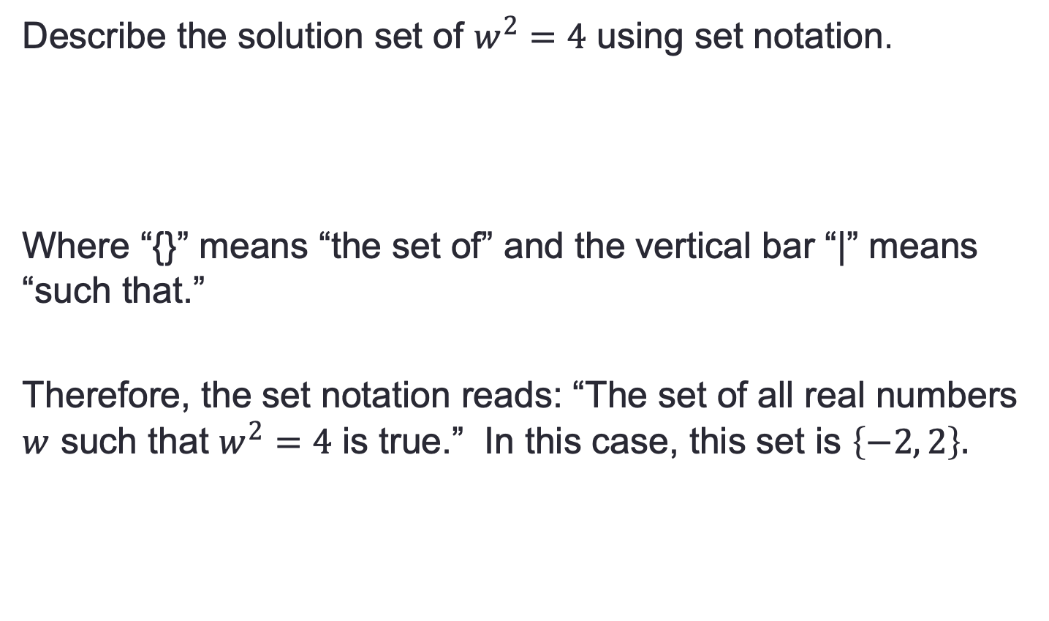
Recall
Describe the solution set of $w^{2}=4$ using set notation.
Where “{}” means “the set of” and the vertical bar “|” means “such that.”
Therefore, the set notation reads: “The set of all real numbers $w$ such that $w^{2}=4$ is true.” In this case, this set is $\left\{−2, 2\right\}.$
$\left\{w real \right| w^{2}=4\}$

Slide 37
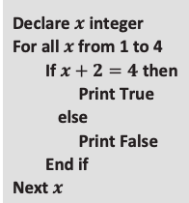
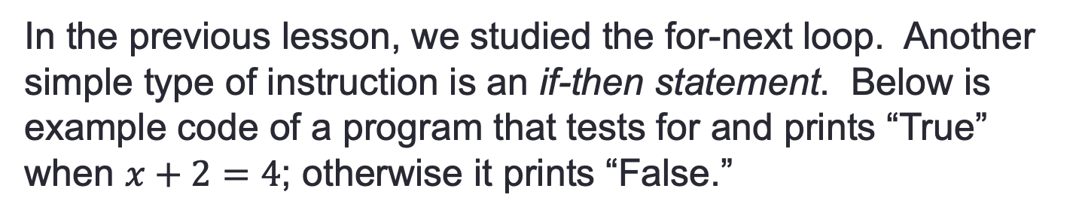
Example 1
In the previous lesson, we studied the for-next loop. Another simple type of instruction is an if-then statement. Below is example code of a program that tests for and prints “True” when $x+2=4$; otherwise it prints “False.”
← x is quantified as an integer
← Define the domain
← Define test
← Print ”true” if equation true for x-value
← Otherwise Print ”false”
← directions performed for all x-values
The output of this program code is: False, True, False, False
Notice that the if-then statement in the code above is really just testing whether each number in the loop is in the solution set.

Slide 38
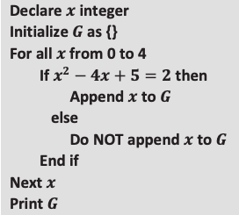

Example 2
Perform the instructions in the following programming code as if you were a computer and your paper were the computer screen.
← x is quantified as an integer
← Open a set called G
← “For” starts the loop with x = 0
← Define test
If true, add the value to the set
← Otherwise don’t add to set
← directions from “for” until ”next” are performed for all x-values
Output: $\{1, 3\}$

Slide 39
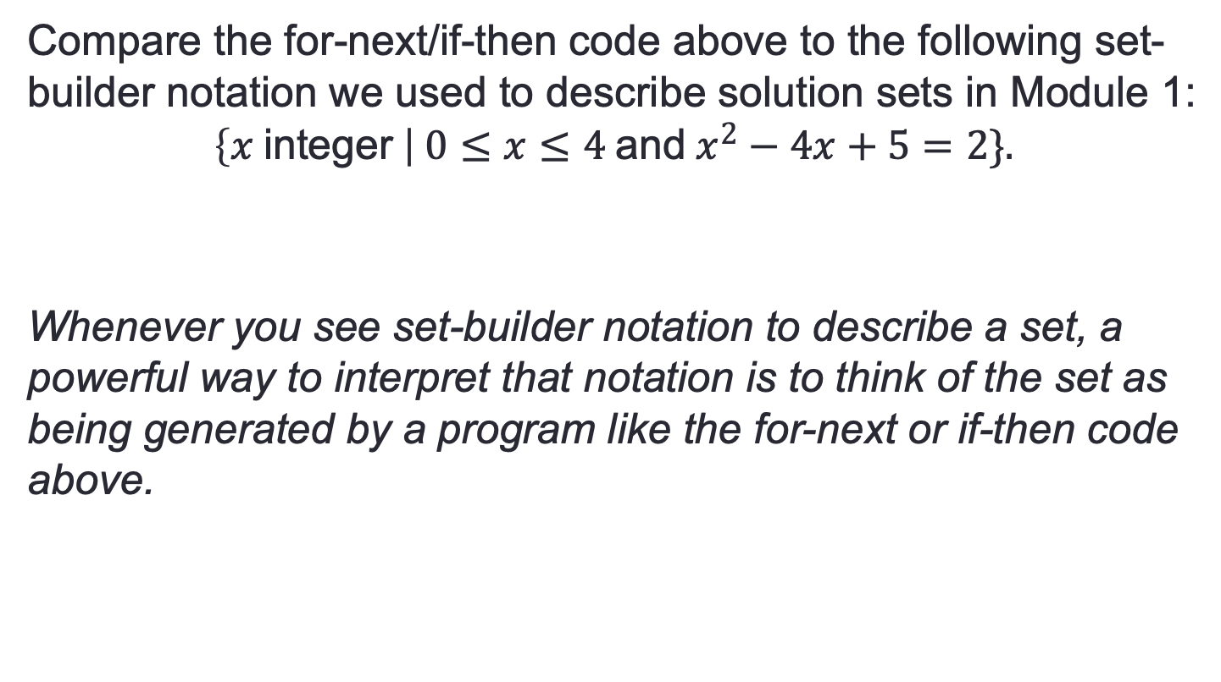
Example 2, continued
Compare the for-next/if-then code above to the following set-builder notation we used to describe solution sets in Module 1:
$$\left\{x \text{integer} \right| 0≤x≤4 \text{and} x^{2}−4x+5=2\}.$$
Whenever you see set-builder notation to describe a set, a powerful way to interpret that notation is to think of the set as being generated by a program like the for-next or if-then code above.

Slide 40
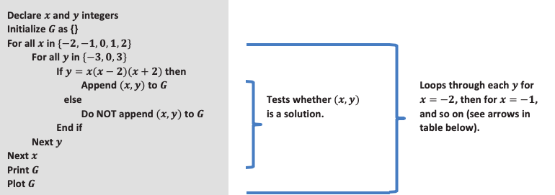
Nested For-Next Loops

Slide 41
Workshop
Must Do
May Do
Classwork11
Classwork12
KhanAcademy
Crossing the River/Carnival Bears
Exponents review
Linear practice

Slide 42
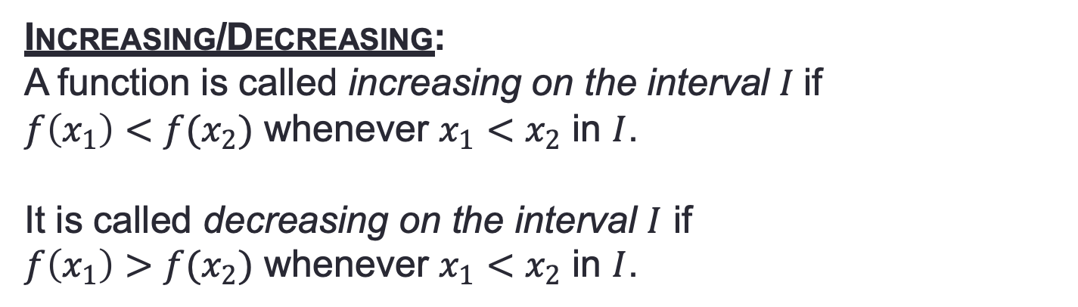
Notes - Graphs
Graph of $f$: Given a function, f, whose domain, D, and range are subsets of the real numbers, the graph of $f$ is the set of ordered pairs in the Cartesian plane given by
$\left\{\left(x,f\left(x\right)\right) \right|x∈D\}.$
Increasing/Decreasing:
A function is called increasing on the interval $I$if
$f\left(x_{1}\right)<f(x_{2})$ whenever $x_{1}<x_{2}$ in $I$.
It is called decreasing on the interval $I$ if
$f\left(x_{1}\right)>f(x_{2})$ whenever $x_{1}<x_{2}$ in $I$.

Slide 43
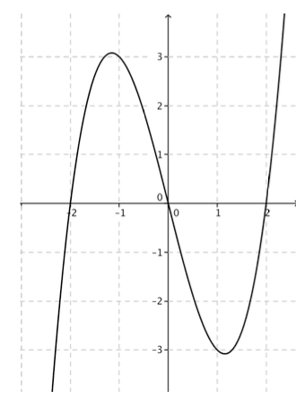
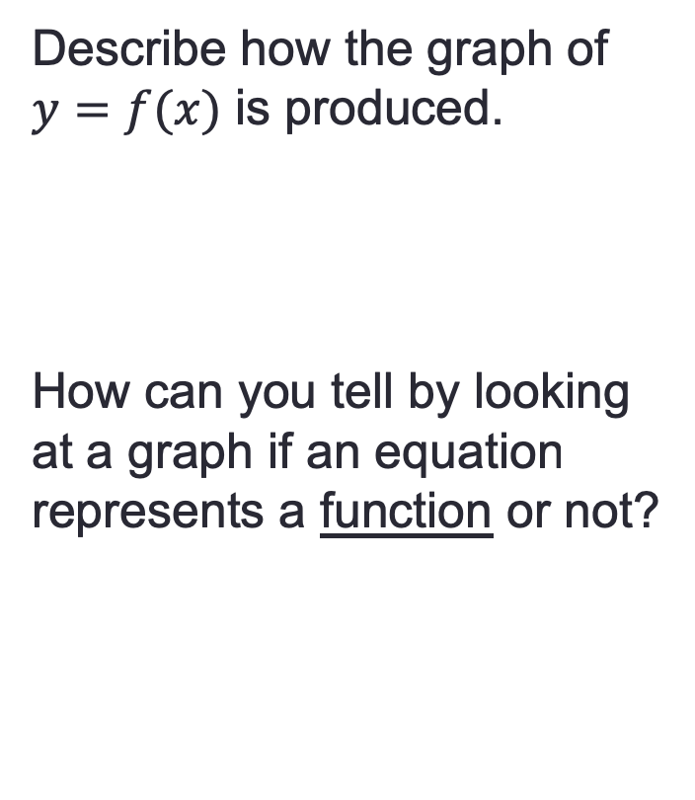
Summary
Describe how the graph of $y=f(x)$ is produced.
How can you tell by looking at a graph if an equation represents a function or not?

Slide 44
Lesson 13
Entry task, discussion, posters, present, notes, classwork

Slide 45
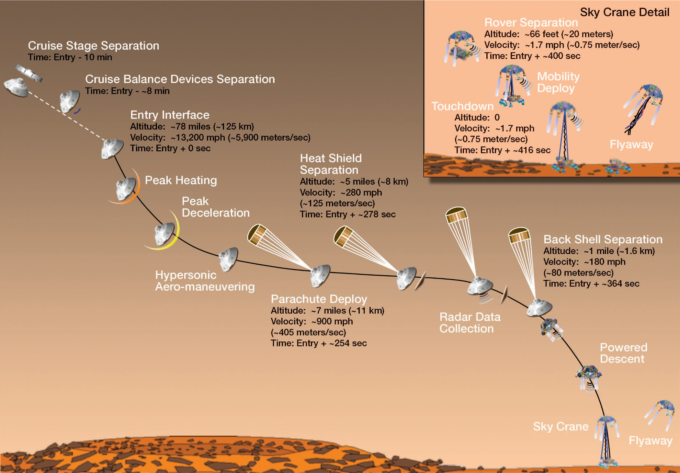
Intro
This graphic was shared by NASA prior to the Mars Curiosity Rover landing on August 6, 2012. It depicts the landing sequence for the Curiosity Rover’s descent to the surface of the planet.
Does this graphic represent the landing path of Curiosity well?

Slide 46
Does this graphic represent the landing path of Curiosity well?
What information is available?
Why are there negative time values? Should other quantities be negative?
What does ~ mean?
Metric or customary?

Slide 47
TASK
Create a table(s) and graphs to represent the altitude and velocity as functions of time.

Slide 48
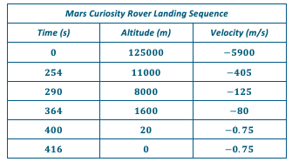
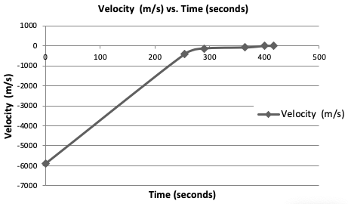
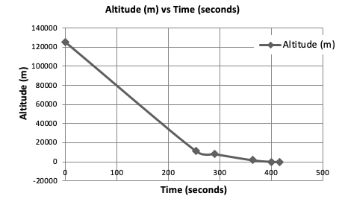
Possible Solution

Slide 49
Notes
A function, f, is increasing on an interval when the f(x) values are getting higher.
A function, f, is decreasing on an interval when the f(x) values are getting lower.
A function, f, is positive on an interval when the f(x) values are > 0.
A function, f, is negative on an interval when the f(x) values are < 0.
Intercepts – where graphs cross the axes
Interval Notation: closed brackets [ ] mean including the end values, curved brackets ( ) mean not including the end values.

Slide 50
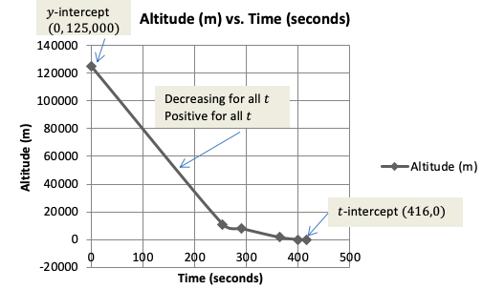
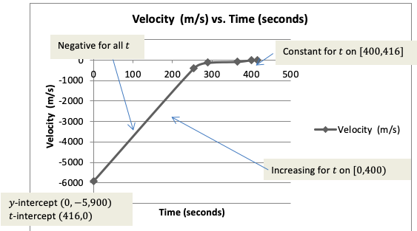
Possible Solution-
Annotated

Slide 51
Workshop
Must Do
May Do
Exit ticket 12
Classwork13 #1-9
Khan Academy
Study/review lessons 1-12
Notes sheet
Folder organize
Linear equation review
Exponents review
Slope practice

Slide 52
Article from Wired http://www.wired.com/thisdayintech/2010/11/1110mars-climate-observer-report/ with students. It explains an earlier mishap by NASA that cost billions of dollars and two lost explorers due to a measurement conversion error. Scientists carefully model all aspects of space travel using mathematical functions, but if they do not attend to precision, it can lead to big mistakes.

Slide 53
Lesson 14
Examples, classwork

Slide 54
Entry Task/Example 1 - Linear
Write a linear function that goes through the points (0,4) and (4,12).
Can you write a linear function, f(x)=mx+b, that goes through (0,4) and (0, -2)?

Slide 55


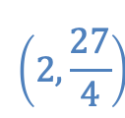

Example 1 - exponential
Write functions in the form g(x) = ab^{x} for each of the graphs.
$$\left(2,\frac{27}{4}\right)$$
$$\left(0,2\right)$$
$$\left(−2,0.5\right)$$
$$\left(−1,2\right)$$

Slide 56
1a)LINEAR f(x).= 2x + 4
1c)EXPONENTIAL. g(x) = 2(2)^{x}
If you restrict the domains of these functions to the positive integers and 0, you get:
An arithmetic sequence (a):
A geometric sequence (c):
Write recursive formulas for these sequences
Summary: linear functions grow additively, while exponential functions grow multiplicatively.

Slide 57

Example 2
A lab researcher records the growth of the population of a yeast colony and finds that the population doubles every hour.
a. Complete the researcher’s table of data:
b. What is the exponential function that models the growth of the colony’s population?

Slide 58

Example 2, continued
P(t) = 5(2)^{t}
c) Several hours into the study, the researcher looks at the data and wishes there were more frequent measurements. Knowing that the colony doubles every hour, how can the researcher determine the population in half-hour increments?
d) Complete the new table that includes half-hour increments.
e) What if we wanted 20 minute increments?

Slide 59
Workshop
Must Do
May Do
Exit ticket 13
Classwork14 #1-2
Summary questions
Khan Academy
Study/review lessons 1-14
Notes sheet
Folder organize
Linear equation review
Exponents review
Slope practice

Slide 60
Test Skills
1b) Identify sequence as arithmetic or geometric and why
1c) Write explicit and recursive formula
1d-e) Use formula to predict
2) Compare linear to exponential function using tables, graphs, and rate of change
3b-c) Write and use a formula based on dot pattern
3d) Is it a function?
4a-c) Function or not (given word problem)
5a) y-intercept from graph; meaning in context
5b) Increasing/decreasing intervals
5c) Write linear function from two points
5d) Domain (in context)
5e) Sketch graph
5f) x-intercept; meaning in context

