Slide 1
Lesson 21
Warm up, example, classwork

Slide 2
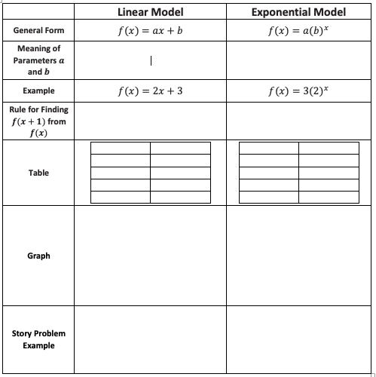
Warm Up
Fill in the missing information in the table as a review of linear and exponential functions.

Slide 3
Example
$$\frac{f\left(x+d\right)−f\left(x\right)}{d}=4$$
Do these tables show linear functions?

Slide 4
Workshop
Must Do
May Do
Classwork21 #1-6
Khan Academy
Linear equation practice
Slope practice
Note sheet
Folder organize
Complete all cw and hw

Slide 5
Lesson 24
Warm up, classwork

Slide 6

Warm Up
Here are two different parking options in the city.
The cost of a $2.75$-hour stay at 1-2-3 Parking is $\$6+\$5+\$4=\$15$. The cost of a $2.75$-hour stay at Blue Line Parking is $\$5(2.75)=\$13.75$.
Which garage costs less for a $5.25$-hour stay? Show your work to support your answer.

Slide 7
Warm Up, continued
Here are two different parking options in the city.
What type of functions would model these plans?
What would reasonable domain and range values be for the situation?

Slide 8
Modeling Cycle

Slide 9
Workshop
Must Do
May Do
Exit ticket 21
Classwork24 #1-4
Summary/reflection
Khan Academy
Linear equation practice
Slope practice
Note sheet
Folder organize
Complete all cw and hw

Slide 10
Lesson 22
Opener, classwork

Slide 11
Opening: Read
The lionfish is a fish that is native to the western Pacific Ocean. The lionfish began appearing in the western Atlantic Ocean in 1985. This is probably because people bought them as pets and then dumped them in waterways leading to the ocean. Because it has no natural predators in this area, the number of lionfish grew very quickly and now has large populations throughout the Caribbean as well as along the eastern coastline of the United States and the Gulf of Mexico. Lionfish have recently been spotted as far north as New York and Rhode Island.

Slide 12
Workshop
Must Do
May Do
Classwork22 #1-10
Reflection
Khan Academy
Linear equation practice
Slope practice
Note sheet
Folder organize
Complete all cw and hw

Slide 13
Lesson 23
Warm up, example/classwork, notes

Slide 14
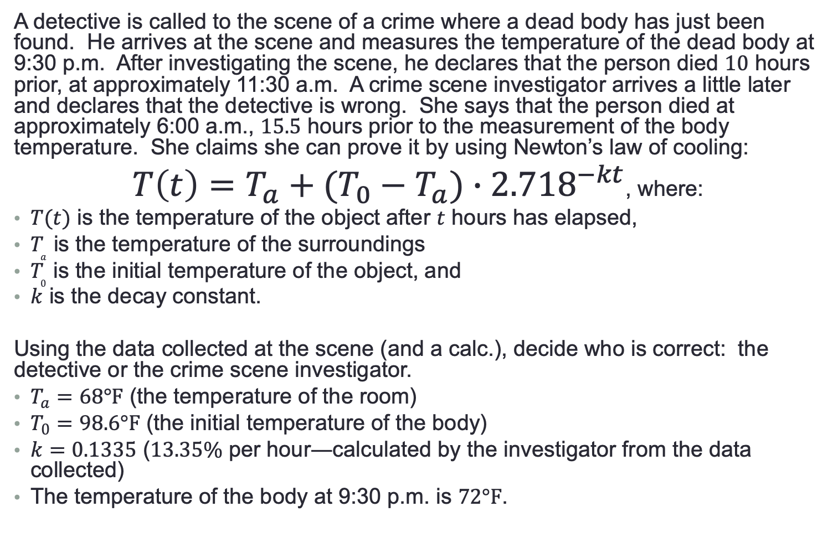
Entry Task
A detective is called to the scene of a crime where a dead body has just been found. He arrives at the scene and measures the temperature of the dead body at 9:30 p.m. After investigating the scene, he declares that the person died $10$ hours prior, at approximately 11:30 a.m. A crime scene investigator arrives a little later and declares that the detective is wrong. She says that the person died at approximately 6:00 a.m., $15.5$ hours prior to the measurement of the body temperature. She claims she can prove it by using Newton’s law of cooling:
$T\left(t\right)=T_{a}+(T_{0}−T_{a})∙{2.718}^{−kt}$, where:
$T(t)$ is the temperature of the object after $t$ hours has elapsed,
$T_{a}$ is the temperature of the surroundings
$T_{0}$ is the initial temperature of the object, and
$k$ is the decay constant.
Using the data collected at the scene (and a calc.), decide who is correct: the detective or the crime scene investigator.
$T_{a}=68°F$ (the temperature of the room)
$T_{0}=98.6°F$ (the initial temperature of the body)
$k=0.1335$ ($13.35\%$ per hour―calculated by the investigator from the data collected)
The temperature of the body at 9:30 p.m. is $72°F$.

Slide 15
Example
http://demonstrations.wolfram.com/NewtonsLawOfCooling/
What type of graph are we looking at?
Why is it exponential decay with base is greater than 1?

Slide 16
Workshop
Must Do
May Do
Classwork23 #1-3
Khan Academy
Linear equation practice
Slope practice
Note sheet
Folder organize
Complete all cw and hw

Slide 17
Test Skills
#1a-c) Moving and graphing function using transformation rules (Lessons 17-20)
#1d-e) Estimating solution on graph and checking (Lesson 16 and several lessons throughout year)
#2a-g) Writing and comparing linear and exponential functions using tables, graphs, and equations. (Lessons 1-14)
#3a-d) Analyzing patterns in pictures (Lesson 8 and many previous)
#4a) Write piecewise function (lessons 15, 20)
#4b-e) Transforming functions (Lessons 17-20)
#5) Comparing domain/range of functions (general understanding)

