Slide 1
Lesson 1
warm up, example, classwork, notes, examples, classwork, notes, example, notes, classwork

Slide 2
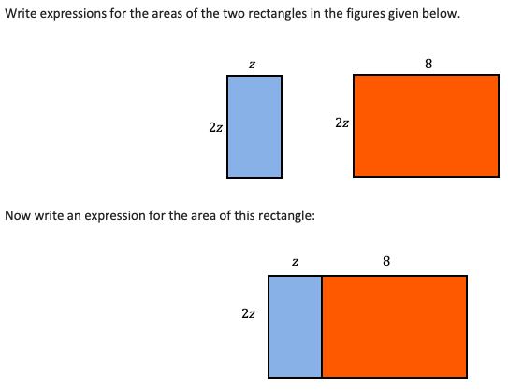
Warm Up

Slide 3
Example 1
There is a major difference between:
Multiplying two monomials: $5ab∙4c$
Mult. a polynomial by a monomial: $(5a+7b)∙3c$

Slide 4
Example 2
Jackson has given his friend a challenge:
The area of a rectangle, in square units, is represented by $3a^{2}+3a$ for some real number$a$. Find the length and width of the rectangle.
How many possible answers are there for Jackson’s challenge to his friend? List the answer(s) you find.
KEY POINT: When factoring a polynomial, you want to first look for the monomial that is the Greatest Common Factor of all terms in the polynomial. Then you do the reverse of distributive property.

Slide 5
Classwork part 1
Complete classwork problems #1-3

Slide 6
Notes, pt.1
Factoring and distributing are opposite processes.
The result of the distributive property is expanded form; the result of factoring is factored form.
Distributing is sometimes called expanding.
By factoring out the GCF, you leave a prime polynomial that is considered factored completely.

Slide 7
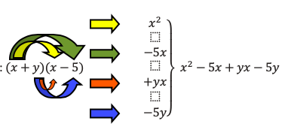
Example 3 – Multiplying 2 Binomials
Write the product of $(x+2)(x+5)$ in standard form:
With area model:
Without area model:

Slide 8
Example 4 – Difference of Squares
Find the product of $(x+2)(x−2)$.
Notes, pt. 2
A General Rule for Finding the Difference of Squares:
$$\left(a+b\right)\left(a−b\right)=a^{2}−b^{2}$$
Factored form Expanded form

Slide 9
Classwork part 2
Complete classwork problem #4-7

Slide 10
Example 5 – Square of a Binomial
To square a binomial like ${(x+3)}^{2}$, multiply the binomial by itself:
Notes, pt. 3
The general rule for squaring a binomial:
$${(a+b)}^{2}=a^{2}+2ab+b^{2}$$
$${(a−b)}^{2}=a^{2}−2ab+b^{2}$$

Slide 11
Classwork, pt. 3
Must Do
May Do
Classwork1 #1 - 9
Reflection questions
Khan Academy
Carnival Bears/Crossing the River
Exponents review
Linear equation practice
Slope practice
HW1 #4

Slide 12
Lesson 2
Warm Up, notes, classwork, notes, example, classwork, notes, example, classwork

Slide 13
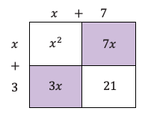
Warm Up
Use an area model to assist in multiplying $(x+7)(x+3)$.
Are there like terms that can be combined? What is the simplest product?

Slide 14
Notes, part 1
Recall: A polynomial expression officially is a numerical symbol, a variable symbol, or a combination of the two using addition and multiplication.
So: The constant in $(x−7)$ is -7 because by definition it can be rewritten as (x + -7)
In other words, the operation serves as the sign of the term.

Slide 15
Classwork part 1
Complete classwork problems #1-2

Slide 16
Notes, part 2
A polynomial expression with degree (highest exponent) 2 is called a quadratic expression.
(Because of their relation to rectangles/squares, also called quadrangles)
When multiplying two binomials with coefficients of 1, the first term is $x^{2}$, the last term is the product of the constants, and middle term is $x$ with coefficient equal to the sum of the constants:
$$\left(x+a\right)\left(x+b\right)=x^{2}+\left(a+b\right)x+ab$$
This can help with factoring the trinomial as well.

Slide 17
Example1
Factor the trinomial: $x^{2}+4x−5$

Slide 18
Classwork part 2
Complete classwork problems #3

Slide 19
Notes, part 3
When the leading coefficient of a quadratic expression isn’t 1, the first step in factoring should be see if all the terms in the expanded form have a common factor.
After factoring out the GCF, it may be possible to factor again.

Slide 20
Example 2
Factor: $2x^{3}−50x$
Step 1: Factor out the GCF of 2x
$2x\left(x^{2}−25\right)$
Step 2: Factor the difference of squares:
$2x(x+5)(x−5)$
Now factor completely: $−16t^{2}+32t+48$

Slide 21
Workshop
Must Do
May Do
Classwork2 #1-3
Summary/Reflection
Complete cw #1
Khan Academy
Crossing River/Carnival Bears
Linear Equation practice
Exponents
Slope practice

Slide 22
Lesson 3
Warm up/example, more examples, classwork

Slide 23
Warm Up/example 1
Carlos wants to build a sandbox for his little brother. He is deciding between a square sandbox with side lengths that can be represented by $x+3$ units and a rectangular sandbox with a length $1$ unit more than the side of the square and width $1$ unit less than the side of the square.
Carlos thinks the areas should be the same because one unit is just moved from one side to the other.
Do you agree that the two areas should be the same?

Slide 24
Example 1, continued
If you use the expressions for length and width without simplifying, how can you then write the area of the rectangle?
How can this expression be seen as the product of a sum and difference: $(a+b)(a−b)$?
$$\left[\left(x+3\right)+1\right]\left[\left(x+3\right)−1\right]$$
$$\left[\left(x+3\right)+1\right]\left[\left(x+3\right)−1\right]$$

Slide 25
Example 1, continued
Can you now rewrite the area expression for the rectangle as the difference of squares: $\left(a+b\right)\left(a−b\right)=a^{2}−b^{2}$?
Look carefully at the answer to the last question. What does it tell you about the areas of the two shapes?
$$\left[\left(x+3\right)+1\right]\left[\left(x+3\right)−1\right]={(x+3)}^{2}−1^{2}$$

Slide 26
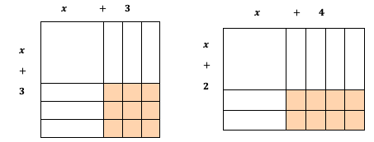
Warm Up/example 1
Can you verify that our algebra is correct using a diagram or visual display?
Try: What if the square was 4 x 4, and you changed to the rectangle? 7x7?

Slide 27
Example 2
Recall from yesterday: $\left(x+3\right)\left(x+5\right)=x^{2}+8x+15$
Compare this to: $\left(2x+3\right)\left(x+5\right)=2x^{2}+13x+15$
Since the rule from yesterday doesn’t work anymore, how can we use the numbers in the expanded form to find the numbers for the factors?
Still need the factor pairs to make +15
Then double 1 factor plus the other to make 13
1x15, 3x5 (why can I ignore the negative options?)
2(1)+15 or 1+2(15) or 2(3)+5 or 3+2(5)

Slide 28
Example 2, continued
$$2x^{2}+13x+15$$
So now we know 3+2(5) makes 13, so we’re using 3 and 5 in our factors. How do we place them?
(__$x$ $±$ __)(__$x ±$ __) [We have four number places to fill in this template.]
(__$x ± 3$ )(__$x ± 5$ ) [We know that the $3$ and $5$ are the correct factors$]$
( $2x ± 3$ )( $1x ± 5$ ) [We know that $2$ and $1$ are the coefficients, put the $2$ opposite the $5$ so that the distribution process gives us $10x$ for one product.]
( $2x + 3$ )( $x + 5$ ) [Finally, we know for this example that all the numbers are positive.]

Slide 29
Example 3
Let’s try factoring: $3x^{2}−x−4$ using that process.

Slide 30
Classwork
Must Do
May Do
Exit ticket 1-2
Classwork 3 #1-10
Challenge questions MUST be attempted
Reflection/summary question
Khan Academy
Exponents review
Linear practice
Slope practice

Slide 31
Lesson 4
Long example, classwork

Slide 32
Warm Up
Factor the following quadratic expressions.
${2x}^{2}+10x+12$
$$6x^{2}+5x−6$$

Slide 33
Example
$6x^{2}+5x−6$ is challenging because there are lots of factors to make 6 that could be coefficients on the x-terms. This makes trial and error time consuming. The following is a strategy that will lead the factors without guess and check.
Step 1: Multiply (a) and (c)
Step 2: Find factor pairs that make
the answer from step 1 Step 3: Choose pair that adds to (b)
Step 4: Rewrite expression with split
middle term.
Step 5: Split the 4-term expression into two parts.
Step 6: Use an area model or factor by grouping.
Step 1: 6(-6) = -36
Step 2: (4, -9) (-4, 9) (-6, 6) (2, -18)
(-2, 18) (1, -36) (-1, 36) (3, -12) (-3, 12)
Step 3: 9 and -4
Step 4: $6x^{2}−4x+9x−6$. or $$6x^{2}+9x−4x−6$$
Step 5: $\left(6x^{2}−4x\right)+\left(9x−6\right)$ or $$\left(6x^{2}+9x\right)+(−4x−6)$$

Slide 34
Example, continued
$6x^{2}+5x−6$ is challenging because there are lots of factors to make 6 that could be coefficients on the x-terms. This makes trial and error time consuming. The following is a strategy that will lead the factors without guess and check.
Step 6: Use an area model or factor by grouping.
$$\left(6x^{2}−4x\right)+\left(9x−6\right)$$
Factor out the common factor from each group.
Factor out the common factor.

Slide 35
Workshop
Must Do
May Do
Classwork3 #1-10
Classwork4 #1-5
Summary/reflection included
Khan Academy
Exponents review
Linear practice
Slope practice

Slide 36
Lesson 5
Warm up, notes, examples, classwork

Slide 37
Warm Up
Find values of $c$ and $d$ that satisfy each of the following equations. (There may be more than one correct answer.)
$cd=0$
$(c−5)d=2$
$(c−5)d=0$

Slide 38
Notes
Zero Product Property: If $ab=0$, then $a=0$ or $b=0$ or $a=b=0$. (i.e. anything times 0 is 0, so if a product is 0, one or both factors must equal 0.
So then when given an equation like: $(c−5)(d+3)=0$ you can find values for c and d that make each factor equal to 0.
Steps for solving a quadratic equation:
Make sure the equation is set equal to 0
Factor the equation
Find values for variable that make each factor equal to 0
If one factor equals 0, the product equals 0 and the equation is true

Slide 39
Example1 (long-ish)
The area of a rectangle can be represented by the expression $x^{2}+2x−3$. Write each dimension of this rectangle as a binomial. Write the area in terms of the product of the two binomials.
Draw and label a diagram that represents the rectangle’s area.
Suppose the rectangle’s area is $21$ square units. Can you find the dimensions of the rectangle?

Slide 40
Example1, continued
To make this easier, rewrite the original expanded form equation so that it is equal to zero and solve.
What are the actual dimensions of the rectangle (in context)?

Slide 41
Example2
A smaller has an area that can be represented by the expression $x^{2}−4x−5$. What are the dimensions of the smaller rectangle in terms of $x$?
What value for $x$would make the smaller rectangle have an area of $\frac{1}{3}$ that of the larger?

Slide 42
Classwork
Must Do
May Do
Exit ticket 4
Classwork5 #1-7
KhanAcademy
Crossing the River/Carnival Bears
Exponents review
Linear practice
Slope practice
Start homework5

Slide 43
Lesson 6
Warm up, examples(2), brief notes, classwork

Slide 44
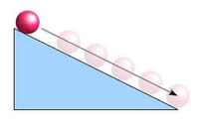
Warm Up
A physics teacher put a ball at the top of a ramp and let it roll down toward the floor. The class determined that the height of the ball could be represented by the equation $h=−16t^{2}+4$, where the height, $h$, is measured in feet from the ground and time, $t$, is measured in seconds.
What do you notice about the structure of the quadratic expression in this problem?
In the equation, explain what the $4$ represents.
Explain how you would use the equation to determine the time it takes the ball to reach the floor.

Slide 45
Example1
Two methods for solving: $h=−16t^{2}+4$
Set equal to 0 $−16t^{2}+4=0$
Subtract 4 from both sides $−16t^{2}=−4$
Divide both sides by -16 $t^{2}=\frac{−4}{−16}=\frac{1}{4}$
Square root both sides $t=\sqrt{\frac{1}{4}}=±\frac{1}{2}$
Set equal to 0 $−16t^{2}+4=0$
Factor out the GCF $−4\left(4t^{2}−1\right)=0$
Difference of squares $−4\left(2t+1\right)\left(2t−1\right)$
Zero-product property $2t−1=0$ or $2t+1=0$, so $t=\frac{1}{2}$ or $t=−\frac{1}{2}$
In context, which answer actually makes sense?

Slide 46
Notes
Mathematicians goal (and thus yours) is to find the most efficient, or most elegant, path to a solution.
Remember to apply CONTEXT to your solutions.
When taking square roots, if there is not a whole number solution it is fine to leave the answer in “radical form.”
(i.e. $\sqrt{3}$ is a final answer better than a rounded decimal)

Slide 47
Example2
Lord Byron is designing a set of square garden plots so some peasant families in his kingdom can grow vegetables. The minimum size for a plot recommended for vegetable gardening is at least $2 m$ on each side. Lord Byron has enough space around the castle to make bigger plots. He decides that each side should be the minimum ($2 m$) plus an additional $x m$.
What expression can represent the area of one individual garden based on the undecided additional length $x$?
There are $12$ families in the kingdom who are interested in growing vegetables in the gardens. What equation can represent the total area, $A$, of the $12$ gardens?

Slide 48
Example2, continued
Lord Byron is designing a set of square garden plots so some peasant families in his kingdom can grow vegetables. The minimum size for a plot recommended for vegetable gardening is at least $2 m$ on each side. Lord Byron has enough space around the castle to make bigger plots. He decides that each side should be the minimum ($2 m$) plus an additional $x m$.
c) If the total area available for the gardens is $300 sq m$, what are the dimensions of each garden?
d) Find both values for $x$ that make the equation in part (c) true (the solution set). What value of $x$ does Lord Byron need to add to the $2 m$?

Slide 49
Workshop
Must Do
May Do
Classwork6 #1-6
Summary/reflection questions
KhanAcademy
Finish classwork5
Linear equation practice
Exponents review
Slope practice
Vocabulary section

Slide 50
Lesson 7
Warm up, examples(2), classwork

Slide 51
Review/Practice
Solve using the best method:
$3d^{2}+d−10=0$ $5b^{2}−25=0$
$$3{(x−2)}^{2}=9$$

Slide 52
Warm Up
The length of a rectangle is $5 in.$ more than twice a number. The width is $4 in.$ less than the same number. The perimeter of the rectangle is $44 in$. Sketch a diagram of this situation, and find the unknown number.

Slide 53
Example1
The length of a rectangle is $5 in.$ more than twice a number. The width is $4 in.$ less than the same number. If the area of the rectangle is $15 {in}^{2}$, find the unknown number.

Slide 54
Example2
A picture has a height and width of a ratio 4 : 3. It is to be enlarged so that the ratio of height to width remains the same, but the area is $192 {in}^{2}$. What are the dimensions of the enlargement?

Slide 55
Workshop
Must Do
May Do
Exit ticket 5-6
Classwork7 #1-5
Summary/reflection questions
KhanAcademy
Finish classwork5-6
Classwork7 #6-7
Linear equation practice
Exponents review
Slope practice
Vocabulary section

Slide 56
Lesson 8
Lengthy notes, example, classwork

Slide 57
Warm Up
What is the special name for the graph of a quadratic function?
Solve:
${(d+5)}^{2}=5$ 2) $4{(g−1)}^{2}+6=13$

Slide 58
Notes – parts of a quadratic graph
A quadratic function is a polynomial of degree 2.
Standard form: $f\left(x\right)=ax^{2}+bx+c$.
Factored form: $f\left(x\right)=a(x−m)(x−n)$
Vertex Form: $f\left(x\right)=a{(x−h)}^{2}+k$
Quadratic functions create a symmetrical curve with either a highest (maximum) or lowest (minimum) point called the vertex.
The x-intercepts of quadratic functions are also called zeroes and solutions and roots.

Slide 59
Notes – parts of a quadratic graph
Axis of symmetry: Given a quadratic function in standard form, the vertical line given by the graph of the equation $x=−\frac{b}{2a}$ is called the axis of symmetry of the graph. (i.e. the vertical line through the vertex is a line of symmetry)
Vertex: The point where the graph of a quadratic function and its axis of symmetry intersect is called the vertex. The $x$-coordinate of the vertex is the average of the $x$-coordinates of the zeros (or any two symmetric points) on the graph.
End behavior of a graph: A quadratic function is said to open up if $a>0$ and open down if $a<0$.

Slide 60
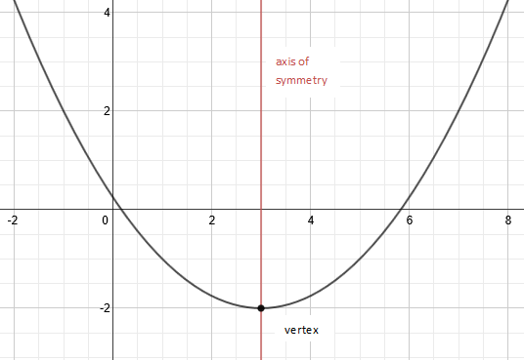
End behavior: This graph of a quadratic function opens up. As the values of $x$ approach $+∞$ and $−∞$, the values of $y$ approach $+∞$.

Slide 61
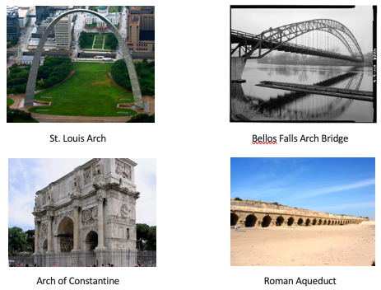
Example – don’t write
Below are some examples of curves found in architecture around the world. Some of these might be represented by graphs of quadratic functions. What are the key features these curves have in common with a graph of a quadratic function?
Describe the overall shape of a graph of a quadratic function.
What is similar or different about the overall shape of the above curves?

Slide 62
Workshop
Must Do
May Do
Classwork8 #1-4
Summary/reflection questions
KhanAcademy
Linear equation practice
Exponents review
Slope practice
Vocabulary section
Notes sheet
Folder organize
Complete all cw/hw 1-8

Slide 63
Lesson 9
Warm up, notes, examples(3), classwork

Slide 64
Warm Up
Solve the following equation:
$x^{2}+6x−40=0$

Slide 65
Notes
When we have a quadratic function in factored form, we can find its $x$-intercepts, $y$-intercept, axis of symmetry, and vertex.
For a quadratic equation written factored form, $m$ and $n$ are the roots of the function. Since the $x$-value of the vertex is the average of the $x$-values of the two roots, we can substitute that value back into the equation to find the $y$-value of the vertex.
If we set $x=0$, we can find the $y$-intercept (also the c in standard form).

Slide 66
Example1
Consider the equation $y=x^{2}+6x−40$.
Given this quadratic equation, can you find the $x$-intercepts?
In the last lesson, we learned about the symmetrical nature of the graph of a quadratic function. How can we use that information to find the vertex for the graph?
How could we find the $y$-intercept (where the graph crosses the $y$-axis and $x=0$)?
What else can we say about the graph based on our knowledge of the symmetrical nature of the graph of a quadratic function? Can we determine the coordinates of any other points?
Plot the points you know for this equation on graph paper, and connect them to show the graph of the equation.

Slide 67
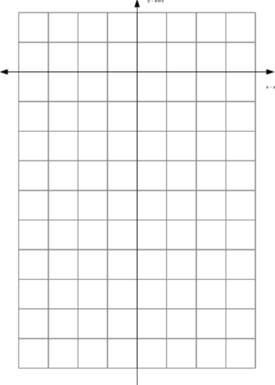
Example 1
Points:
(0, -40)
(4, 0)
(-10, 0)
(-3, -49)
(-6, 40)

Slide 68
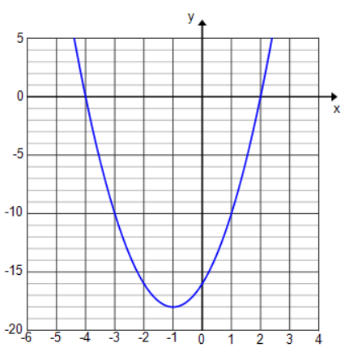
Example2
Consider the graph of the quadratic function shown below with $x$-intercepts $−4$ and $2$.
Write a formula for a possible quadratic function, in factored form, that the graph represents using $a$ as a constant factor.
Why is this not enough to be done with the equation?
The $y−$intercept of the graph is $−16$. Use the $y$-intercept to adjust your function by finding the constant factor $a$.

Slide 69
Example3
A science class designed a ball launcher and tested it by shooting a tennis ball straight up from the top of a $15$-story building. They determined that the motion of the ball could be described by the function:
$h\left(t\right)=−16t^{2}+144t+160$,
where$t$ represents the time the ball is in the air in seconds and $h(t)$ represents the height, in feet, of the ball above the ground at time $t$. What is the maximum height of the ball? At what time will the ball hit the ground?
With a graph, we can see the number of seconds it takes for the ball to reach its peak and how long it takes to hit the ground. How can factoring the expression help us graph this function?
Once we have the function in its factored form, what do we need to know in order to graph it? Now graph the function.

Slide 70
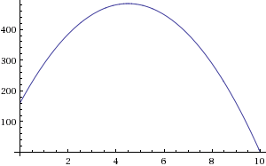
Example3, continued
A science class designed a ball launcher and tested it by shooting a tennis ball straight up from the top of a $15$-story building. They determined that the motion of the ball could be described by the function:
$h\left(t\right)=−16t^{2}+144t+160$,
Using the graph, at what time does the ball hit the ground?
Over what domain is the ball rising? Over what domain is the ball falling?
Using the graph, what is the maximum height the ball reaches?

Slide 71
Workshop
Must Do
May Do
Classwork9 #1-4
Summary/reflection questions
KhanAcademy
Linear equation practice
Exponents review
Slope practice
Vocabulary section
Notes sheet
Folder organize
Complete all cw/hw 1-10

Slide 72
Lesson 10
Examples(2), short notes, classwork

Slide 73
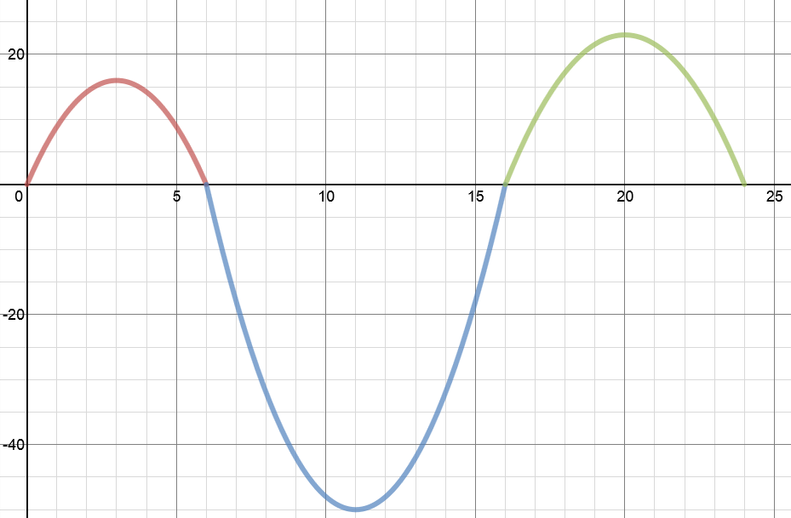
Example 1
In a study of the activities of dolphins, a marine biologist made a $24$-second video of a dolphin swimming and jumping in the ocean with a specially equipped camera that recorded one dolphin’s position with respect to time. This graph represents a piecewise function, $y=f(t)$, that is defined by quadratic functions on each interval. It relates the dolphin’s vertical distance from the surface of the water, in feet, to the time from the start of the video, in seconds. Use the graph to answer the questions.
Height of the dolphin in feet (distance from water surface)
$$y$$
$$y=f(t)$$
$$t$$
Time in seconds

Slide 74
Example 1
Height of the dolphin in feet (distance from water surface)
$$y$$
Describe what you know for sure about the actions of the dolphin in the time interval from $0$–$6$ sec.
Where do you find the values for which $f(t)=0$? Explain what they mean in the context of this problem.
How long was the dolphin swimming under water in the recorded time period?
Estimate the maximum height that the dolphin jumped in the recorded time period.
Locate the point on the graph where $f\left(t\right)=−50$, and explain what information the coordinates of that point give you in the context of this problem.
$$y=f(t)$$
$$t$$
Time in seconds

Slide 75
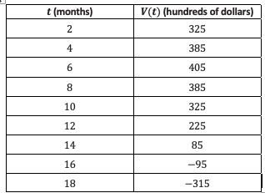
Example2
The table below represents the value of Andrew’s stock portfolio, where $V$ represents the value of the portfolio in hundreds of dollars and $t$ is the time in months since he started investing. Answer the questions that follow based on the table of values.

Slide 76
Example2
What kind of function could model the data in this table?
How much did Andrew invest in his stock initially?
What is the maximum value of his stock, and how long did it take to reach the maximum value?
How fast is Andrew’s stock value decreasing between $[10, 12]$? Find another two-month interval where the average rate of change is faster.
Are there other two-month intervals where the rate of change is the same as $[10, 12]$?

Slide 77
Notes (not on mid-unit test)
In the table of a quadratic function, the second differences are constant. The creates a predictable pattern of change in the table.
(Linear equations have constant first differences – the slope or rate of change).

Slide 78
Workshop
Must Do
May Do
Exit ticket 7-9?
Classwork10 #1-2
KhanAcademy
Linear equation practice
Exponents review
Slope practice
Vocabulary section
Notes sheet
Folder organize
Complete all cw/hw 1-10

Slide 79
Test Content
Factoring. Solving, Word problems, Graphing
1ab) Area/perimeter of rectangle
1c) Solve quadratic
1d) Factor/Solve quadratic
2a) Factor quadratic
2b) Distribute
2c) Combine like terms AND distribute
3) Falling object problem: relate equation to graph, max/min, hit ground, increasing/decreasing, meaning of a point in context, domain, graph it with all key features identified
ALSO A REVIEW SECTION – MODULES 1-3

