Slide 1
Similarity
Eureka Math
8th Grade Module 3

Slide 2
Lesson 1
Review/explore, notes, workshop

Slide 3
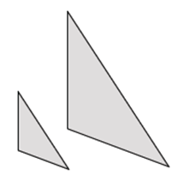
Similar or no?
Recall: Informally, two shapes are said to be similar if they have the same shape but not necessarily the same size.

Slide 4
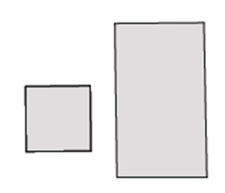
Similar or no?
Recall: Informally, two shapes are said to be similar if they have the same shape but not necessarily the same size.

Slide 5
Similar or no?
Recall: Informally, two shapes are said to be similar if they have the same shape but not necessarily the same size.

Slide 6
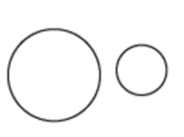
Similar or no?
Recall: Informally, two shapes are said to be similar if they have the same shape but not necessarily the same size.

Slide 7
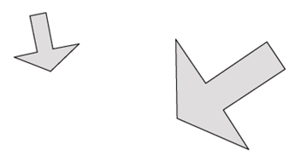
Similar or no?
Recall: Informally, two shapes are said to be similar if they have the same shape but not necessarily the same size.

Slide 8
Similar or no?
Recall: Informally, two shapes are said to be similar if they have the same shape but not necessarily the same size.

Slide 9
Similar or no?
Recall: Informally, two shapes are said to be similar if they have the same shape but not necessarily the same size.

Slide 10
Similar or no?
Recall: Informally, two shapes are said to be similar if they have the same shape but not necessarily the same size.

Slide 12
Notes
Dilations – stretching or shrinking with a scale factor
Scale factor – the consistent factor by which all items are multiplied by to maintain proportionality
If the scale factor is greater than 1, the figure grows
If the scale factor is less than 1 the figure shrinks
If the scale factor is 1, the figure is congruent
Dilations happen with a center which does not move
Maps lines to lines, angles to angles, points to points
Angles are preserved
Lengths are multiplied by the scale factor
Dilated points are denoted using “Prime” notation (P’)
The center, a point, and the image point all fall on one line

Slide 13
Workshop
Must Do
Can Do
Lesson 1 cw #1-4
Khan academy
PARCC tasks
Test rewrites

Slide 14
Lesson 2
Examples(4), workshop

Slide 15
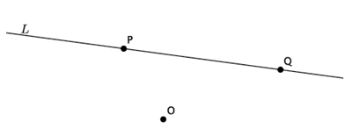
Example 1
Scale factor = 2

Slide 16
Example 2
Scale factor = 3

Slide 17
Example 3

Slide 18
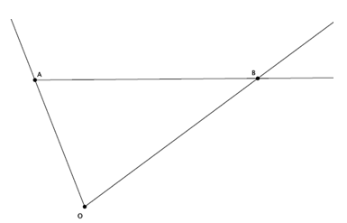
Example 4
Scale factor = 1/2
5 cm
8 cm

Slide 20
Workshop
Must Do
Can Do
Lesson 2 cw #1a-e
Khan academy
PARCC tasks
Angle review/practice

Slide 21
Lesson 3
Examples(3), workshop

Slide 22
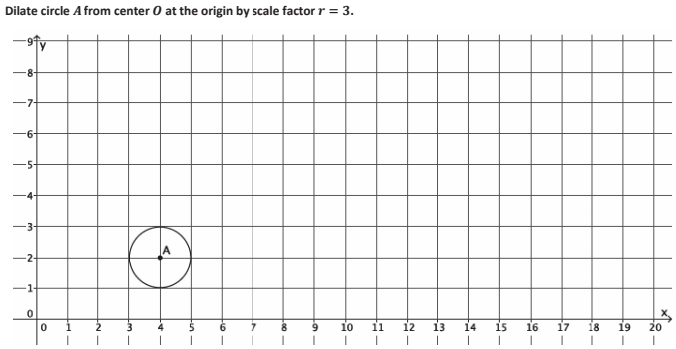
Example 1

Slide 23
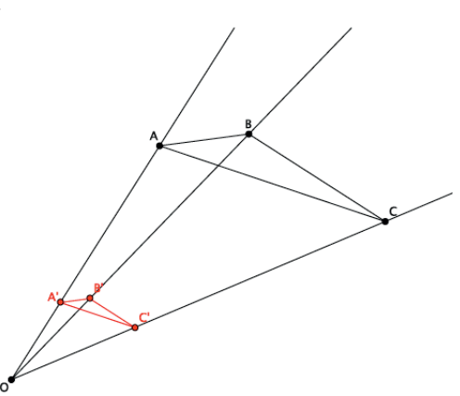
Example 2

Slide 24
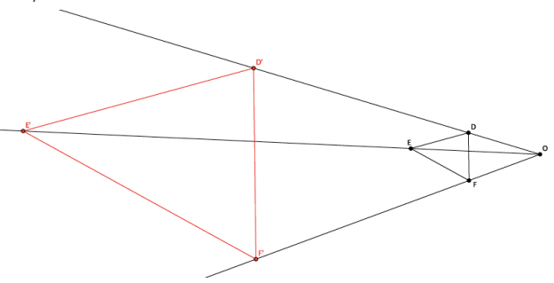
Example 3

Slide 25
Workshop
Must Do
May Do
Lesson 3 cw #1-3
Exit ticket lesson 1&2
Khan academy
PARCC task on transparency
Extra practice
Inky puzzles

Slide 26
Lesson 4
Examples/discussion, workshop

Slide 28
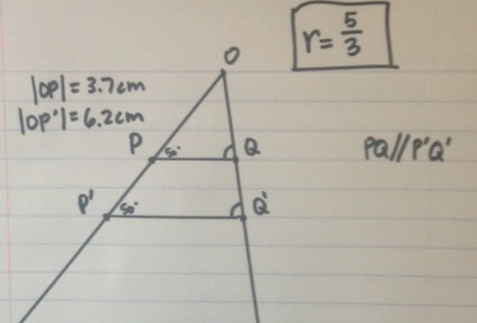

Slide 29
Workshop
Must Do
May Do
Finish Lesson 3 cw #1-3
Lesson 4 classwork 1-2
Khan academy
PARCC task on transparency
Extra practice
Inky puzzles

Slide 30
Lesson 5
Discussion, examples (3), workshop

Slide 31
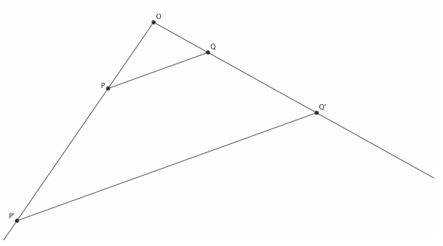
Recall
When you dilate two points with the same scale factor and connect the points, parallel lines are created.
In the diagram below, PQ and P’Q’ are parallel and P’Q’ is equal to PQ multiplied by a scale factor, r. What else do you think is true?

Slide 32
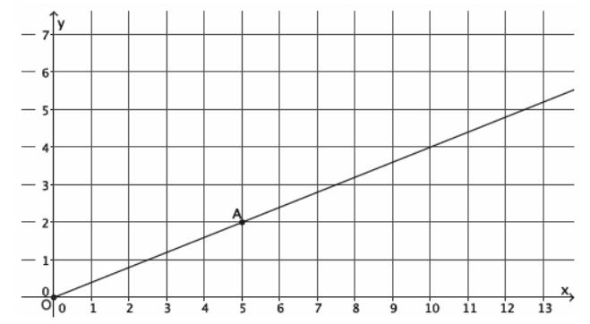
Example 1
Scale factor = 2

Slide 33
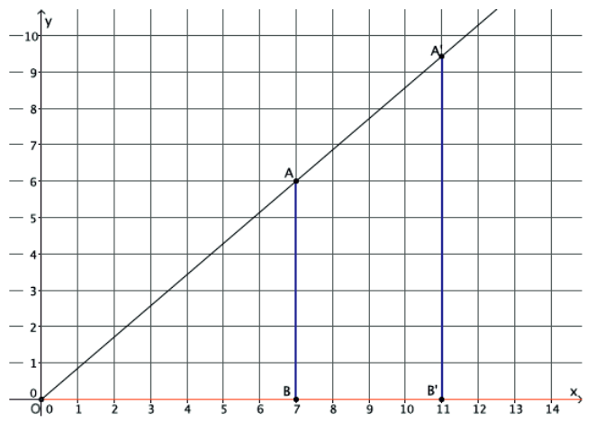
Example 2
Scale factor = 11/7

Slide 34
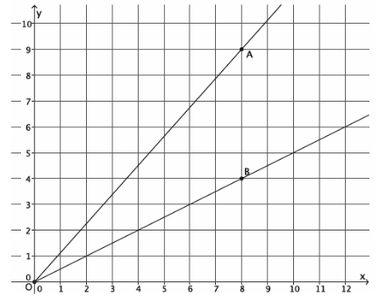
Example 3
Scale factor = 5/8

Slide 35
Workshop
Must Do
May Do
Lesson 5 #1-3
Exit ticket 3&4
Khan academy
PARCC task (transparency)
Extra practice sheet
Inky puzzle

Slide 36
Lesson 6
Discussion, examples (3), workshop

Slide 37
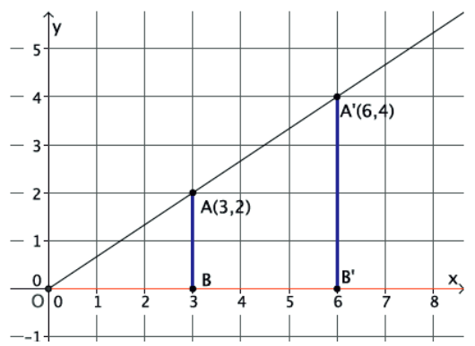
Example 1

Slide 38
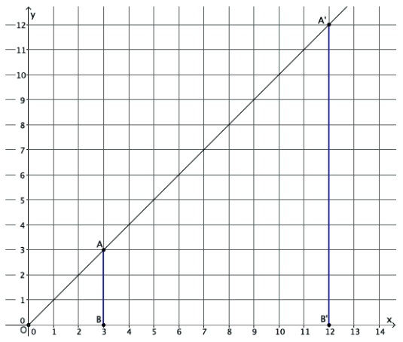
Example 2

Slide 39
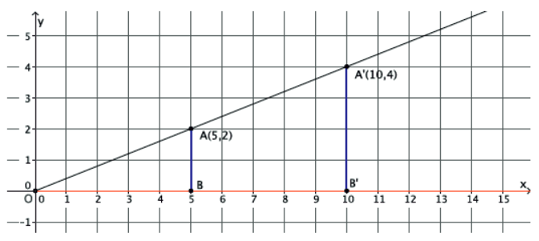
Example 3

Slide 40
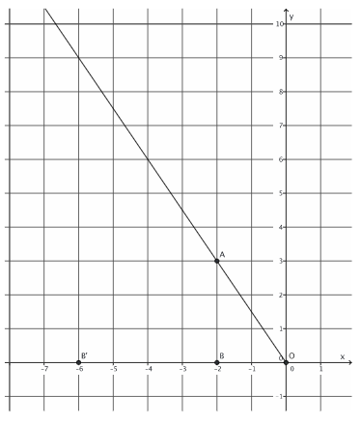
Example 4

Slide 41
Workshop
Must Do
May Do
Lesson 6 #1-8
Khan academy
PARCC task (transparency)
Extra practice sheet
Notes sheet
Folder organize

Slide 42
Lesson 7
Demonstration, workshop

Slide 43
What do you know about dilations?

Slide 44
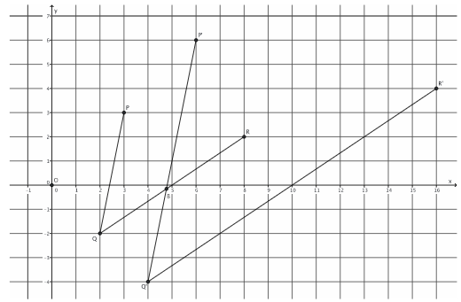
Bringing it together

Slide 45
Workshop
Must Do
May Do
Complete CW & HW 1-6
Exit ticket 5&6
Khan academy
PARCC task (transparency)
Extra practice sheet
Notes sheet
Folder organize

Slide 46
Lesson 8
Demonstration/examples, workshop

Slide 47
Do they look similar?

Slide 48
Notes
Similar – figures that are the same shape but different size;
the symbol used is: $\sim$
Two figures are similar if they can be mapped onto each other using a sequence of dilations and rigid motions (reflections, translations, and rotations)

Slide 49
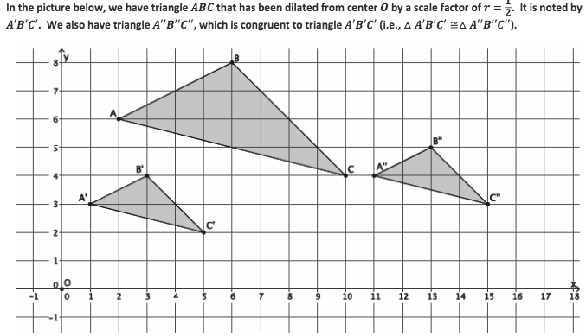
Example 1

Slide 50
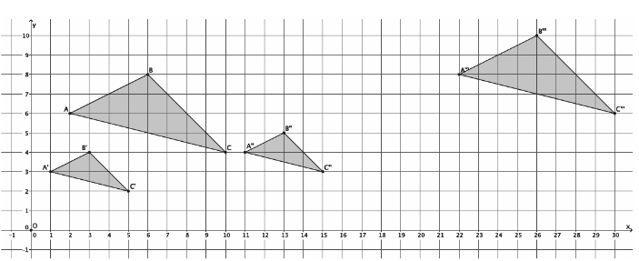
Example 1 continued

Slide 51
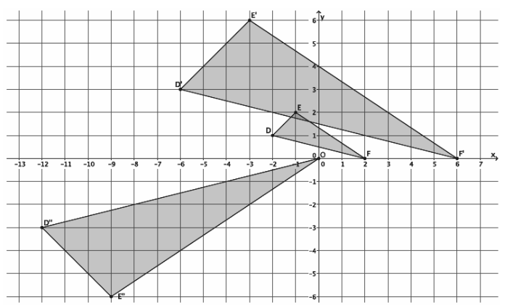
Example 2

Slide 52
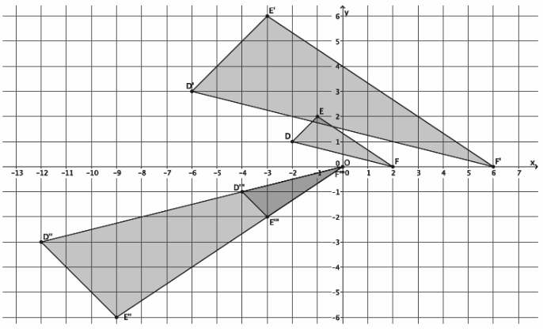
Example 2 continued

Slide 53
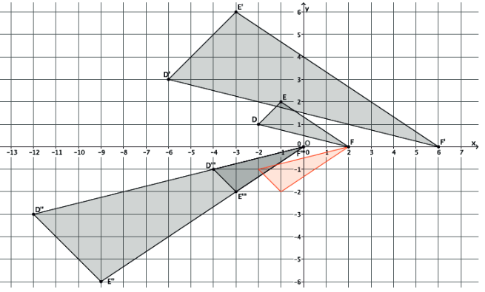
Example 2 continued

Slide 54
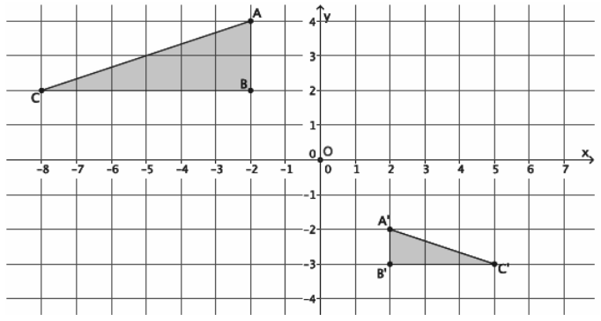
Example 3

Slide 55
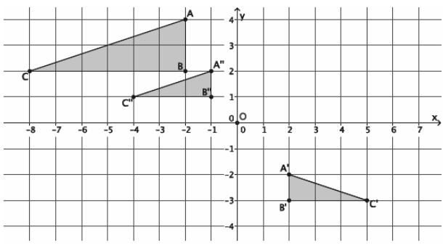
Example 3 continued

Slide 56
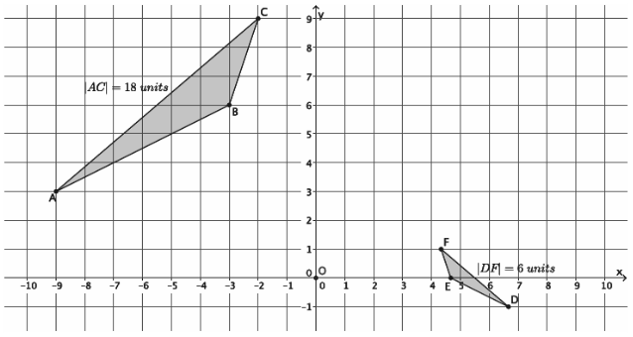
Example 4

Slide 57
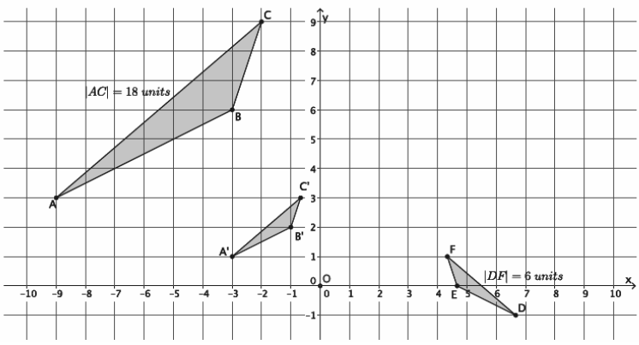
Example 4 continued

Slide 58
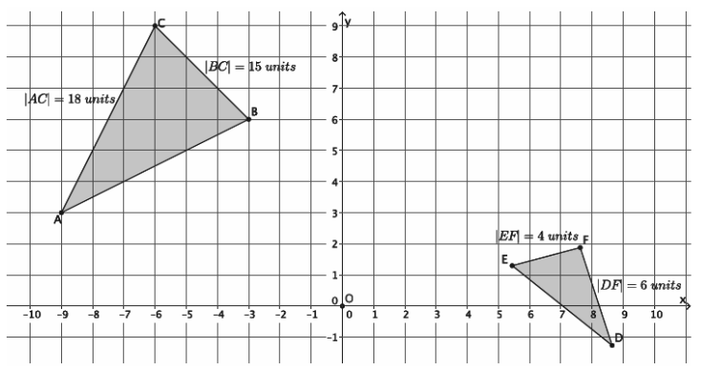
Example 5

Slide 59
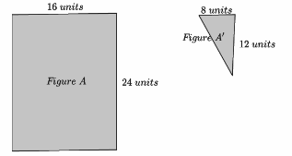
Example 6

Slide 60
Workshop
Must Do
May Do
Lesson 8 cw #1-4
Khan academy
Test rewrites

Slide 61
Lesson 9
Workshop, discussion, notes

Slide 62
Workshop
Must Do
May Do
Lesson 9: exploratory challenge #1 and #2
Khan academy
Test rewrites

Slide 63
Notes
Similarity works in both directions. So if Figure A is similar to Figure B, then Figure B is also similar to Figure A.
Similarity is also transitive, meaning if Figure A is similar to Figure B, and Figure B is similar to Figure C, then Figure A must be similar for Figure C.
A
B
A
B
C
B
A

Slide 64
Lesson 10
Discussion, notes, examples(3), workshop

Slide 65
O
P
A
Q
P’
A’
Q’

Slide 66
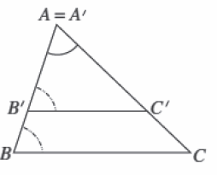

Slide 67
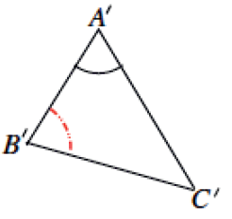
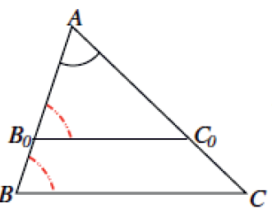

Slide 68
Notes
Two triangles are always similar if they have two corresponding angles that are equal.
This is because if two angles are equal, the 3rd angle must also be equal in order to add up to 180 degrees.

Slide 69
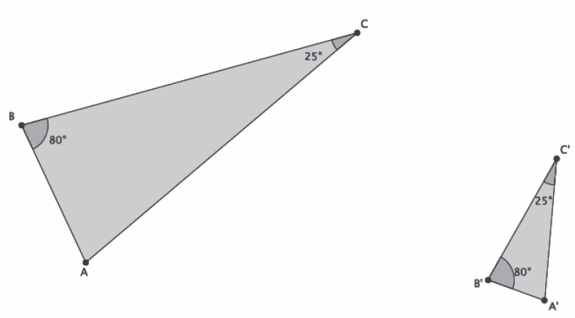
Example 1

Slide 70
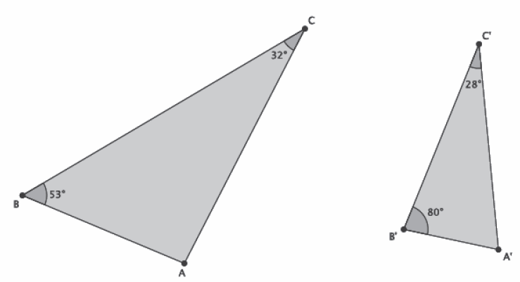
Example 2

Slide 71
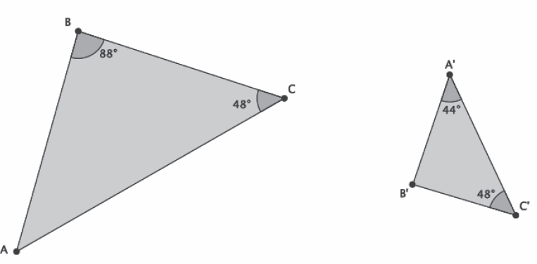
Example 3

Slide 72
Workshop
Must Do
May Do
Lesson 10 #1-3
Lesson 8 & 9 exit ticket
Khan academy
Inky puzzles

Slide 73
Warm Up Review
Simplify each expressions using the laws of exponents:

Slide 74
Laws of Exponents
Product Rule: when multiplying powers with the same base, keep the base and add the exponents.
Quotient Rule: when dividing powers with the same base, keep the base and subtract the exponents.
Power to Power Rule: When raising a power to another power, keep the base, multiply the exponents.
“When in doubt, write it out.”

Slide 75
Lesson 11
Examples(4), workshop

Slide 76
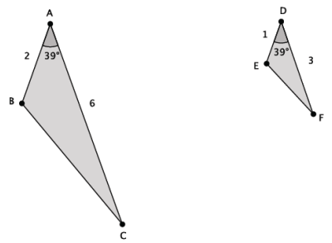
Example 1
Are these triangles similar?

Slide 77
Example 1 continued
Are these triangles similar?

Slide 78
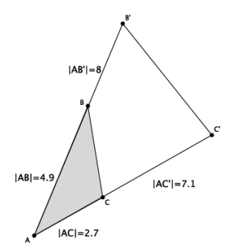
Example 2
Are these triangles similar?

Slide 79
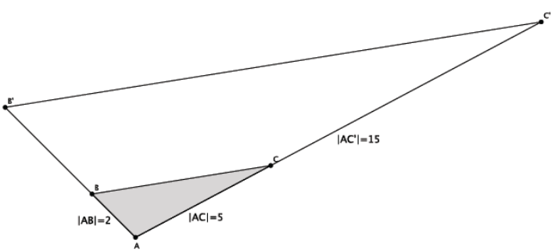
Example 3
Given that these triangles similar, what is the length of AB’?

Slide 80
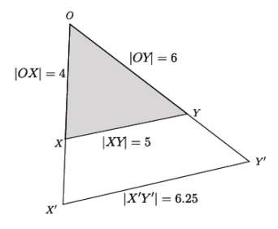
Example 4
Given that XY is parallel to X’Y’, are these triangles similar? If so, can we find the length of OX’ and OY’?

Slide 81
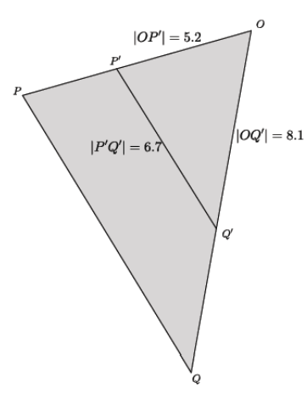
Example 5
Are these triangles similar?

Slide 82
Workshop
Must Do
May Do
Lesson 11 #1-3
Khan academy
PARCC Tasks
Inky puzzles
Exponents review/practice
Test rewrites (tomorrow last day)

Slide 83
Warm Up Review
Simplify:
Select all that apply

Slide 84
Lesson 12
Example(1), workshop

Slide 85
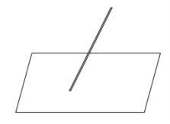
Example
Not all flagpoles are perfectly upright; some are tilted or bent. Imagine a flagpole near an abandoned building. How can we find the length of the flagpole? Assume: the length of the shadow is 15 feet, there is a mark 3 feet up on the pole and it’s shadow is 1.7 feet on the ground.

Slide 86
Workshop
Must Do
May Do
Finish Lesson 11 #1-3
Lesson 12 #1-3
Exit ticket lessons 10 & 11
Khan academy
PARCC tasks
Exponents review and practice
Test rewrites - last day
Inky puzzles

Slide 87
Warm Up Review
Simplify (expand!)

Slide 88
Lesson 13
Video, Discussion/proof, workshop

Slide 89
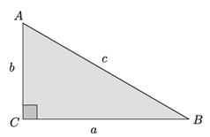
Recall – Pythagorean Theorem

Slide 90
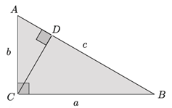
Recall – Pythagorean Theorem

Slide 91
Recall – Pythagorean Theorem

Slide 92
http://www.youtube.com/watch?v=QCyvxYLFSfU

Slide 93
Workshop
Must Do
May Do
Finish Lesson 12 #1-3
Lesson 13 #1-3
Exit ticket lesson 12
Khan academy
PARCC tasks
Exponents practice
Note sheet
Folder organize
Complete all classwork and homework 8-12

Slide 94
Lesson 14
Notes, Examples(2), workshop

Slide 95
Pythagorean Theorem
So far we have shown with two proofs and much practice that if a triangle is a right triangle, then a² + b² = c²
The converse of this is also true: If a² + b² = c², then a triangle is a right triangle.

Slide 96
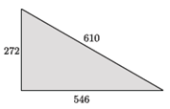
Example 1

Slide 97
Example 2

Slide 98
Workshop
Must Do
Can Do
Finish all classwork 8-12
Finish lesson 13 #1-4
Lesson 14
Khan academy
PARCC tasks
Exponents practice
Note sheet
Folder organize

