Slide 1
Linear Equations
Eureka Math
8th Grade Module 4
Topic C

Slide 2
Lesson 15
Discussion, Notes, examples(4), workshop

Slide 3
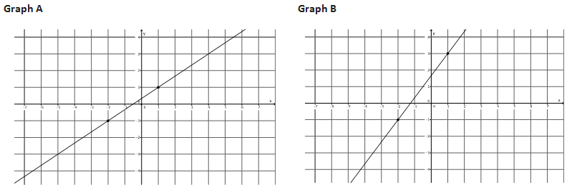
Which graph looks steeper?
How can you move from one point to another on each graph?
Write the directions as a ratio and compare.

Slide 4
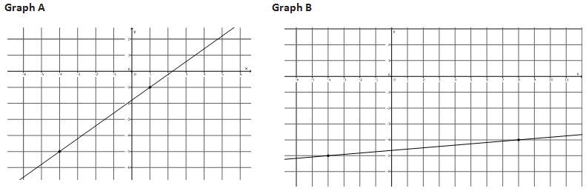
Which graph looks steeper?
How can you move from one point to another on each graph?
Write the directions as a ratio and compare.

Slide 5
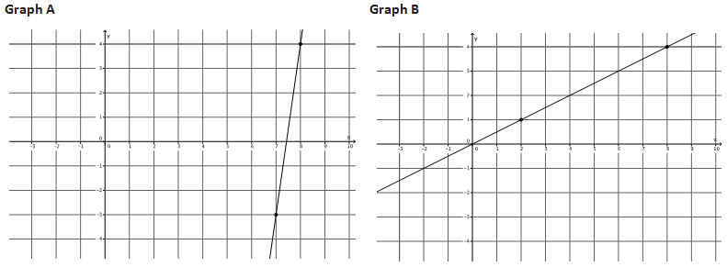
Which graph looks steeper?
How can you move from one point to another on each graph?
Write the directions as a ratio and compare.

Slide 6
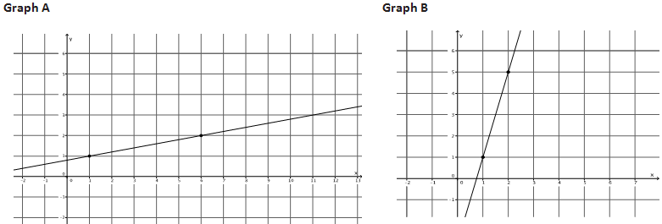
Which graph looks steeper?
How can you move from one point to another on each graph?
Write the directions as a ratio and compare.

Slide 7
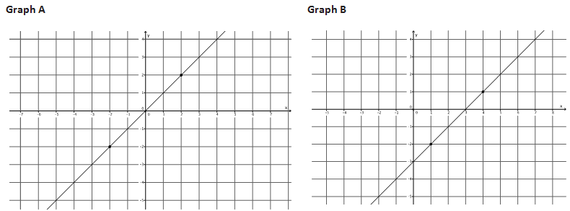
Which graph looks steeper?
How can you move from one point to another on each graph?
Write the directions as a ratio and compare.

Slide 8
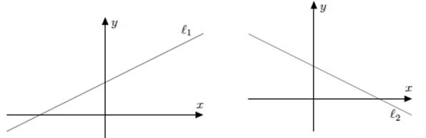
Notes – Slope
Slope - a number that defines the steepness of a line. The steeper a line, the further the slope is from 0.
Symbol is m
Lines that go up to the right have a positive slope
Lines that go down to the right have negative slope
Horizontal lines have 0 slope
To find slope, identify two points on the line and write the ratio (fraction):
change in y vertical change rise
change in x horizontal change run

Slide 9
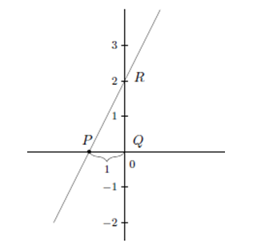
Example 1

Slide 10
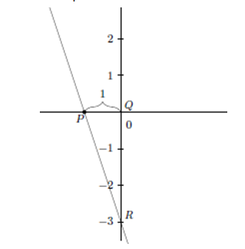
Example 2

Slide 11
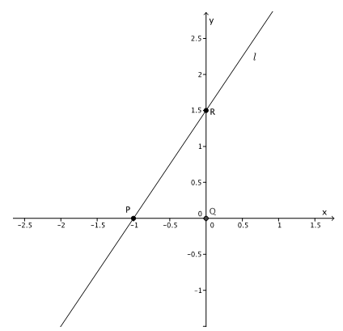
Example 3

Slide 12
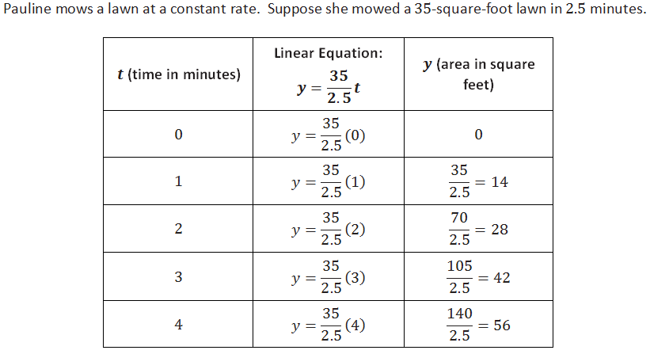
Example 4

Slide 13
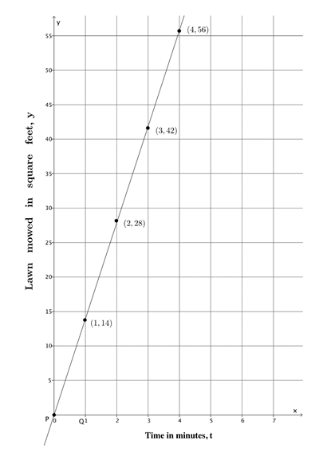

Slide 14
Workshop
Must Do
May Do
Lesson 15 cw #1-6
Khan academy
Slope extra practice
Linear equations
Exponents review
Make up work

Slide 15
Lesson 16
Examples(4), notes, workshop

Slide 16
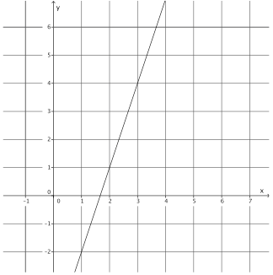
Example 1
Find the slope of this line

Slide 17
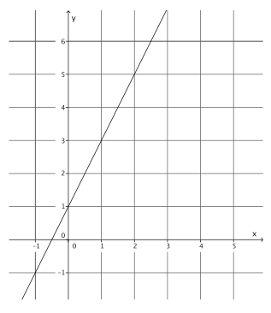
Example 2
Find the slope of this line.

Slide 18
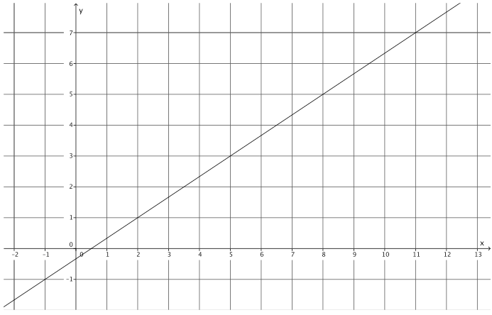
Example 3
Find the slope of this line.

Slide 19
Notes – Slope
Slope - a number that defines the steepness of a line. The steeper a line, the further the slope is from 0.
Symbol is m
Lines that go up to the right have a positive slope
Lines that go down to the right have negative slope
Horizontal lines have 0 slope
To find slope, identify two points on the line and write the ratio (fraction):
change in y vertical change y₂ – y₁ rise
change in x horizontal change x₂ – x₁ run

Slide 20
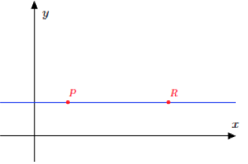
Example 4
Find the slope of this line.

Slide 21
Workshop
Must Do
May Do
Lesson 16 cw #1-6
Khan academy
Slope extra practice
Exponents practice
Lesson 16 #7 (challenge)
Linear equation exploration
Test re-writes
Make up work

Slide 22
Lesson 17
Review, notes, example, workshop

Slide 23
Warm Up
Complete #1-3
Find at least 3 solutions (choose x, find y)
Graph on coordinate plane (graph paper)
Connect the points and find the slope

Slide 24
Standard Form of Linear Equations
A linear equation in the form:
Where A, B, and C represent set numbers, and x and y represent variables or unknowns.
A solution to this equation is an ordered pair (x, y), that makes the equation true.
To find solutions, you pick a set number for x or y, substitute, and then solve for the other value.
SLOPE = -A/B
y-intercept = C/B

Slide 25
Notes: Slope-Intercept Form
A linear equation in the form:
Where m and b represent set numbers, and x and y represent variables or unknowns.
m is the constant rate of change (slope)
b is the y-intercept (crosses y-axis)
(x, y) are solutions that make the equation true
THIS IS THE FAR MORE USEFUL FORM!!

Slide 26
Converting Standard to Slope-Intercept
-Ax -Ax
B B

Slide 27
Example

Slide 28
Workshop
Must Do
May Do
Lesson 17 cw #1-9
Khan academy
Slope extra practice
Exponents practice
Lesson 16 #7 (challenge)
Linear equation exploration
Test re-writes
Make up work

Slide 29
Lesson 18
Explore, notes, examples workshop

Slide 30
Explore
Look at the four examples.
What do you notice about the relationship between the equation and point where the line crosses the y-axis?

Slide 31
Notes: Slope-Intercept Form
A linear equation in the form:
Where m and b represent set numbers, and x and y represent variables or unknowns.
m is the constant rate of change (slope)
b is the y-intercept (crosses y-axis)
(x, y) are solutions that make the equation true

Slide 32
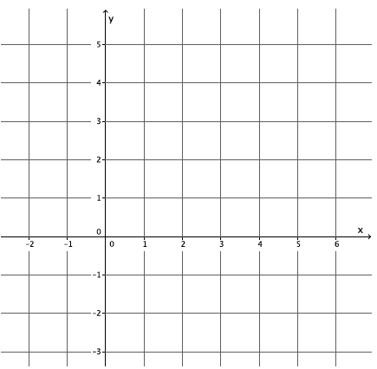
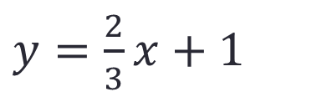
Example 1
$y=\frac{2}{3}x+1$

Slide 33
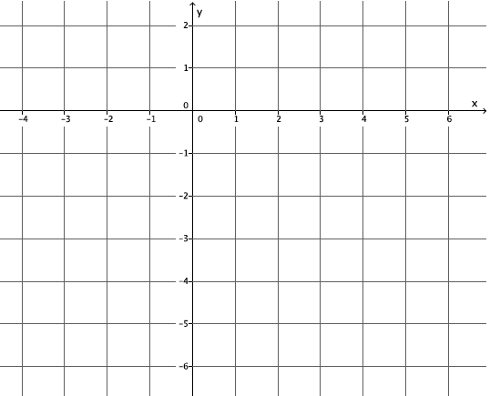
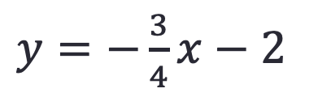
Example 2
$y=−\frac{3}{4}x−2$

Slide 34
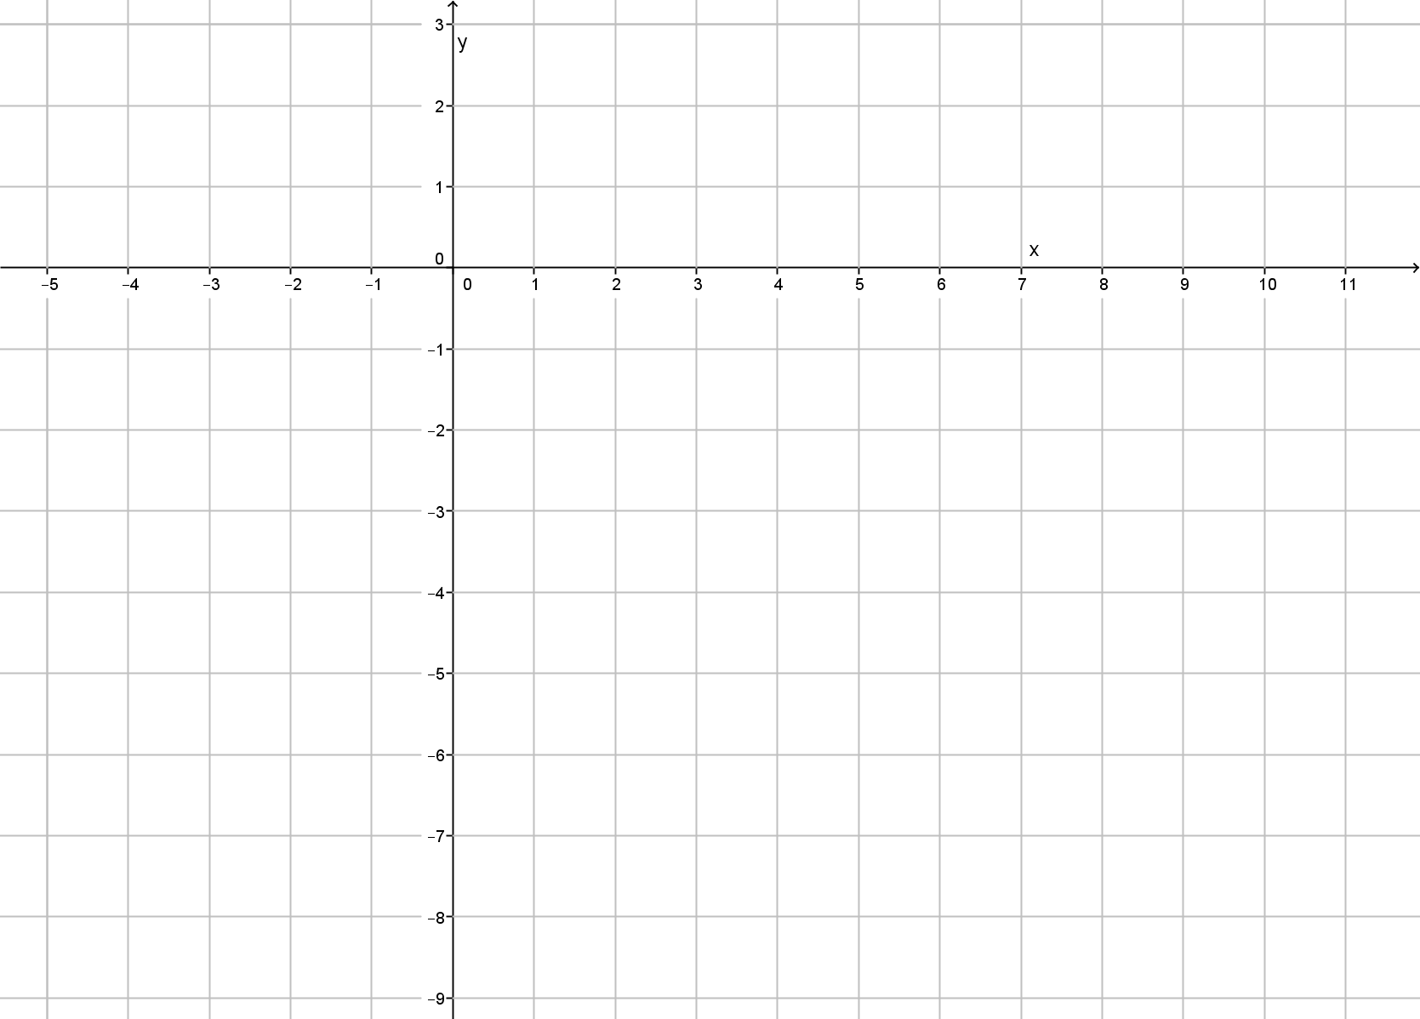

Example 3
$y=4x−7$

Slide 35

Example 4
$y=−3x+2$

Slide 36
Workshop
Must Do
May Do
Exit ticket #15 & 16
Lesson 18 cw #1-6
Khan academy
Slope extra practice
Exponents practice
Lesson 16 #7 (challenge)
Linear equation exploration
Test re-writes
Make up work

Slide 37
Lesson 19
Warm Up, workshop, example, notes, workshop

Slide 38

Warm Up
How can we find out if the graph of $y=2x+3$ includes the points $(0, 3)$ and $(4, 11)$ ?
Are the points solutions to the equation $y=2x+3$?

Slide 39
Workshop
Must Do
May Do
Lesson 19 cw #1-4
Khan academy
Slope extra practice
Exponents practice
Linear equation exploration

Slide 40
Notes
The graph of a linear equation is a line
All solutions (x, y) to the equation are points on the line
All points (x, y) on the line are solutions to the equation
The y-intercept is the point where a line crosses the y-axis
  x = 0
The x-intercept is the point where a line crosses the x-axis
  y = 0
To graph using the intercepts, substitute 0 for each variable to find the two solutions and plot.

Slide 41
Example

Slide 42
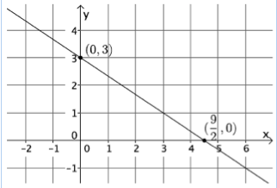
Example continued
y-intercept = (0, 3)
x-intercept = (9/2, 0)

Slide 43
Workshop
Must Do
May Do
Lesson 19 cw #5-7
Khan academy
Slope extra practice
Exponents practice
Lesson 16 #7 (challenge)
Linear equation exploration

Slide 44
Lesson 20
Opening, notes, examples(3) workshop

Slide 45
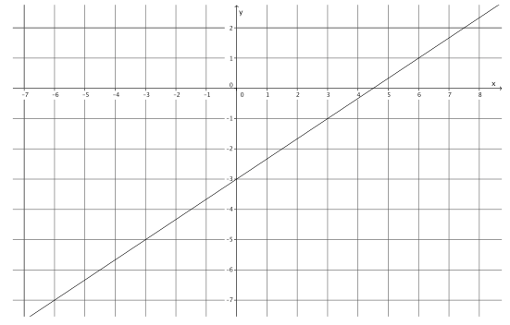
Opening
How can you write an equation for this line?

Slide 46
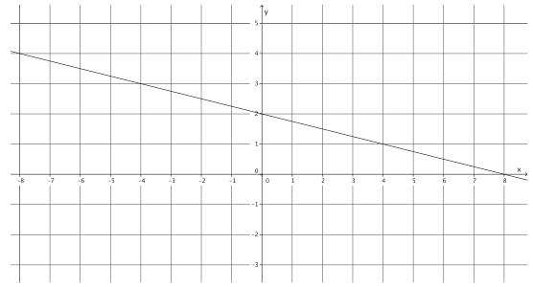
Opening
How can you write an equation for this line?

Slide 47
Notes – Writing equation from graph
Identify y-intercept
Calculate or count slope (remember scales on graph!)
Substitute slope for m and y-intercept for b in y=mx + b
Rewriting into standard form:
  Get rid of a fractional slope by multiplying the whole equation by denominator
  Subtract x-term from both sides
  If coefficient of x is negative, multiply whole equation by -1

Slide 48
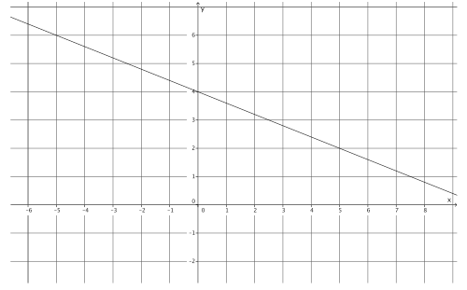
Example 1

Slide 49
Example 1 continued

Slide 50
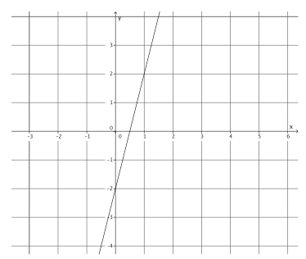
Example 2

Slide 51
Example 2 continued

Slide 52
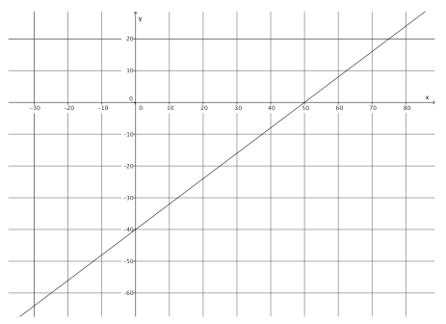
Example 3

Slide 53
Example 3 continued

Slide 54
Workshop
Must Do
May Do
Lesson 20 cw #1-6
Khan academy
Converting standard to slope-intercept practice
Linear equation practice
Carnival Bears/Crossing the River
PARCC tasks

Slide 55
Lesson 21
Example(4), notes, workshop

Slide 56
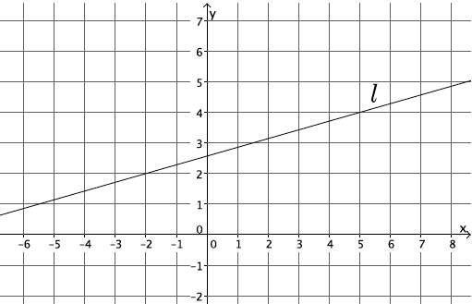
Opening
Write an equation for this line.
Why is this more difficult than the ones we did yesterday?

Slide 57
Example 1
Write an equation for this line when y-intercept not clear.

Slide 58
Review/Practice on Example 1
Find the slope using two points and the slope formula
Rewrite the equation in standard form

Slide 59
Example 2
Write an equation for this line.

Slide 60
Review/Practice on Example 2
Find the slope using two points and the slope formula
Rewrite the equation in standard form

Slide 61
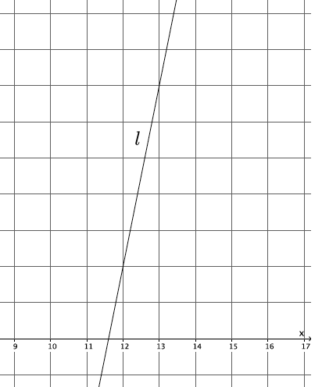
Example 3
Write an equation for this line.

Slide 62
Review/Practice on Example 3
Find the slope using two points and the slope formula
Rewrite the equation in standard form

Slide 63
Example 4
Write an equation for this line.

Slide 64
Review/Practice on Example 4
Find the slope using two points and the slope formula
Rewrite the equation in standard form

Slide 65

Notes/Summary
To write the equation of a line you need the slope and the y-intercept.
  y = mx + b is called “slope-intercept form”
If you are given two points you can calculate the slope using the formula:
With the slope and a point, you can substitute into y = mx + b and solve to find the y-intercept (b).
$$m=\frac{y_{2}−y_{1}}{x_{2}−x_{1}}$$

Slide 66
Workshop
Must Do
May Do
Exit ticket 19 and 20
Lesson 21 cw #1-5
Khan academy
Converting standard to slope-intercept practice
Linear equation practice
Carnival Bears/Crossing the River
PARCC tasks

Slide 67
Lesson 22
Example(5), workshop

Slide 68
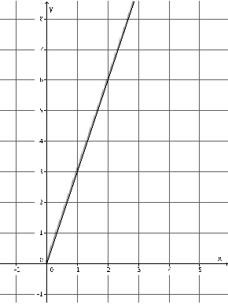
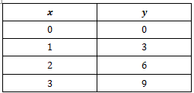
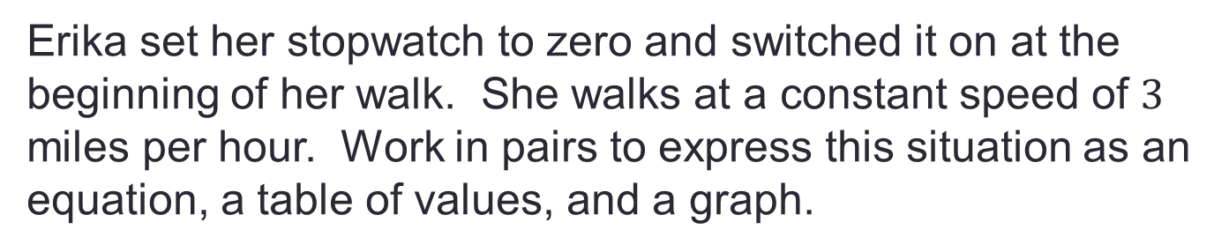
Example 1
Erika set her stopwatch to zero and switched it on at the beginning of her walk. She walks at a constant speed of $3$ miles per hour. Work in pairs to express this situation as an equation, a table of values, and a graph.

Slide 69
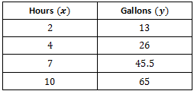
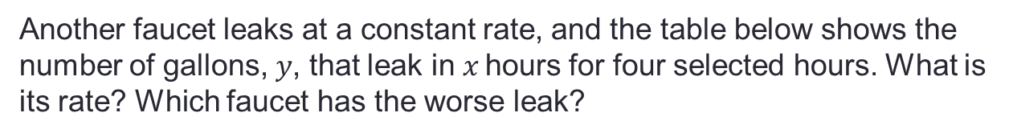
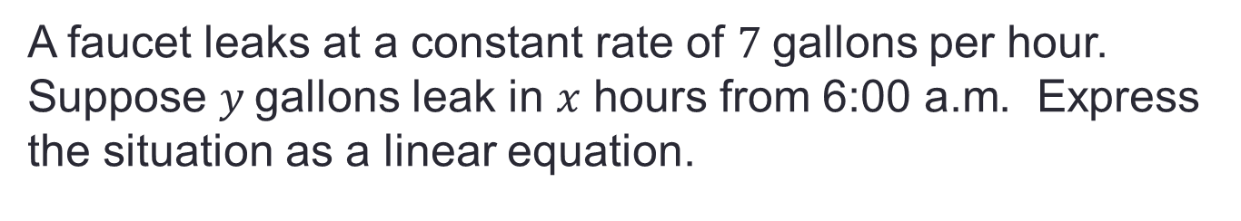
Example 2
A faucet leaks at a constant rate of $7$gallons per hour. Suppose $y$gallons leak in $x$ hours from 6:00 a.m. Express the situation as a linear equation.
Another faucet leaks at a constant rate, and the table below shows the number of gallons, $y$, that leak in $x$hours for four selected hours. What is its rate? Which faucet has the worse leak?

Slide 70
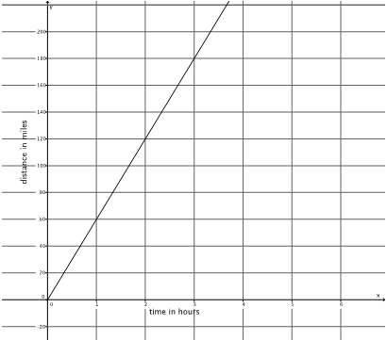
Example 3
The graph below represents the constant rate at which Train A travels. What is the is its constant rate?
Train B travels at a constant rate and does 95 miles in one and a half hours. Which has the greater speed?

Slide 71
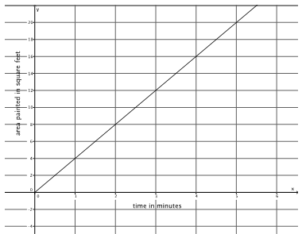
Example 4
The graph below represents the constant rate at which Kristina can paint. What is the is its constant rate?
Her sister paints at an average rate of 45 square feet in 12 minutes. Which sister paints faster?

Slide 72
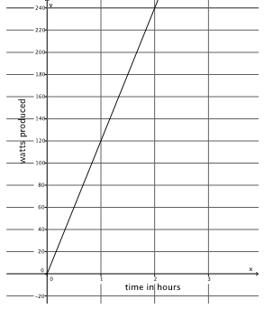
Example 5
The graph below represents the constant rate of watts of energy produces by a solar panel.
Another company can produce 325 watts in 2.6 hours. Which is more efficient?

Slide 73
Workshop
Must Do
May Do
Lesson 22 cw #1-5
Khan academy
Converting standard to slope-intercept practice
Linear equation practice
Carnival Bears/Crossing the River
PARCC tasks
Finish lesson 21 cw
Prep for mini-test

Slide 74
Lesson 23
Workshop, notes, workshop

Slide 75
Workshop
Must Do
May Do
Lesson 23 cw #1-2
Khan academy
Converting standard to slope-intercept practice
Linear equation practice
Carnival Bears/Crossing the River
PARCC tasks
Prep for mini-test

Slide 76
Notes/Conclusion
If you have two equations in standard form, and the A, B, and C constants can be multiplied by the same value to get the second equation, the graphs of the equations will be the same.

Slide 77
Workshop
Must Do
May Do
Lesson 23 cw #1-7
Khan academy
Converting standard to slope-intercept practice
Linear equation practice
Carnival Bears/Crossing the River
PARCC tasks
Finish lesson 21&22 cw
Prep for mini-test

Slide 78
Warm Up
Solve the following equations:
1. 2.

Slide 79
What you should know/be able to do
Write linear equations from words
Solve linear equations using for a variable using:
  Distributive property
  Combining like terms
  Properties of equality
Find solutions for equations with two variables (x, y)
Identify number of solutions
Find constant rate/slope from:
  Word problems, graphs, equations, tables
Write equations when given a graph
Convert between standard form and slope-intercept form
Graph equations in standard form and slope-intercept form

Slide 80
Review Day
Must Do
Can Do
Sean – 4, 5b, 6
Elijah – 1, 4, 6
Kennedy – 1, 4, 7 or 8
Shyanne – 1, 4, 6, 5b
Joe – 1, 4, 5b
Amirah – 5b, 3, 7 or 8
Makayla – 2, 4, 6
Marlon – 1, 4, 7 or 8
Shaniya – 1, 4, 3
Taniya – 4, 3, 7 or 8
Lacy – 3, 7 or 8
Myasia – 1, 2, 4, 6
Layne – 4, 5b, 6
Malachi – 1, 2, 4, 5b, 6
Other stations not assigned
Organize folder
PARCC tasks
Algebra practice
Independent work packet
Complete unfinished classwork and homework

Slide 81
Review Day
Should Do
Can Do
Kiarra – 2, 4, 5
Aniyah – 4, 5b, 6
Kevin – 4, 5b, 7 or 8
Taniya – 1, 2, 5
Greene – 4, 6, 7 or 8
Montaze – 1, 4, 6
Jalen – 3, 6, 7 or 8
JoJo – 3, 6, 7 or 8
Bria – 4, 5, 6,
Sellimjay – 1, 2, 5
Akil – 3, 6, 7 or 8
Cassidy – 1, 2, 4, 6
Amina – 1, 4, 6
Jewell – 4, 6, 7 or 8
Danaye – 3, 6, 7 or 8
Jada – 1, 2, 6
Other stations not assigned
Organize folder
PARCC tasks
Algebra practice
Independent work packet
Complete unfinished classwork and homework

