Slide 1
Linear Equations
Eureka Math
8th Grade Module 4
Topic D

Slide 2
Lesson 24
Opener, Notes, examples(3), workshop

Slide 3
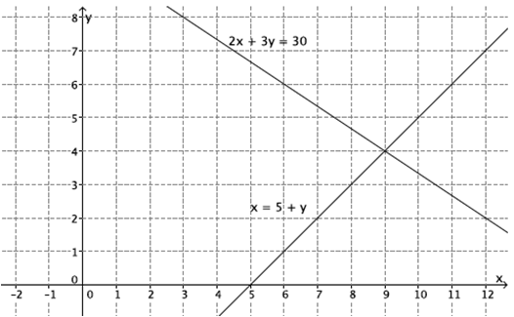
Opener
Complete problems 1-3 in pairs

Slide 4
Notes – Systems of Equations
A System of Equations (aka Simultaneous Equations) is a situation when a pair of equations work together.
A system can have one solution, no solutions, or infinitely many solutions (just like in lesson 7).
The goal is to determine the exact coordinates of the point where the lines intersect. This is a solution to both equations and the solution to the system.
equation 1
Notation:
equation 2
{

Slide 5
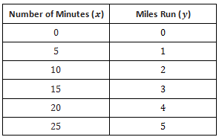
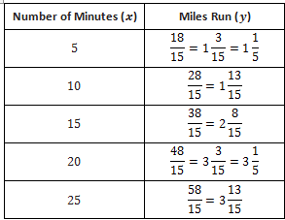
Example 1
Sandy and Charlie run at constant speeds. Sandy runs from their school to the train station in $15$ minutes, and Charlie runs the same distance in $10$ minutes. Charlie starts $4$ minutes after Sandy left the school. Can Charlie catch up to Sandy? The distance between the school and the station is $2$ miles.

Slide 6
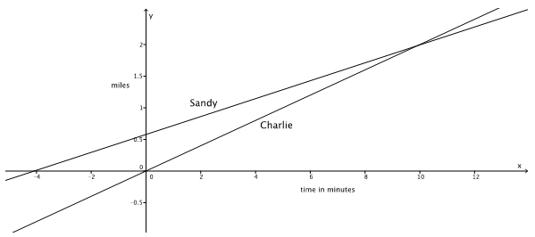

$$\left\{\begin{aligned}y=\frac{2}{15}x+\frac{8}{15} \\ y=\frac{1}{5}x \end{aligned}\right.$$
The $y$-intercept of Sandy’s run shows the distance she has run at the moment that Charlie starts walking.
The point of intersection is when they have traveled the same distance at the same time (they meet).

Slide 7
Example 2
Randi and Craig ride their bikes at constant speeds. It takes Randi $25$ minutes to bike $4$ miles. Craig can bike $4$ miles in $32$ minutes. If Randi gives Craig a $20$-minute head start, about how long will it take Randi to catch up to Craig?
Write the equations for each.

Slide 8
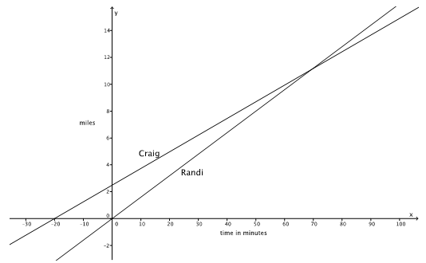
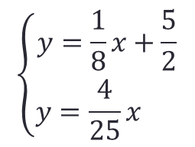
$$\left\{\begin{aligned}y=\frac{1}{8}x+\frac{5}{2} \\ y=\frac{4}{25}x \end{aligned}\right.$$

Slide 9
Workshop
Must Do
May Do
Lesson 24 cw #4-5
Khan academy
PARCC tasks
Linear equation practice
Make up work
Slope practice
Exponents review

Slide 10
Warm Up
Rewrite these equations into slope-intercept form (look in lesson 17 for a refresher)
$$3x+2y=10$$
$$5x−y=12$$

Slide 11
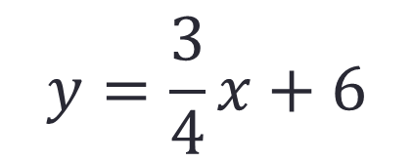
Warm Up
Rewrite these equations into standard form (look in lesson 20 for a refresher)
$$y=\frac{3}{4}x+6$$
$$y=−5x−10$$

Slide 12
Lesson 25
Workshop, notes

Slide 13
Workshop
Must Do
May Do
Lesson 25 cw #1-5
Khan academy
PARCC tasks
Lesson 25 cw #6
Finish lesson 24 cw
Linear equation practice
Slope practice
Exponents review

Slide 14
Notes – Systems of Equations
A System of Equations (aka Simultaneous Equations) is a situation when a pair of equations work together.
A system can have one solution, no solutions, or infinitely many solutions, like in lesson 7.
The goal is to determine the exact coordinate (solution) where the two lines intersect. This is also a solution to both equations.
equation 1
Notation:
equation 2
Systems of equations typically have ONE SOLUTION because lines intersect at one point. But,
If the lines are parallel (same slope, different y-intercept) they will never intersect → NO SOLUTION
If lines are the same (same slope and same y-intercept) they always intersect → INFINITE SOLUTIONS
{

Slide 15
Lesson 26
Review notes, workshop

Slide 16
Notes – Systems of Equations
A System of Equations (aka Simultaneous Equations) is a situation when a pair of equations work together.
A system can have one solution, no solutions, or infinitely many solutions, like in lesson 7.
The goal is to determine the exact coordinate (solution) where the two lines intersect. This is also a solution to both equations.
equation 1
Notation:
equation 2
Systems of equations typically have ONE SOLUTION because lines intersect at one point. But,
If the lines are parallel (same slope, different y-intercept) they will never intersect → NO SOLUTION
If lines are the same (same slope and same y-intercept) they always intersect → INFINITE SOLUTIONS
{

Slide 17
Workshop
Must Do
May Do
Lesson 26 cw #1-9
Khan academy
PARCC tasks
Lesson 25 cw #6
Finish lesson 24 cw
Linear equation practice
Slope practice
Exponents review
Make up work

Slide 18
Lesson 27
Notes, examples(3), workshop

Slide 19
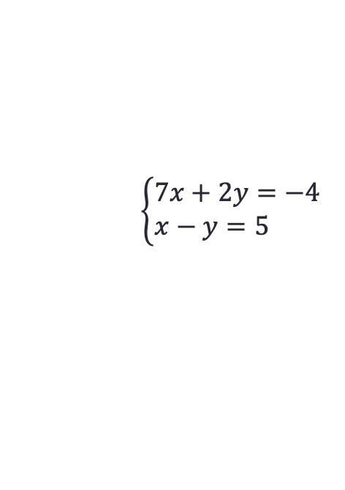
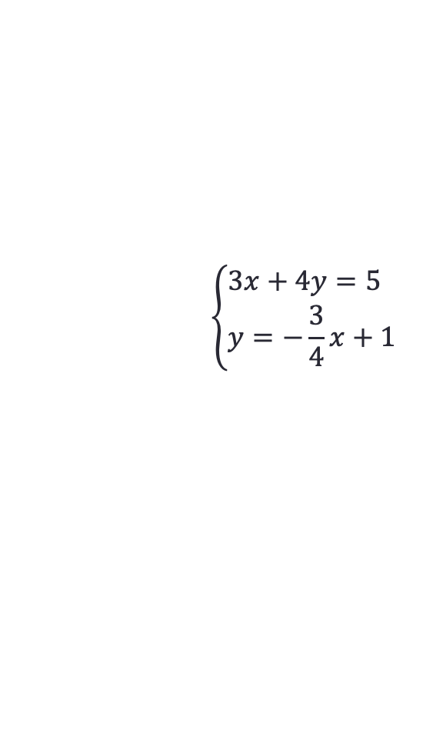
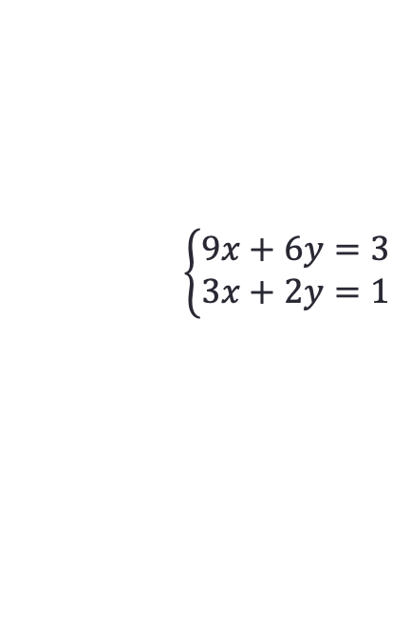
Warm Up/Entry
Determine the nature of these systems of equations. Do they have one, zero, or infinite solutions?
$$\left\{\begin{aligned}&3x+4y=5 \\ &y=−\frac{3}{4}x+1\end{aligned}\right.$$
$$\left\{\begin{aligned}&7x+2y=−4 \\ &x−y=5 \end{aligned}\right.$$
$$\left\{\begin{aligned}&9x+6y=3 \\ &3x+2y=1\end{aligned}\right.$$

Slide 20
Notes – Solving Systems of Equations
By substitution:
Solve one equation so that is says either y= something or x=something (if it already does, you can skip this step)
Substitute the entire equation from step 1 into the other equation for that variable
Solve for the one variable that remains by:
Distributing
Simplifying
Using properties of equality
Substitute back into one equation to find the other.

Slide 21
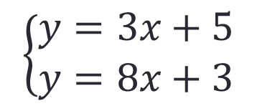
Example 1
$$\left\{\begin{aligned}y=3x+5 \\ y=8x+3\end{aligned}\right.$$
First, does this system have a solution?

Slide 22
Example 2
First, does this system have a solution?
$$\left\{\begin{aligned}y=7x−2 \\ 2y−4x=10\end{aligned}\right.$$

Slide 23
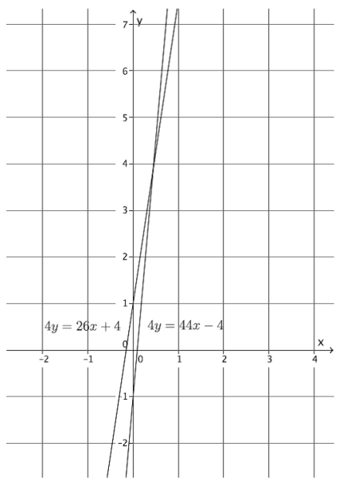
Example 3
$$\begin{aligned}4y=26x+4 \\ y+1=11x\end{aligned}$$
First, does this system have a solution?

Slide 24
Workshop
Must Do
May Do
Lesson 27 cw #1-6
Khan academy
PARCC tasks
Finish lesson 24-26 cw
Linear equation practice
Slope practice
Exponents review
Note sheet
Folder organize

Slide 25
Lesson 28
Warm Up, Notes, examples(3), workshop

Slide 26
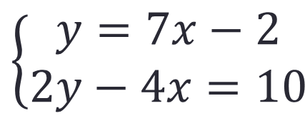
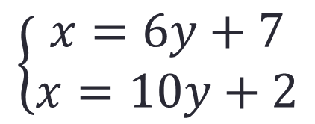
Warm Up
Explain how you would solve these systems of equations.
$$\left\{\begin{aligned}x=6y+7 \\ x=10y+2\end{aligned}\right.$$
$$\left\{\begin{aligned}y=7x−2 \\ 2y−4x=10\end{aligned}\right.$$

Slide 27
Notes – Solving Systems of Equations
By substitution:
Solve one equation so that is says either y= something or x=something (if it already does, you can skip this step)
Substitute the entire equation from step 1 into the other equation for that variable
Solve for the one variable that remains by:
Distributing
Simplifying
Using properties of equality
Substitute back into one equation to find the other variable.
By Elimination:
Works best when both equations are in standard form (or can easily be put in standard form)
Scale the equations so that the coefficients on one variable will cancel out.
Add or subtract the entire equations
Solve for the one remaining variable
Substitute back into one equation to find the other

Slide 28
Example 1
$$\left\{\begin{aligned}6x−5y=21 \\ 2x+5y=−5\end{aligned}\right.$$

Slide 29
Example 2
$$\left\{\begin{aligned}−2x+7y=5 \\ 4x−2y=14 \end{aligned}\right.$$

Slide 30
Example 3
$$\left\{\begin{aligned}7x−5y=−2 \\ 3x−3y=6 \end{aligned}\right.$$

Slide 31
Workshop
Must Do
May Do
Lesson 28 cw #1-6
Khan academy
PARCC tasks
Finish lesson 27 cw
Linear equation practice
Slope practice
Exponents review
Note sheet
Folder organize

Slide 32
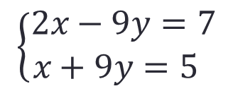
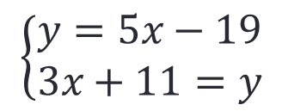
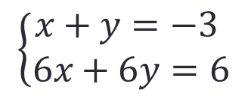
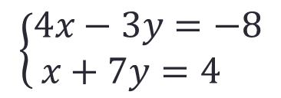
Warm Up
Which method for solving would you use for each system?
$$\left\{\begin{aligned}y=5x−19 \\ 3x+11=y\end{aligned}\right.$$
$$\left\{\begin{aligned}2x−9y=7 \\ x+9y=5 \end{aligned}\right.$$
$$\left\{\begin{aligned}4x−3y=−8 \\ x+7y=4 \end{aligned}\right.$$
$$\left\{\begin{aligned}x+y=−3 \\ 6x+6y=6\end{aligned}\right.$$

Slide 33
Notes/Summary
Graphing is, in many ways, the easiest way to solve systems of equations, but the point will only be an estimate.
Substitution works best when one already equation has x= or y= or it can easily be written that way.
Elimination works best if both equations are in standard form.

Slide 34
Lesson 29
Examples(4), workshop

Slide 35
Example 1
The sum of two numbers is 361, and the difference of the numbers is 173. What are the numbers?

Slide 36
Example 2
There are 356 8th graders at Euclid Middle School. 34 more than four times the number of girls is equal to half the number of boys. How many boys and how many girls are there?

Slide 37
Example 3
A family member has some five-dollar bills and one-dollar bills in her wallet. Altogether, she has 18 bills and a total of $62. How many of each bill does she have?

Slide 38
Example 4
A friend bought 2 boxes of pencils and 8 notebooks and it cost $11. He went back and bought his brother 3 boxes of pencils and 5 notebooks for $11.25. How much would 7 notebooks cost?

Slide 39
Workshop
Must Do
May Do
Exit ticket 27 and 28
Lesson 29 cw #1-3
Khan academy
PARCC tasks
Linear equation practice
Slope practice
Exponents review
Note sheet
Folder organize

Slide 40
Lesson 30 & 31
Notes, Examples, workshop

Slide 41
Celsius & Fahrenheit
Two different scales for temperature (American and metric)
This led to the formula: F = C + 32
$$\frac{5}{9}$$
This led to the formula: C = (F – 32)

Slide 42
Examples
Change 37°C into degrees Fahrenheit.
Change 50°F into degree Celsius

Slide 43
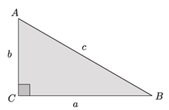
Recall – Pythagorean Theorem

Slide 44
Pythagorean Theorem
So far we have shown with two proofs and much practice that if a triangle is a right triangle, then a² + b² = c²
The converse of this is also true: If a² + b² = c², then a triangle is a right triangle.

Slide 45
Pythagorean Triples
Any 3 positive integers that satisfy a² + b² = c² are called Pythagorean Triples.
For example: 3, 4, 5 is the most known. It works because 3² + 4² = 5² (9 + 16 = 25)
Multiples of Pythagorean Triples also work:
6, 8, 10 is a triple and so is 9, 12, 15, etc.
The other “well-known” triple is: 5, 12, 13

Slide 46
Pythagorean Triples
You can generate a Triple using the system of equations:
Where s and t are any integers and t > s
The solution will always be:
And a, b, c will be a Pythagorean Triple.
{

Slide 47
Example
Let s = 1 and t = 2
{
{
→

Slide 48
Workshop
Must Do
May Do
Lesson 30&31 cw
Khan academy
PARCC tasks
Linear equation practice
Slope practice
Exponents review
Note sheet
Folder organize

Slide 49
The Test Content
1a: Count slope (15)
1b: Calculate slope (16)
1c: understand slope (15-16)
2a: Compare rates (11, 24)
2b: Write equation (1, 2, 11, 24)
2c: Graph from equation (18)
2d: Slope from graph (11, 15) 3a-c: Solve systems (27-28)
4: Type of solution (7, 25-26)
5ab: Type of solution (7, 25-26)
6a: write system (29)
6b: Solve system (27-29)
7: Equation from points (16)
8a: Graph from slope-intercept (18)
8b: Graph from standard (19)
9ab: Y-intercept (17)
9c: Write system and equations (18, 24, 29)
9d: Solution on graph (24- 25)

